Slide 1
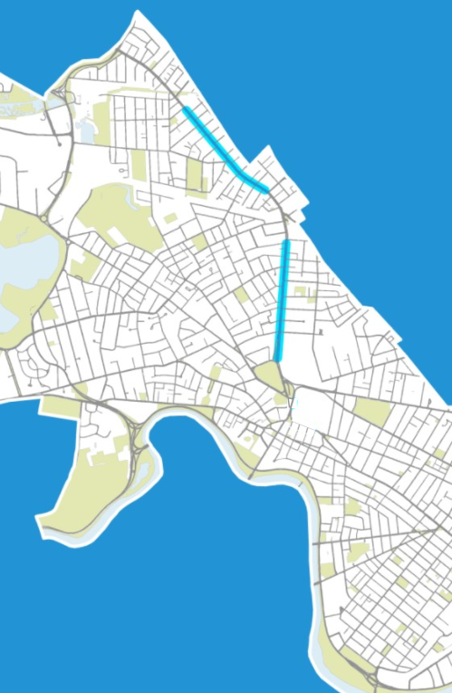
MASSAVE4 CYCLING SAFETY ORDINANCE PROJECT
DUDLEY TO BEECH
ROSELAND TO WATERHOUSE
Community Meeting
March 2022

Slide 2
Welcome
Welcome
Project Presentation 6:00-6:20PM
Introductions 6:20 to 6:25
Question and Answer 6:25-8:00 PM
Presentation and survey available on the project webpage: cambridgema.gov/MassAve4A

Slide 3
Virtual Meeting Instructions
Use "Raise Hand" button to signal you have a question or press *9 if you are joining by phone only
Verbal questions will be taken in order hands are raised
Questions/comments limited to 1 minute to allow as many people as possible to participate
We will take 10 to 15 questions/comments at a time
Write in questions in Q&A Window
Questions may be submitted at any time
Will answer as many questions as possible during Q & A
Will alternate between verbal questions and responses to written questions
Please be kind to each other and help us hear from as many people as possible
Technical support: Wally Joseph (wajoseph@cambridgema.gov)
Bottom Panel of Zoom Screen

Slide 4
QUESTIONS SUBMITTED IN ADVANCE OF MEETING

Slide 5
If the MBTA is proposing to remove the overhead wires, why is the project still talking about them as a conflict?

Slide 6
How does the City Council order regarding an economic analysis of bike lanes affect this project?

Slide 7
Why are the goals of the project limited to those listed on the project page? What about business access, parking and street trees?

Slide 8
Why is a two-way bike lane on one side infeasible? Wouldn't it allow more parking to be retained on Mass Ave? Parking on only one side requires drivers and passengers to cross the street more often. Why is one more acceptable than the other?

Slide 9
Why isn't full build being proposed?

Slide 10
MEETING CONCLUSION

Slide 11
Next Steps
Get feedback on DRAFT Recommendation
Obtain City Council approval of Partial Construction recommendation and timeline by April 30, 2022
If approved, additional public engagement will be completed as the detailed design is developed
If approval is not granted, the corridor must be implemented as a quick-build by April 2024 in accordance with requirements of the CSO
WE ARE HERE
Feasibility Study
Concept Design
Final Design
Construction
NOV 2021
TODAY
COUNCIL MEETING
Public Engagement Events

Slide 12
Tell us what you think!
Let us know:
Did we miss anything?
What are your thoughts about our DRAFT Recommendation to proceed with Partial Construction?
Complete the survey on the project webpage: cambridgema.gov/MassAve4A Attend the Community Meeting on Thursday, March 3rd 6pm-8pm on Zoom
Join City staff in person on Saturday, March 19th
10am-2pm outside Lunder Arts Center (1801 Mass Ave)
Email the project team at: kriley@cambridgema.gov

Slide 13
MASSAVE4 CYCLING SAFETY ORDINANCE PROJECT
DUDLEY TO BEECH
ROSELAND TO WATERHOUSE
Informational Video
March 2022

Slide 14
Purpose of Video
This video will share:
The project timeline as it relates to the Cycling Safety Ordinance requirements
What we heard from the public during engagement events in November
The range of cross section possibilities as well as feasibility considerations for each
The draft approach to be presented to City Council for consideration
How to provide feedback to the project team
Next Steps

Slide 15
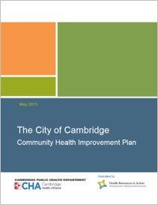
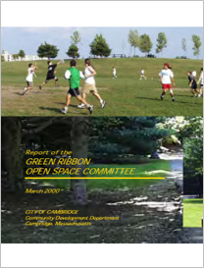
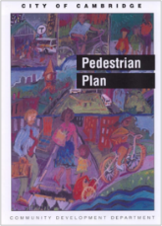
What drives our street design?
We design for people of ALL ages and abilities. This means including:
People who many not have access to a car
Safe and accessible facilities, including bike lanes, that can be used by a wide range of people
How we think about vehicle congestion and delay
Moving people slowly is moving people safely
We do not prioritize eliminating delay for people driving alone
Many policies and plans are foundational to our work
1) 1992 Cambridge Vehicle Trip Reduction Ordinance, 2) 1993/2007 Cambridge Growth Policy, 3) 2016 Complete Streets Policy, 4) 2016 Vision Zero Policy
Focus is on moving people and goods, not their vehicles
Buses run less frequently than cars and carry more people
Cannot ignore access for trucks and local deliveries

Slide 16
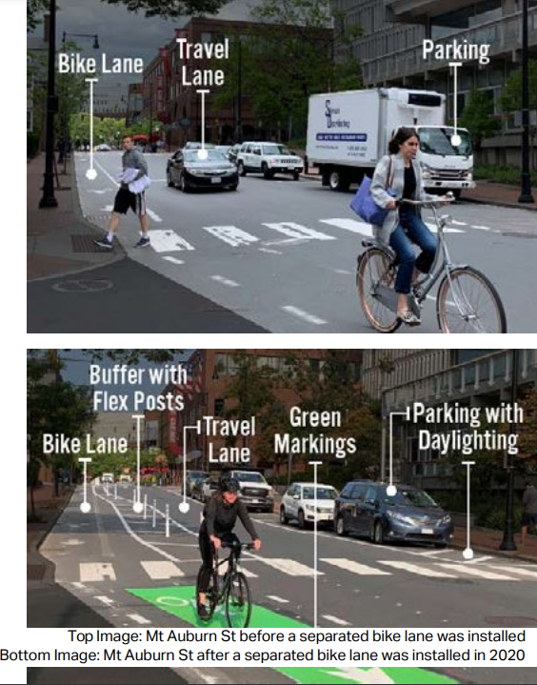
Why Separated Bike Lanes?
Fewer crashes
Eliminates threat of “dooring” from parked vehicles
Buffer space reduces conflicts between turning vehicles and people biking
Shorter crossing distances for people walking
Increased comfort for people biking of all ages and abilities
Increased comfort for people driving as they know where to expect people biking
Enables more people to choose cycling as a transportation option
Supports City’s climate goals

Slide 17
Project Background
Cambridge Cycling Safety Ordinance (CSO) requires separated bike lanes along Mass Ave
For MassAve4 - by April 30, 2022 the City must:
Present analysis on which sections can be quick-build or construction
Obtain approval from the City Council on a construction timeline for separated bike lane sections not recommended for quick-build
Any sections recommended for quick-build must be installed by April 30, 2023
If a timeline is not approved by the City Council for sections recommended for construction, those sections must be quick-build and installed by April 30, 2024

Slide 18
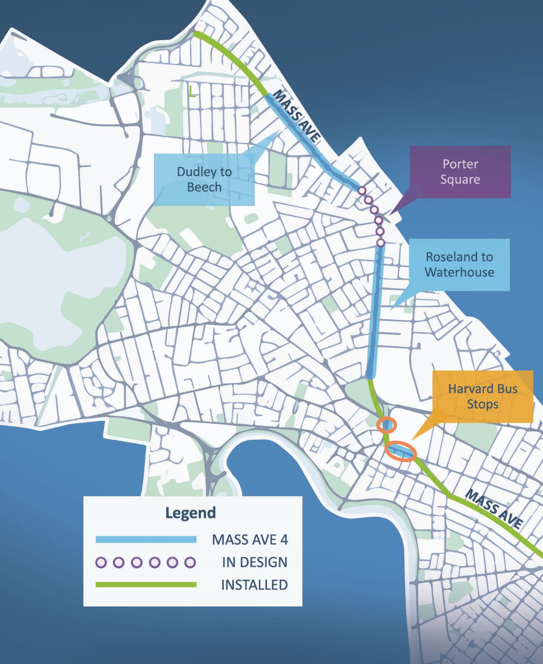
Study Area
There are many installed, planned and ongoing projects along Mass Ave
This study is reviewing the MassAve4 segments with overhead wires, including:
Dudley Street to Beech Street
Roseland Street to Waterhouse Street
Notes:
Update color of installed segments to green

Slide 19
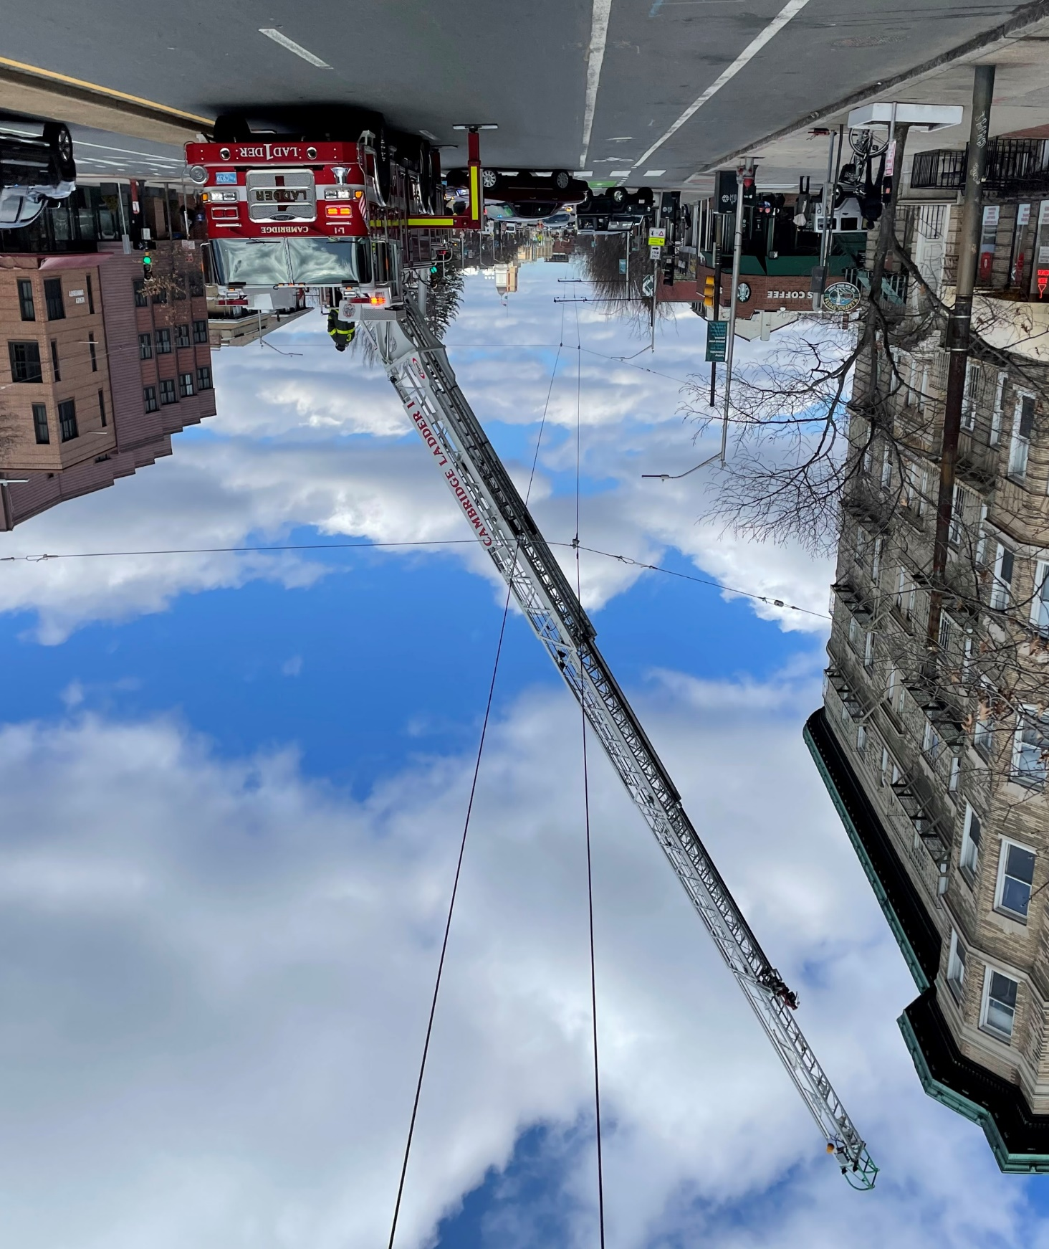
MBTA Overhead Wires
Overhead wires power trackless trolley buses along Mass Ave
Overhead wires present design challenges for access to buildings by the fire department
Design options must ensure no conflicts between ladder trucks and overhead wires
Notes:
Include unclear timelines in script

Slide 20
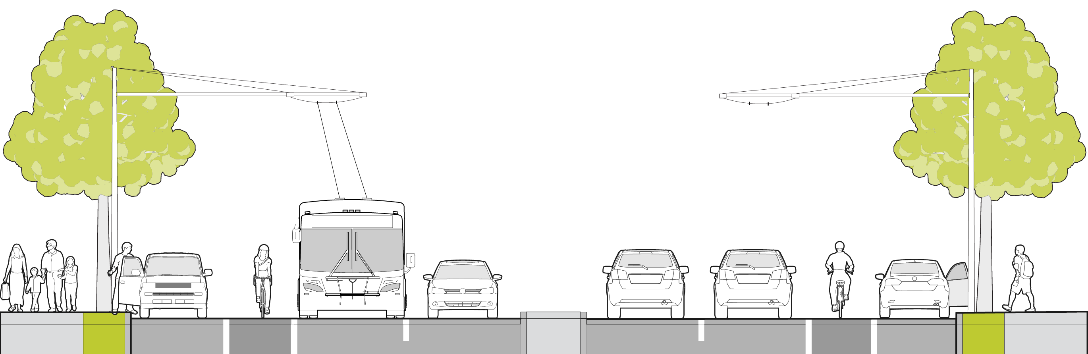
MBTA Overhead Wire Status
Beginning March 2022, MBTA will de-energize the overhead wires on Mass Ave for five years to accommodate construction projects in Cambridge and Watertown
MBTA is proposing to convert the trolley buses to Battery Electric Buses (BEBs) and remove the overhead wires. The timeline for removal is currently unknown
Removing the overhead wires provides significantly more flexibility for design options
Notes:
Include unclear timelines in script

Slide 21
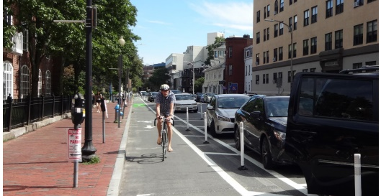
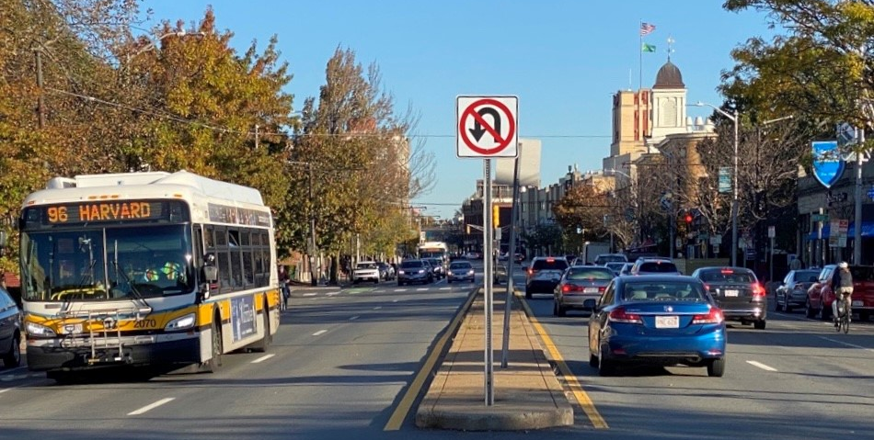
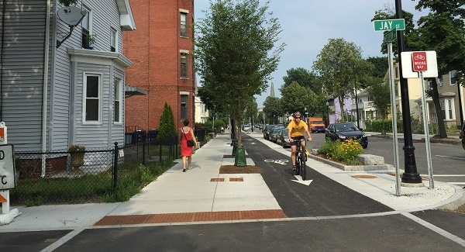
Design Opportunities
Recall the three levels of construction that could be considered:
Quick Build – paint and flex posts, maintain median and sidewalks
Partial Construction – removal of center median, paving and upgrades to affected utilities
Full Construction – median removal, street/sidewalk reconstruction and full utility upgrades

Slide 22
Public Engagement Summary November 2021

Slide 23
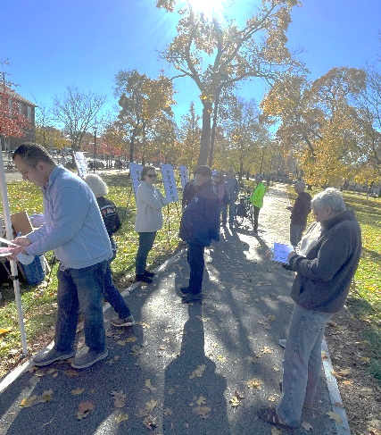
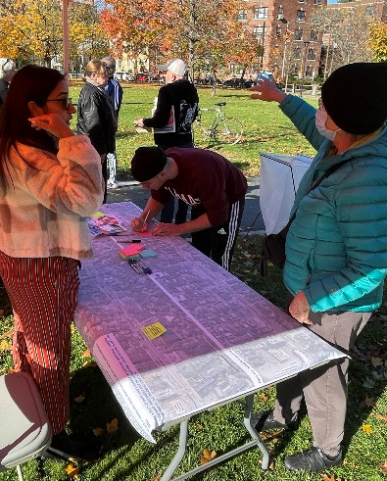
Public Engagement: Overview
Four pop-up events in November
1400+ recorded comments
200+ survey respondents
(through 11/30/2021)
St. John’s Church
location
Cambridge Common
location
Notes:
Saturday, November 13th
St. John’s Church
Cambridge Common
Monday, November 15th
St. John’s Church
Tuesday, November 16th
Cambridge Common
1,400+ comments =number of dots on boards and number of comments/dots on maps
Exact # of survey responses through 11/30 is 233

Slide 24
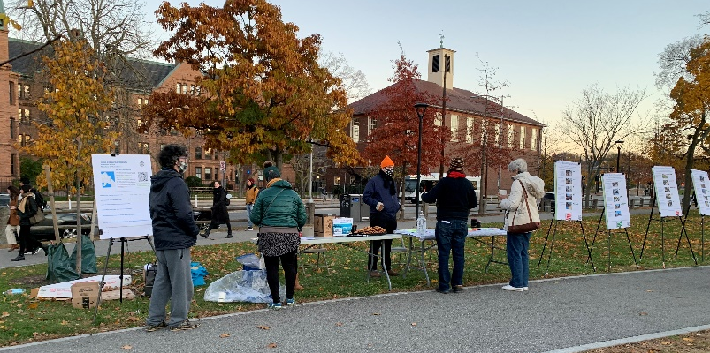
Public Engagement: Common Themes
“Crossing Mass Ave is extremely frightening”
“Please… retain parking to help small businesses survive”
“I love all the shops and restaurants”
“Consider the needs of … elderly and disabled in the area”
“I love seeing people walk around and eat outside”
“Bike travel is much more dangerous than it should be”
“We need separated bike lanes”
“Parking for us will be challenging if taken away”

Slide 25
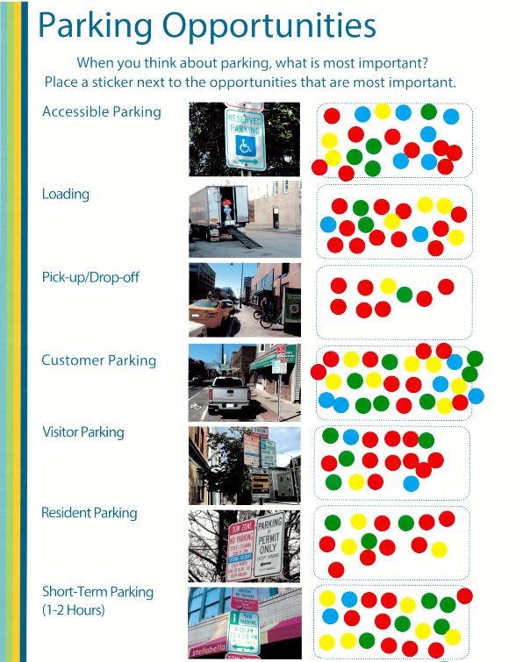
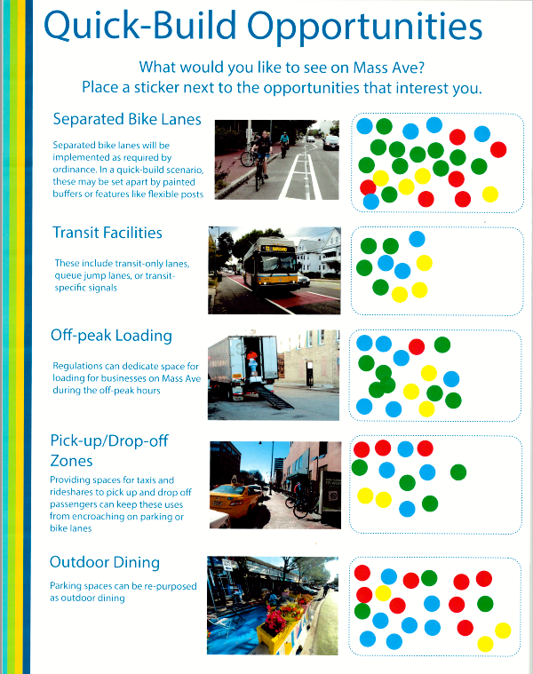
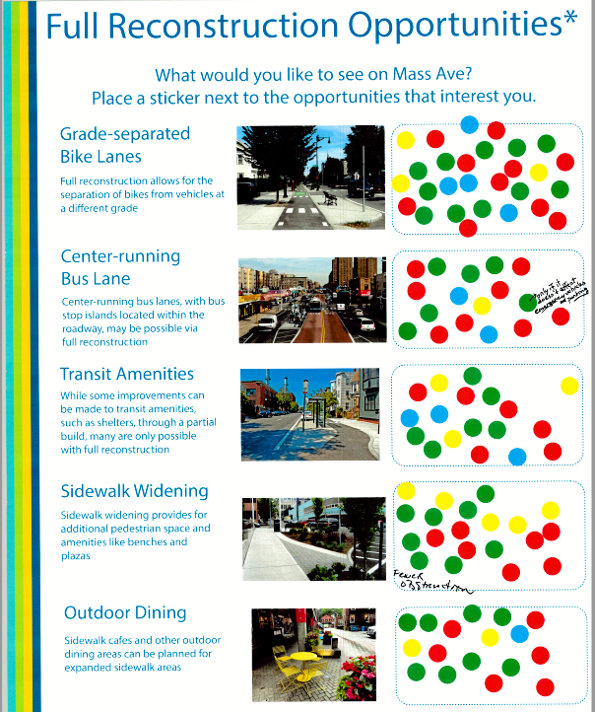
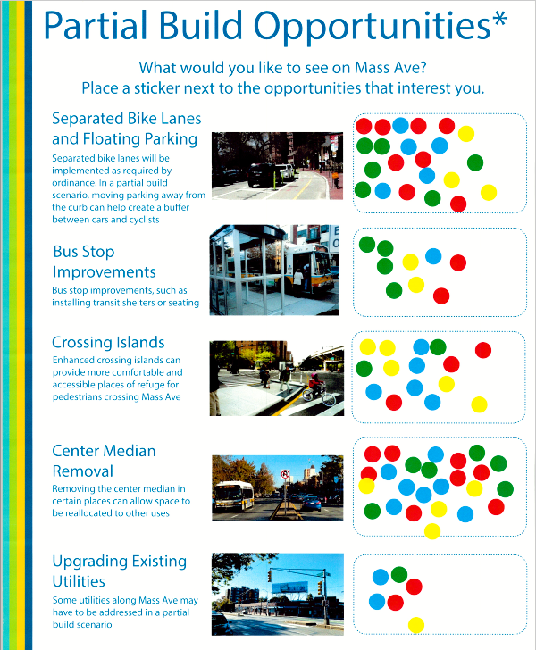
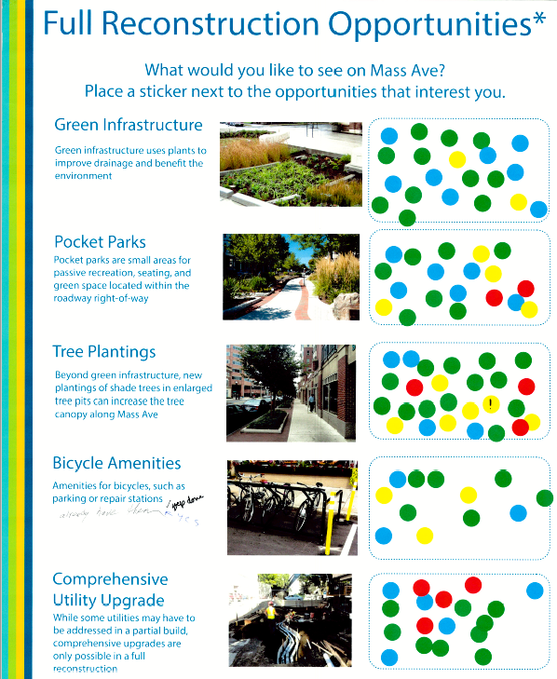
Public Engagement Themes
Expand Separated Bike Lanes
Provide Customer Parking
Reconsider the Median
Improve experience for people walking and taking the bus

Slide 26
Option Feasibility Review

Slide 27
Feasibility Considerations
There are many possible configurations for Mass Ave based on the available space
For these segments of Mass Ave, special consideration for emergency and fire access is required due to the median and overhead wires
Other considerations include:
Safety for people walking
Safety for people biking
Transit efficiency
Parking/curbside access for businesses
Utility impacts
Implementation timeline

Slide 28
Infeasible Options
Several options were reviewed but deemed infeasible and therefore not advanced:
Parking along the median
Bike or bus lanes along the median
Two-way bike lane on one side
Wider landscaped median
One lane and parking on each side with median
Two lanes and parking on each side without median
These options do not:
Allow for safe and intuitive use of the street by all users;
Allow emergency services to travel down the corridor and access buildings unimpeded; and/or
Fit within the available space.

Slide 29
Quick-Build Options Existing Median Maintained
Two Travel Lanes
FEASIBLE
Allows for emergency and fire access. Requires removal of parking along the corridor
Travel Lane and Bus Lane
FEASIBLE
Allows for emergency and fire access. Requires removal of parking along the corridor
Center median removal, customer parking, and separated bike lane options generated high interest

Slide 30
Partial Construction Options Existing Median Removed/Modified
Two Travel Lanes with Parking on One Side
FEASIBLE
Parking can change sides along the corridor. More design flexibility if overhead wires are removed.
Travel Lane and Bus Lane with Parking on one side
FEASIBLE
Parking can change sides along the corridor. More design flexibility if overhead wires are removed.
One Travel Lane with Painted Median/Turn Lane
FEASIBLE
for small segments if overhead wires are removed. Not compatible with bus lanes

Slide 31
Full Construction Options Median Removed and Sidewalks Reconstructed
Two Travel Lanes with Parking on One Side
FEASIBLE
Parking can change sides along the corridor. More design flexibility if overhead wires are removed.
Travel Lane with Bus Lane and Parking on One Side
FEASIBLE
Parking can change sides along the corridor. More design flexibility if overhead wires are removed.
Center-running Bus Lanes
FEASIBLE
Requires long-term investments. Parking limited to one side between bus stops and intersections
Notes:
Remove buffer and add space to boarding island

Slide 32
Feasible Option Summary
Quick Build
Partial & Full Construction
Median Maintained
Parking removed for emergency access
May include bus lanes for all or part of the corridor
Median Removed
Parking on one side of street (may change sides as needed)
May include bus lanes for all or part of the corridor
Additional design flexibility if overhead wires are removed

Slide 33
Possible Design Features

Slide 34
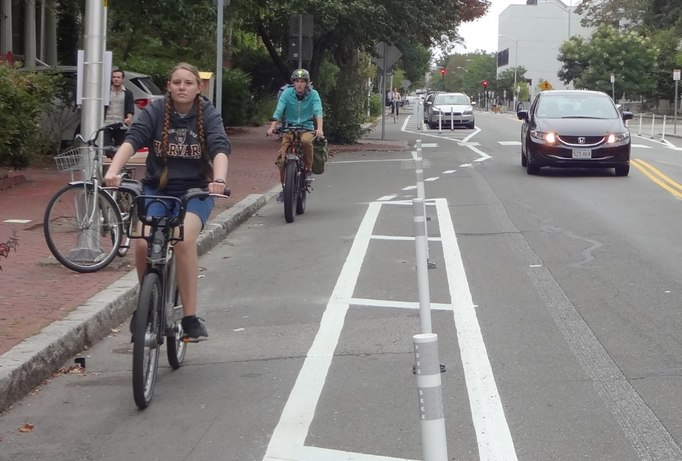
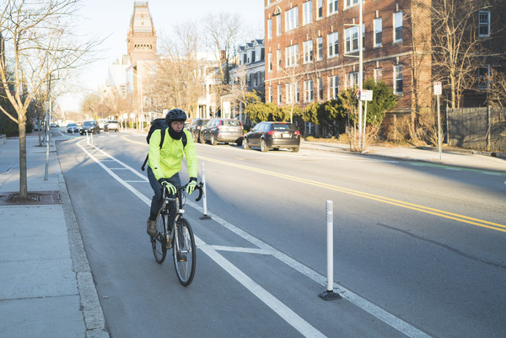
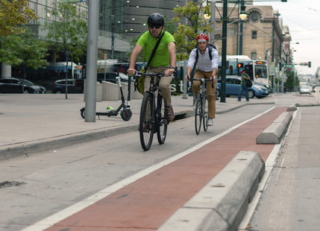
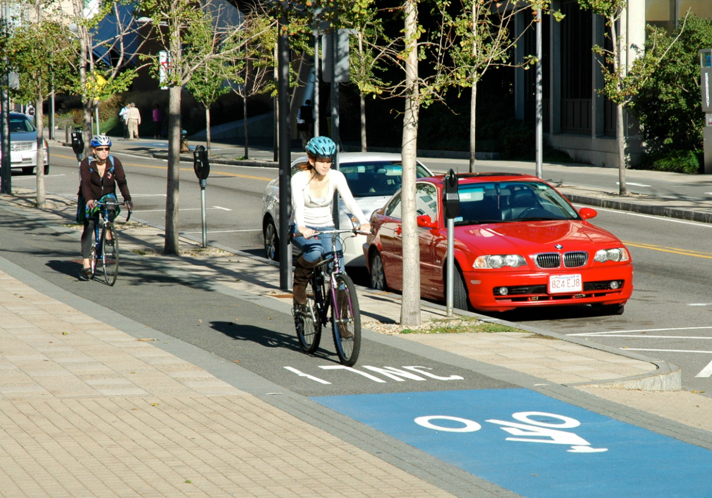
Improvements for people biking
Quick Build
Partial Construction
Full Construction
Flex posts and paint
Flex post or concrete curb barrier separation
Raised sidewalk-level bike lanes
Notes:
Quick build and partial build bike lanes will have similar separation

Slide 35
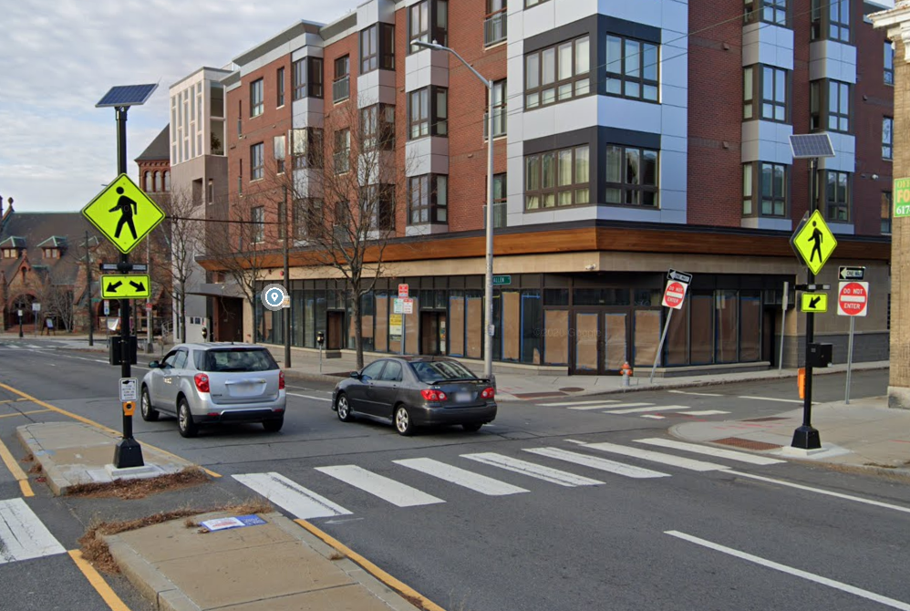
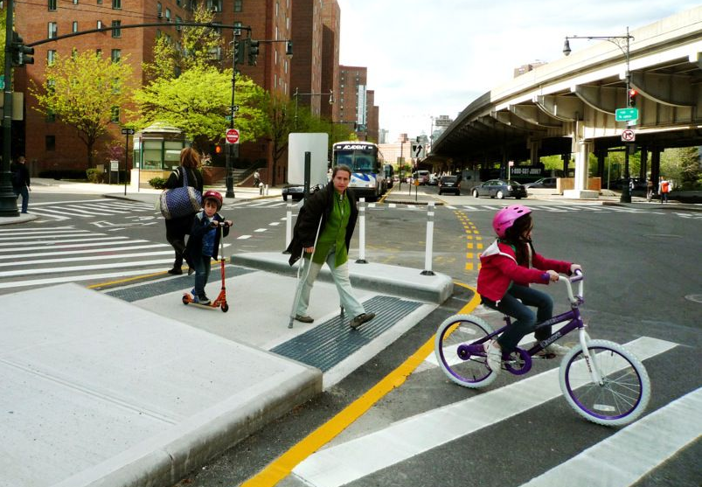
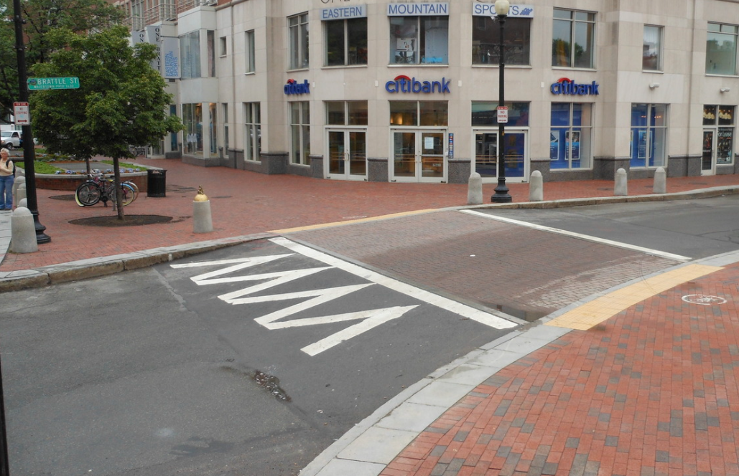
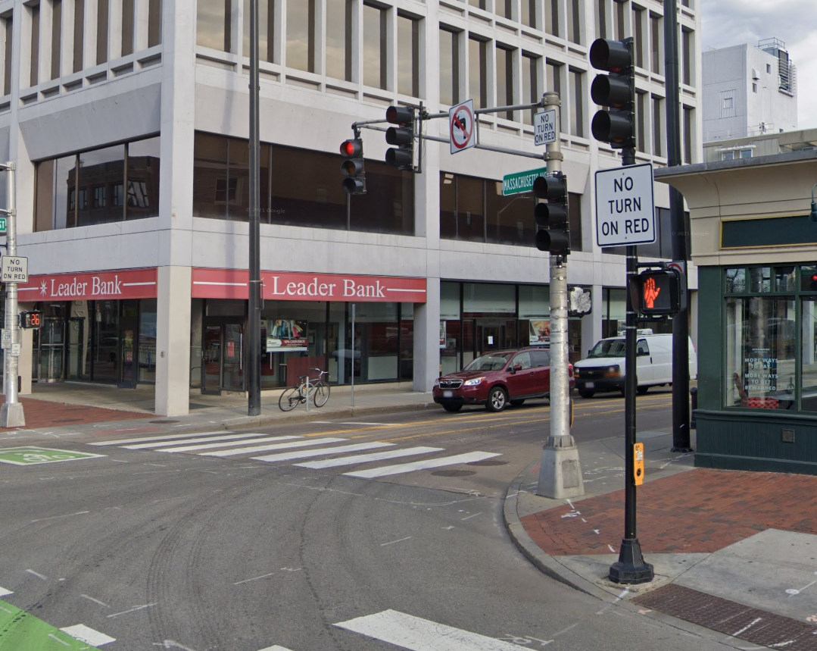
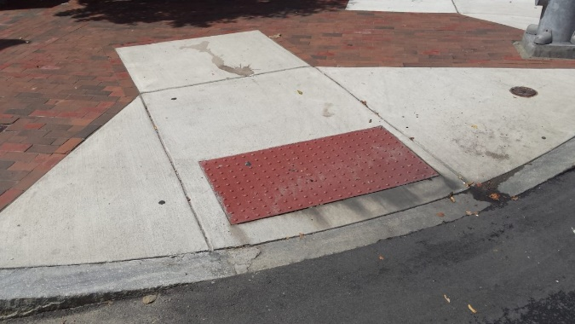
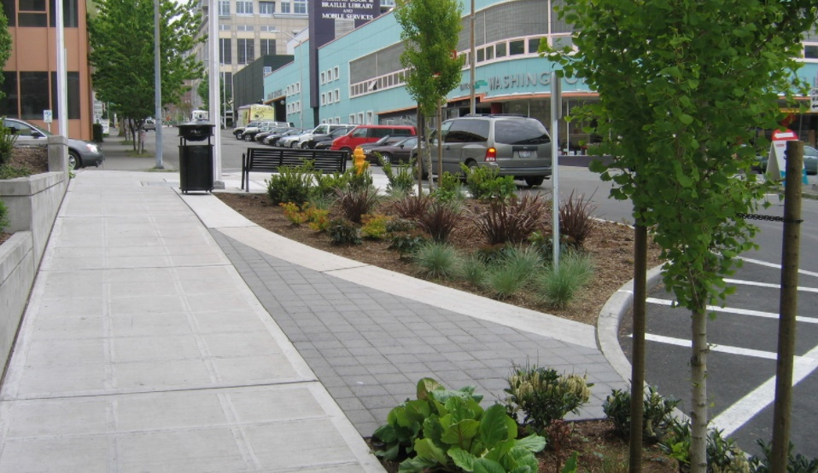
Improvements for people walking
Quick Build
Partial Construction
Full Construction
Refresh existing crosswalks
Leading Pedestrian Intervals (LPIs)
Reconstruct crossing islands and accessible pedestrian ramps
Leading Pedestrian Intervals (LPIs)
Reconstruct islands and ramps
Raised side street crossings
Add trees and landscaping
Notes:
Accessibility?

Slide 36
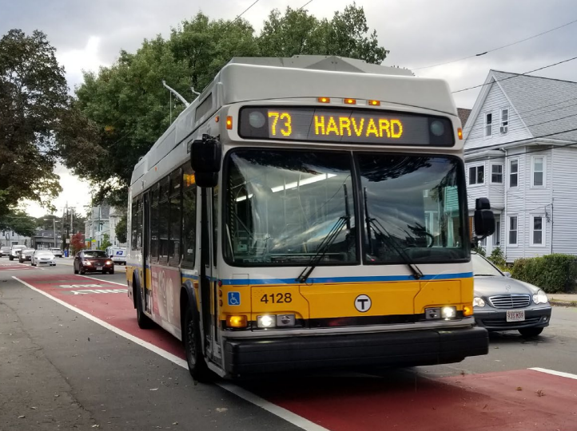
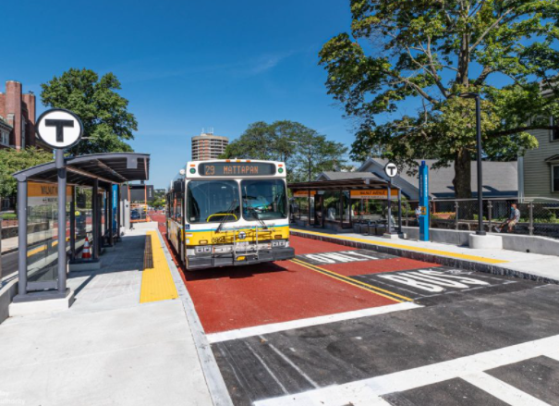
Improvements for people taking the bus
Quick Build
Partial Construction
Full Construction
Bus Lanes
Transit Signal Priority/Queue Jumps
Bus Lanes
Transit Signal Priority/Queue Jumps
Floating bus islands
Center bus lanes

Slide 37
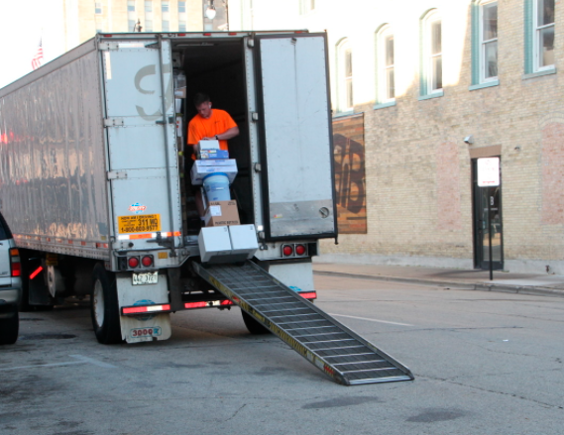
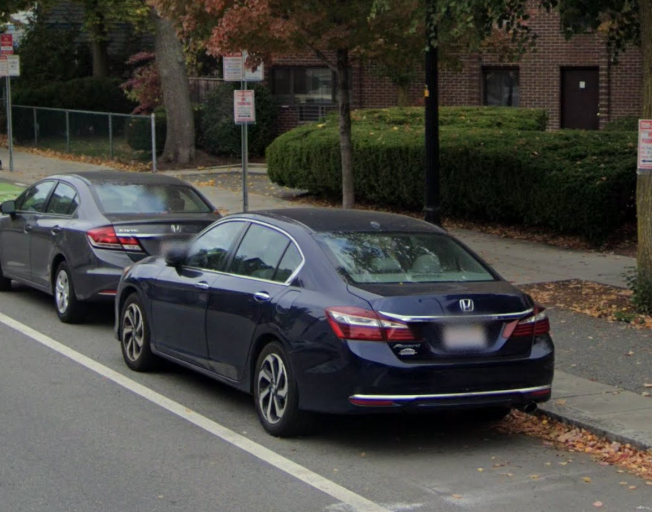
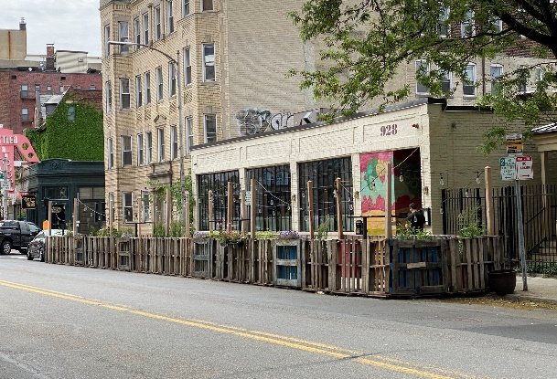
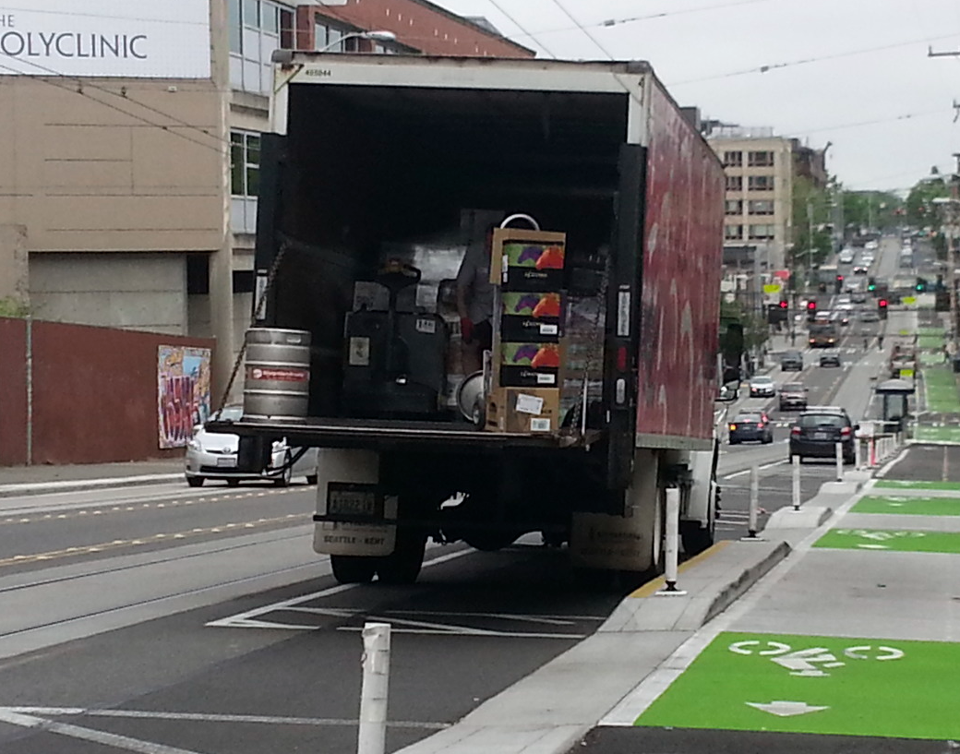
Curbside Use
Quick Build
Partial Construction
Full Construction
Add photo of outdoor dining
Off-peak loading
Accessible parking
Short term and accessible parking
Outdoor dining
Loading zones
Short term and accessible parking
Outdoor Dining
Loading zones

Slide 38
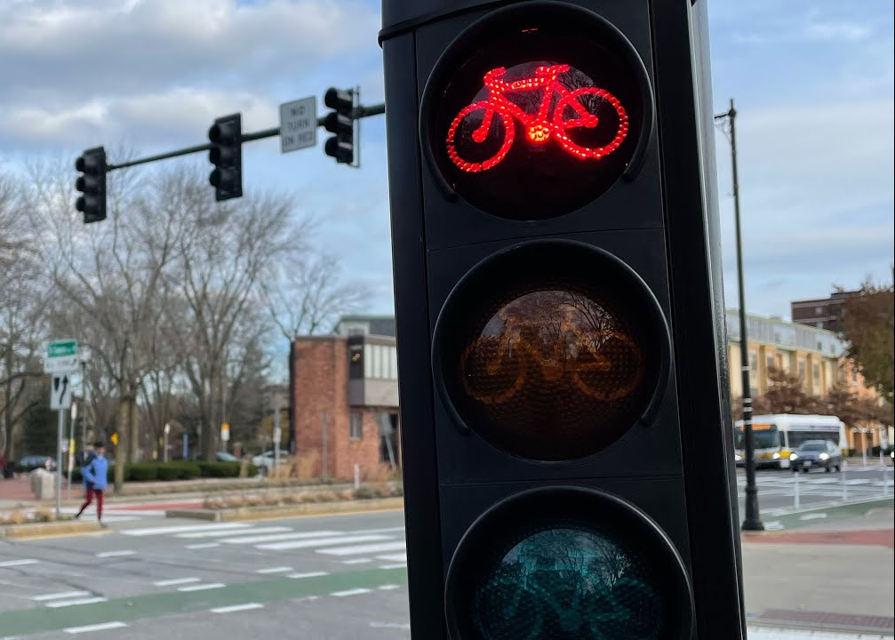
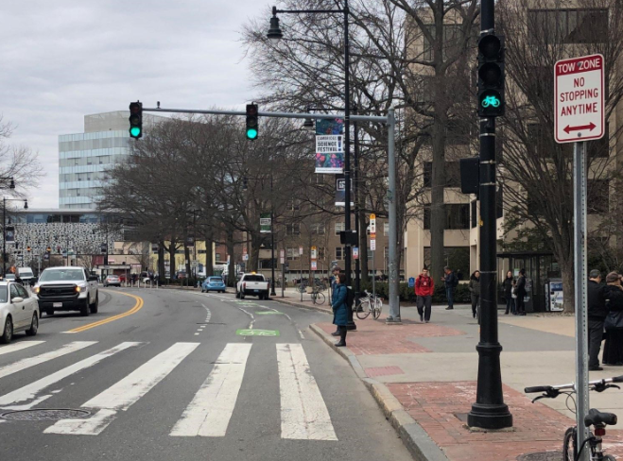
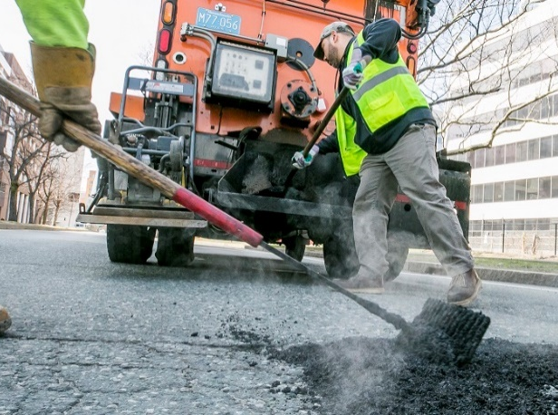
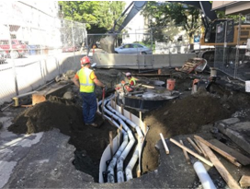
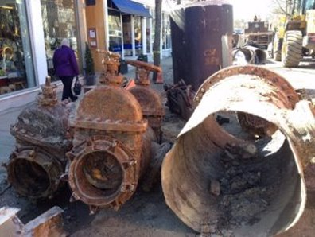
Utility and Signal Considerations
Quick Build
Partial Construction
Full Construction
Minor signal upgrades
Spot repaving
Signal relocation/upgrades
Upgrades to affected utilities
Full signal upgrades
Major utility upgrades

Slide 39
Option Evaluation

Slide 40
Quick Build Summary
Flex-post bike lane separation
0-5% parking maintained
Lowest impact on utilities
Shorter implementation timeline (1 year)
Lower cost ($)
Public Engagement Themes
Separated Bike Lanes
Improvements for people walking and taking the bus
Provide Customer Parking on Mass Ave
Remove the Median
Meets CSO goal of accelerated separated bike lane implementation

Slide 41
Partial Construction Summary
Flex-post or Curbed bike lane separation
Median removed, but upgraded at pedestrian crossings
Upgrade affected utilities
40-50% parking possible to maintain (if wires are removed)
Medium implementation timeline (to be determined based on project scope and utilities)
Medium cost ($$)
Public Engagement Themes
Separated Bike Lanes
Improvements for people walking and taking the bus
Provide Customer Parking on Mass Ave
Remove the Median
Meets CSO goal of accelerated separated bike lane implementation
Notes:
Timeline to be developed for consideration by Council

Slide 42
Full Construction Summary
Raised bike lane separation
Median removed, but maintained and upgraded at pedestrian crossings
Sidewalk reconstruction and new plantings/amenities
Major utility upgrades
40-50% parking possible to maintain (if wires are removed)
Longer design and implementation timeline (10+ years)
Higher cost ($$$$)
Public Engagement Themes
Separated Bike Lanes
Improvements for people walking and taking the bus
Provide Customer Parking on Mass Ave
Remove the Median
Meets CSO goal of accelerated separated bike lane implementation

Slide 43
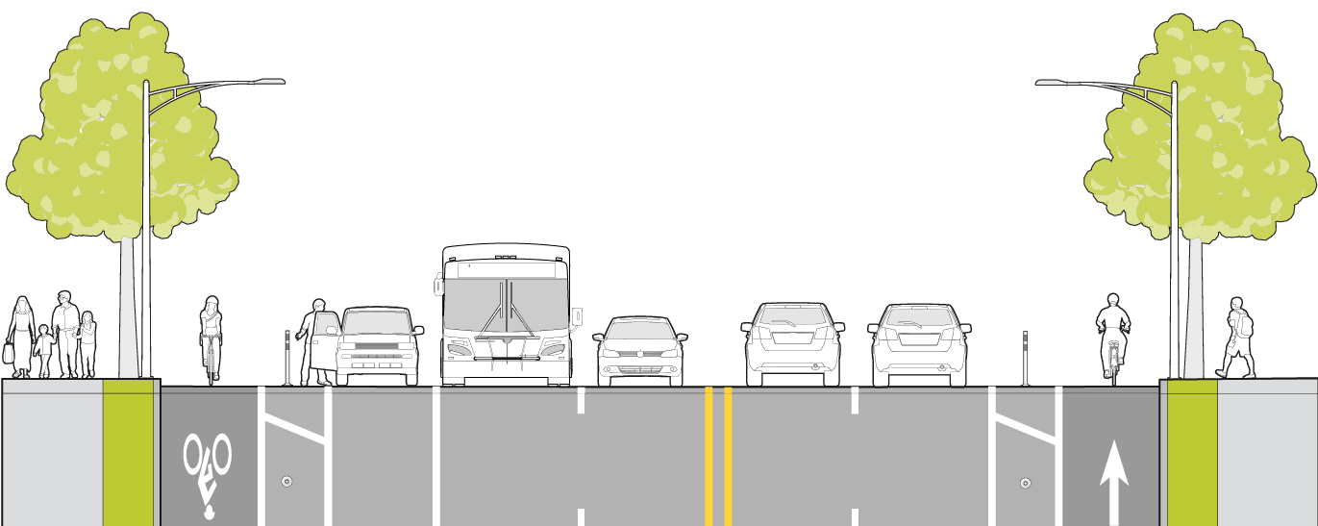
DRAFT Recommendation
Based on community feedback and the analysis completed, the Partial Construction option of removing the median is recommended
This option meets CSO goals, can maintain up to 40-50% of existing parking (if overhead wires are removed) and allows for improvements for people walking, biking and taking the bus

