Slide 1
Getting to Net Zero Taskforce November 19th
Source: EcoDistricts.org

Slide 2
Agenda
6:00 Welcome & review of agenda
6:05 Process review and discussion of final report.
Review of Timeline to date
Feedback we have heard to date and how we are going to integrate it.
Next steps to get to final recommendations
6:30 Commercial tenant engagement (Barbra)
6:35 Economic Study on the Cost of Zero
7:55 Discussion on Solar Ready Requirements
7:20 Discussion on Energy Supply Strategy
- Micro girds
- Aggregation
- Other energy sources
7:45 Public comment

Slide 3
Proposed Work Plan
Research
Recommendations
Working Groups formed
Public Events
Early Actions
Public & Stakeholder Input
1st Meeting
Series of Short Primers:
NZ Best Practices
Current State Policy review
Building Energy Primer
Renewable Energy
Testing of options
Working Groups set up
Initial workshops
Some Consultant support for analysis
Consistent inputs
Prioritization
long list of ideas generated
Alignment & Analysis of Options
Winter
Spring
Summer
Fall

Slide 4
“Big Moves”
First Draft
1. Create a compelling incentive program for Net-Zero Buildings
Define Net-Zero
Height and/or FAR bonus?
Fee-bate model?
Set a date for Types of new construction to be Net-Zero
2. Energy Supply Strategy:
Planning areas are identified that are conducive to specific uses: renewables, storage, micro-grids, co-gen, district energy

Slide 5
“Big Moves” First Draft
3. Study and evaluate the development of a “Carbon Fund”
- Functions like locally generated offsets (retro-fits, renewable energy)
- Provides an ability to achieve net-zero now to projects
- Optional but can be used to meet regulatory requirements
4. Develop a retro- fit & Continuous Optimization Strategy,
- Incentive program for commercial, and multi-family
- Energy Management Plans - Requires property owners (X-sqft and above) to submit (once every 3 years?) a plan showing how they are going to reduce/manage their energy consumption, increase renewables
- Makes use of energy disclosure data and prioritizes the in-efficient users

Slide 6
“Big Moves” First Draft
5. Develop an approach to community renewable energy that catalyzes local investment.
Explore 3rd party vehicles to invest in community renewable Energy projects
Recruit participation from local leaders
6. Develop an MOU with the Utilities to work on Net-Zero Emissions Target and programs
collaborate on micro-grids
District energy expansion in Kendall Square
Incentive program promotion and harmonization

Slide 7
“Quick Moves” First Draft
1. Revise LEED Policy to:
Achieve LEED Gold
Explicitly require energy performance
Ensure the correct standard is being used
Develop something for 1-3 family residential
2. Communications strategy on Net-Zero
Brand development
Engagement of Businesses and Residents
Partnership building (Cambridge Compact)
Recognition and rewards programs
3. Solar Ready roof requirements moving to Renewable Requirements
For residential
For commercial
Includes structural loading, access to mechanical room
Sets context for Renewables requirements in the future

Slide 8
“Quick Moves”
New
3. Net Zero and Deep Energy Retrofits for City Owned Properties.
- New Projects target Net Zero or Net Zero Ready in the short term
- Undertake deep energy retrofits to existing stock

Slide 9
Summary of feedback
No consensus yet
Broadly affirmative (generally right tools for the job)
Targets need to better reflect the complexity of the Cambridge market
Fee-bate model needs much more clarity and work
Amalgamate “bold” and “quick” moves
Better integration of current city initiative (resiliency, master-plan etc)
Engage utilities now

Slide 10
Firm Profile| We design high Performance buildings
Largest certified net zero building | Packard Foundation Headquarters, CA
First certified net zero energy project | Integral Group “Z Squared” Office, CA
Highest Scoring LEED CI project (120 points) | Integral Group’s Deep Green Office, CA
First LEED Platinum Laboratory in Canada | CANMET, ON
First Net Zero-energy, zero-carbon and LEED Platinum laboratory | j. Craig Venter Institute
First LEED Platinum for a laboratory in a historic building | Caltech Linde+Robinson Lab, CA
First state office building in the US to be awarded a LEED Platinum rating | Lewis & Clark, MO
First Net Zero museum | Exploratorium
First certified LEED Platinum Data Center | Advanced Data Center
First radiantly cooled office builiding in India | Inforsys Buildings
First laboratory with chilled beams | US Davis, Tahoe Center for Environmental Sciences
45 Net-Zero Projects in Design
29 LEED Platinum Certified Projects
26 LEED Gold Certified Projects
06 Living Building Challenge project in Design

Slide 11
Peter Morris, MRICS
Lisa Matthiessen, FAIA
Laura Lesniewski, AIA

Slide 12
Research Objectives
Knowledgeably discuss the cost/benefit implications of building to Zero Net Energy and Living Building Challenge standards
Know how the construction costs of next generation green buildings compare to those of LEED and non-LEED buildings
Compare high-performance buildings relative to energy goals and strategies
Understand value and cost drivers for deep green buildings and communities

Slide 13
Cost of Zero
Statistical Analysis
Normalization
Building types
Key take away’s
500
sample pool of buildings
88
high-performance buildings

Slide 14
building types
statistical analysis
community centers (learning/visitor)
k-12 schools
office buildings – low-rise
wet labs
NETZEROSTUDIO by

Slide 15
approach
statistical analysis
Normalized comparative approach (what we did)
common location
common time
Other ways to baseline
the project itself, without the green elements
similar projects

Slide 16
wet labs
statistical analysis
$ / SF
Green
BUILDINGS MEASURED
NETZEROSTUDIO

Slide 17
K-12
statistical analysis
$ / SF
BUILDINGS MEASURED
NETZEROSTUDIO

Slide 18
community centers
statistical analysis
$ / SF
Green
Platinum
BUILDINGS MEASURED
NETZEROSTUDIO

Slide 19
low-rise office building
statistical analysis
*
*
$ / SF
BUILDINGS MEASURED
NETZEROSTUDIO

Slide 20
EUI to cost
Residential Low-Rise
COST IN $ PER SF
NETZEROSTUDIO

Slide 21
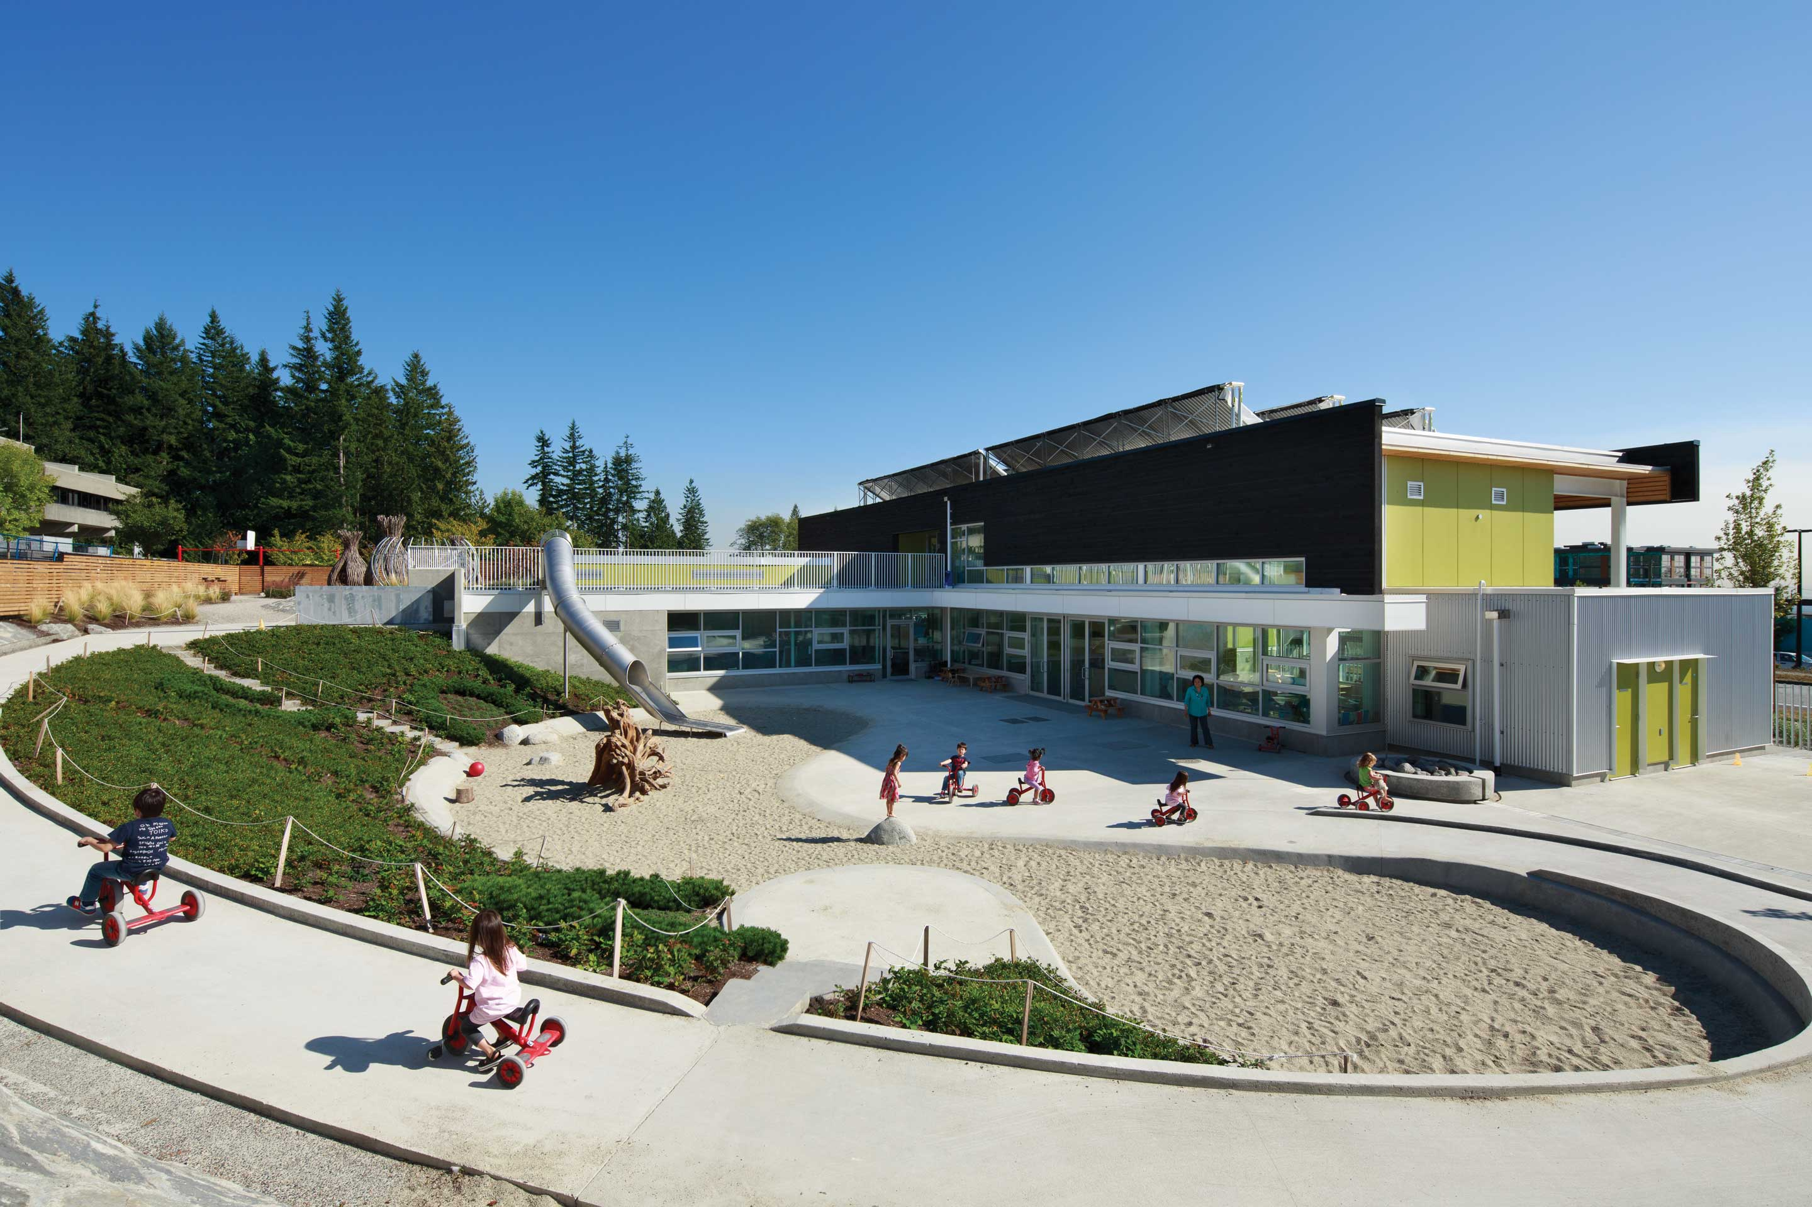
STUDYFINDINGS
comparison of component costs
High Performance buildings are happening
There are two distinct families
Demonstration projects
‘Mainstream’ projects – (a growing cohort)
HPB are getting there by reducing consumption
Costs are approaching ‘conventional’ buildings
We could use good metrics for non-energy performance
NETZEROSTUDIO by

Slide 22
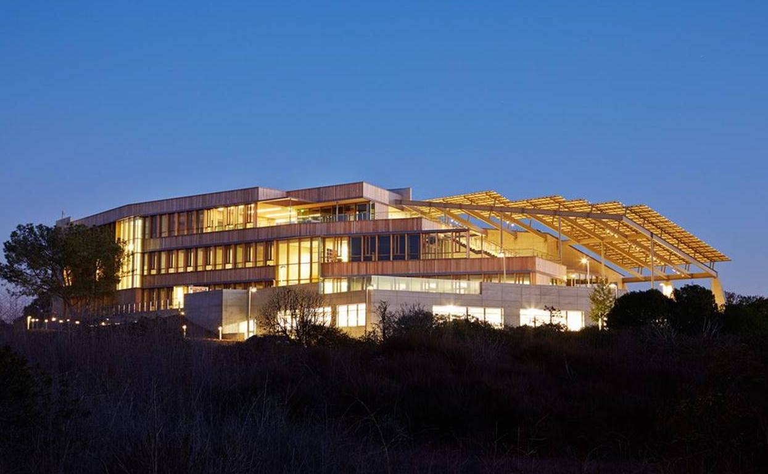
J.CRAIGVENTERINSTITUTE
Targeting: Net Zero Energy, Zero Carbon, LEED Platinum Certification
La Jolla, California
Area: 45,000 ft²
Architects: ZGF Architects
Lab focused on human, microbial, plant, environmental, social and ethical genomic research
Flexible laboratories for molecular biology and computational biology
Seeking to be net-zero, carbon neutral without buying carbon offsets and minimum of 50% less energy use and on-site power generation
Entire electrical load is generated from roof-mounted PV panels
Water strategies include 100% rainwater collected, no runoff, net-zero waste water and 50% domestic water demand reduction
NETZEROSTUDIO by

Slide 23
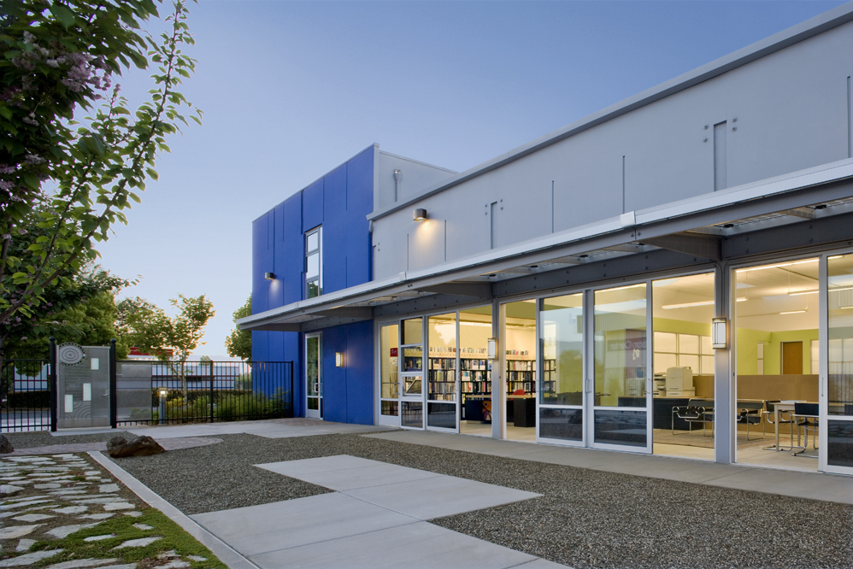
‘10
‘00
‘05
‘15
‘20
Integral Group Z Squared Design Facility
Certified Net Zero Energy
First Net Zero Commercial Office in U.S.

Slide 24
435INDIOZNE
Passive night cooling
Upgraded exterior insulation with thermal mass walls
Ceiling fans extend comfort temperature range
Custom operable skylights use prevailing breezes to induce internal airflow
High performance glazing – no need for external shades
Daylighting to all occupied spaces
Skylights designed to provide equal light levels in summer and winter, and 15% higher levels at equinox
High efficiency LED lighting (.5W/sf)
Integral daylight, occupancy, and temperature sensors at every light fixture
Individually controlled desk fans and task lights
Metering by load type (lighting, plug loads, mechanical)
Building energy use dashboard
Occupancy sensor controlled plug strips

Slide 25
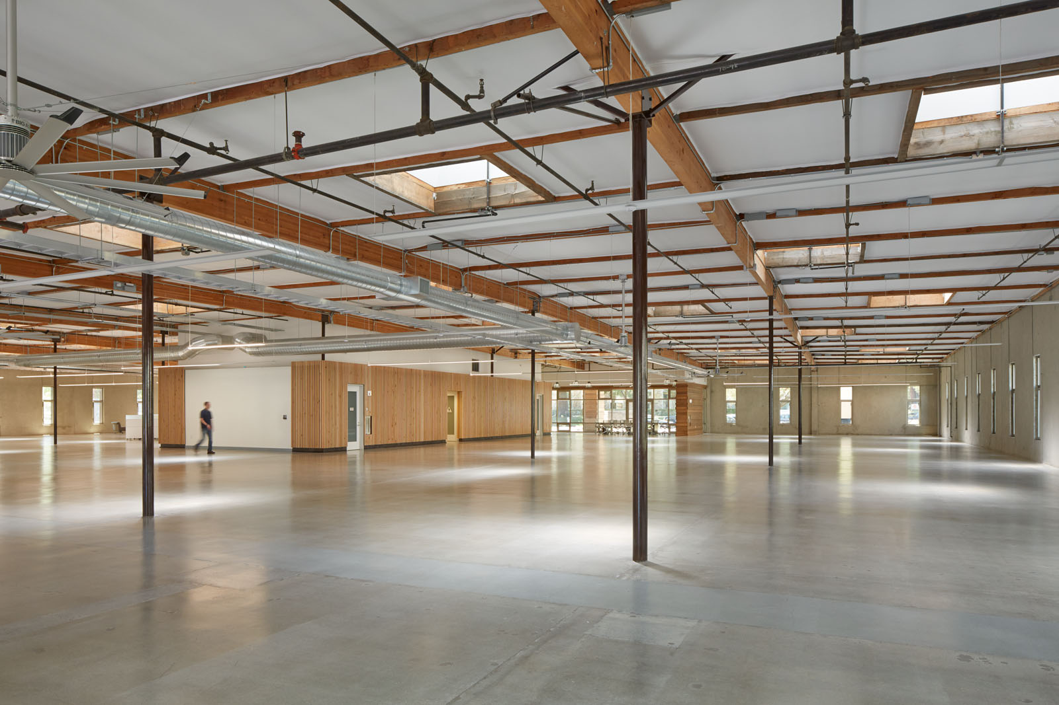
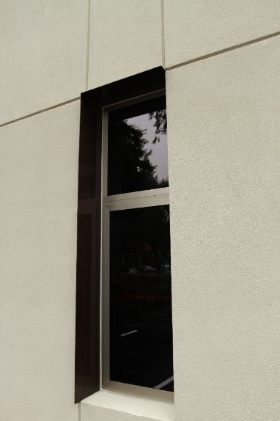
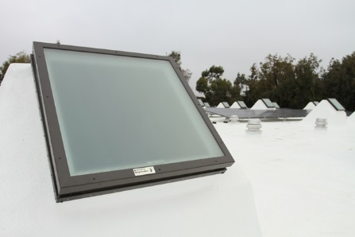
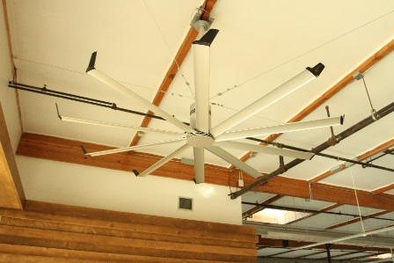
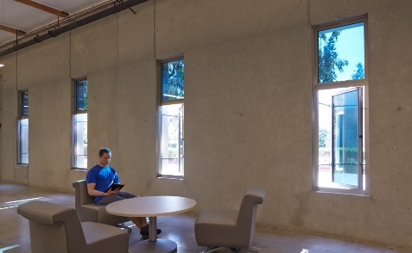
435INDIOZNE
PASSIVE THERMAL COMFORT

Slide 26
Solar Ready
Start with “Solar ready”
Explore Solar required
(and expand requirement)
Require Solar installation
What we have heard?
Clarify where it does not apply (IE shaded lots, labs?)
Explore Solar requirement sooner (1-4 years)
Review height and overlook guidance
Provide opportunities for solar hot water
Cost impacts of moving mechanical and increased loading

Slide 27
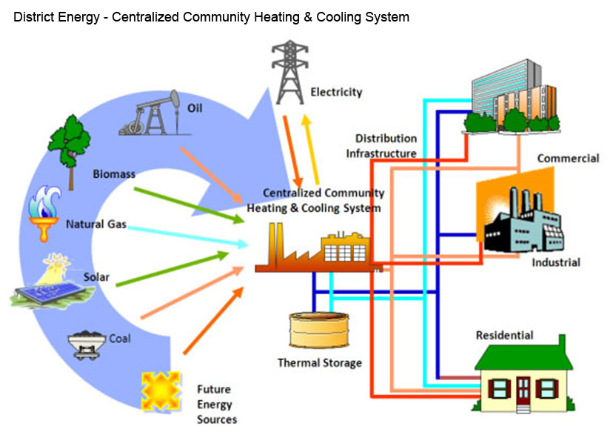
Cambridge Energy Strategy
What we have heard:
Review municipal aggregation
Legislative review of barriers to energy sharing/micro grids
Expand the exploration of other renewable technologies
Expand references to waste heat capture
Prioritize Micro grid development
Review from resiliency lenses
Source: Veolia North America

