Slide 1
Getting to Net Zero Taskforce March 4

Slide 2
Agenda
Getting to Net Zero Task Force Meeting.
March 4th, 2015 7:00PM-9:00 PM
Smith Campus Center
700 pm Welcome and Introductions
7:05 pm Process update
7:20 pm Review of Documents and actions
8:30 pm Next steps
8:45 pm Public Comment

Slide 3
Process Slide:
2 months of stakeholder feedback
Work closely with stakeholders not represented by NZTF

Slide 4
NZTF Objectives (March 2014)
Broad-based agreement from the Task Force and key stakeholders on a methodology, strategy, targets, and timeline for achieving net zero emissions, including agreement on the definition of the scope of net zero for the purposes of this initiatives.
A comprehensive list of recommendations outlining a set of short-term (1-3 years) actions and a set of longer-term (4-10 years) actions. These recommendations will include direction on regulation, planning measures, incentives, and renewable energy generation initiatives that are within Cambridge’s direct control.
The projected impacts of each action (to assist in decision-making and implementation of the recommendations, and in tracking and reporting progress and impacts of each action over time).
Identification of roles and responsibilities associated with each of the recommended action, including who (i.e. City, state gov't, stakeholder group) will lead and/or support implementation of each.

Slide 5
NZTF Objectives (March 2014)
A comprehensive list of additional, promising action areas that require further research.
Identification of resource needs to begin work on short-term actions and high-priority research topics.
Commitments of support or alignment from partners who are critical to the success of the plan.
Agreement on an ongoing communication, reporting and accountability strategy.

Slide 6
What we have heard? Overall Comments
Definition of terms:
A - Net Zero Emissions for New Buildings
Include GMGMI definitions of Scope 1 & 2 emissions
B - Community of Net Zero Emissions Buildings (new, existing, considers supply)
C – Provide more context and what has been achieved to date
D – Need more time for Consultation

Slide 7
What we have heard? Overall Comments
This study has to balance the economic demands and address if there will be tradeoffs. (will happen for each action as they are designed.)
Clearly identify what will change in short-term (1 - 4 years)
Solar ready
LEED Update
Research and consultation for market-based strategies to incentivize the lowest performing buildings to improve, including fee-rebate
BEUDO and Data collection
Energy Supply strategy

Slide 8
Target years: Process
Type: | Municipal | Residential | Multi-Family | Commercial | Institutional | Labs
Target year: | 2020 | 2022 | 2025 | 2025 | 2025 | 2030
The Policy Target is the year when legislation enacting the requirements will be recommended for adoption.
The targets will be reviewed again in 2019 as part of the comprehensive review, and again in 2024.
Each target will also be reviewed for feasibility a minimum of 2 years prior to enactment

Slide 9
Target years: Process
Type: | Municipal | Residential | Multi-Family | Commercial | Institutional | Labs
Target year: | 2020 | 2022 | 2025 | 2025 | 2025 | 2030
The criteria that will be evaluated in order to determine the the feasibility is:
Number of Net Zero Buildings in that building type
Technical feasibility/Industry capacity
Access to renewable energy
Economics including NPV analysis
Contribution to other goals such as resiliency

Slide 10
What we have heard? Action 1 - Retrofits
Regulating Retrofits:
More emphasis on tenant engagement.
Allowance for larger portfolio owners to deal with reductions portfolio wide.
Regulation at time of sale and/or retrofit permit
Investigate what to require at time of permit
Investigate whether to do it and How

Slide 11
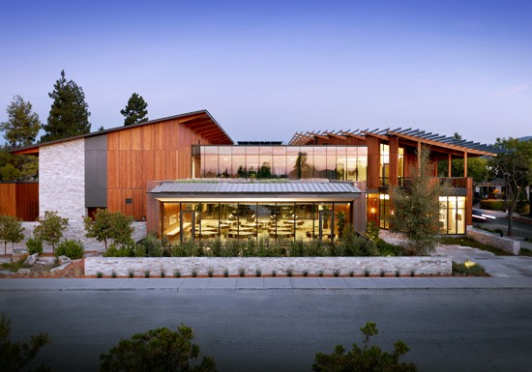
What we have heard: Action 2 – New Construction
Incentives:
market-based strategies to incentivize the lowest performing buildings to improve, including fee-rebate
Fee & rebate cannot be punitive to energy intensive building types
Potential height & FAR bonus to be reviewed in the context of other demands
For CAMBRIDGE GETTING TO NET ZERO TASK FORCE

Slide 12
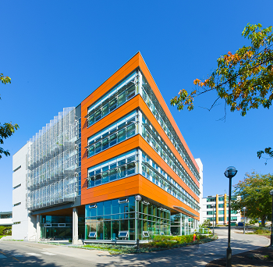
What we have heard? Action 3 – Energy Supply Strategy
Energy Supply Strategy:
Ensure that solar regulation is applied in appropriate circumstances
Include climate resiliency in analysis and design of possible solar requirements
Energy supply strategy should be expedited and include thorough stakeholder consultation
Photo credit: Perkins & Will

Slide 13
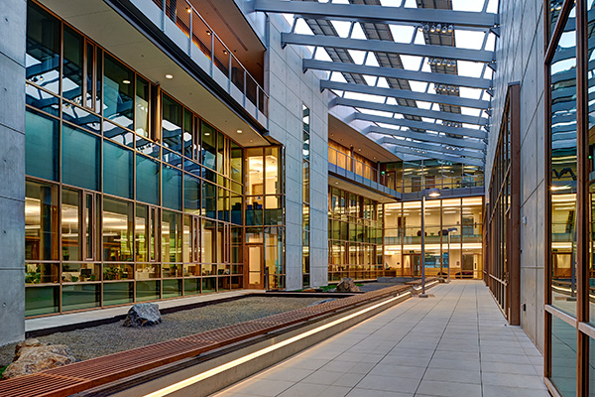
What we have heard? Action 4: Local Carbon Fund
No substantive changes

Slide 14
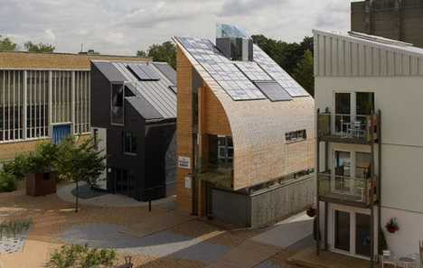
What have we heard: Action 5: Capacity Building
Lots of commentary from task force that they want this supported with adequate resources.
Photo credit: Journal of Commerce

Slide 15
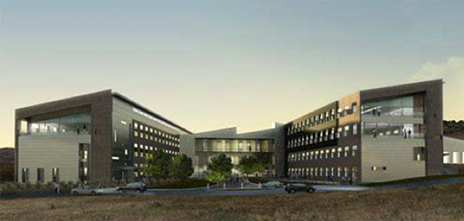
Public Consultation
New Public Consultation Date is March 25th
Panel Format with task force
More stakeholder meetings in the meantime.
Photo credit: Stantec

Slide 16
Thank you
Public Meeting March 25th

