Slide 1
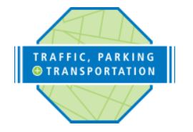
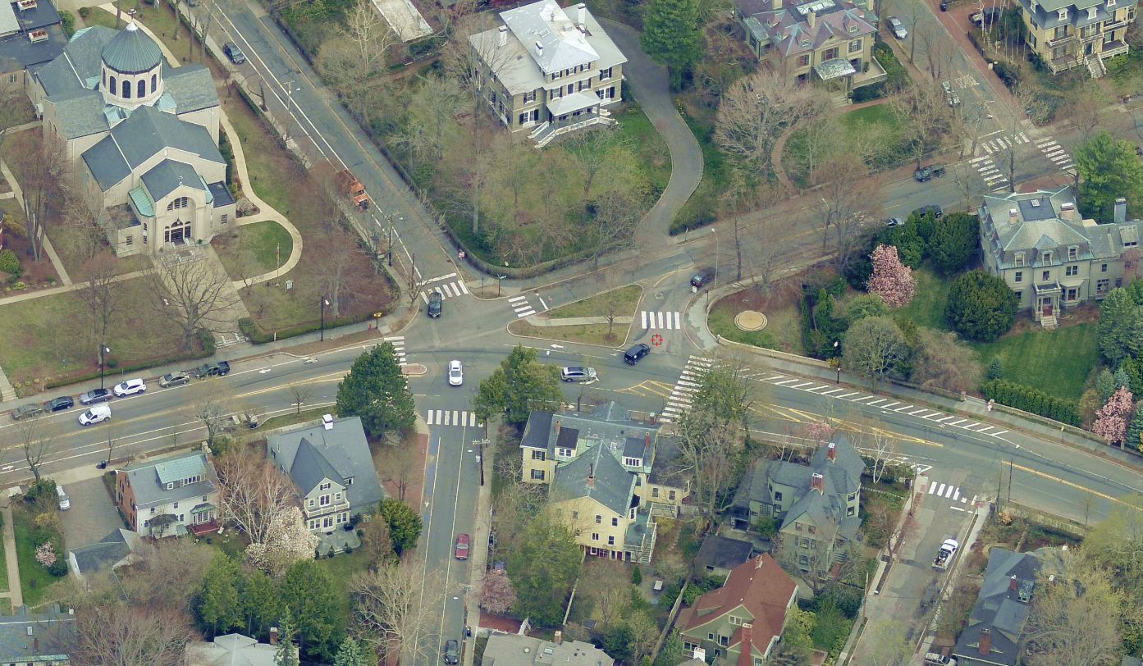
Brattle Street at
Sparks Street & Craigie Street
Community Meeting
The City of Cambridge is considering two alternatives for intersection safety improvements. The goal of the project is to improve safety for all users of the intersection. Alternatives presently under consideration include a traffic signal or a modern roundabout.
Wednesday, June 13
Holy Trinity Armenian Church
145 Brattle Street, Cambridge
Red Brick Building next to the parking lot.
6:00 PM – 8:00 PM
For more information on this project, please contact Cambridge Traffic, Parking & Transportation Department, Engineering Manager, Patrick Baxter, PE at pbaxter@cambridgema.gov.
Sparks Street
Craigie Street
Brattle Street

