Slide 1
Alewife Linear Park Restoration Project
Community Discussion - October 10, 2019

Slide 2
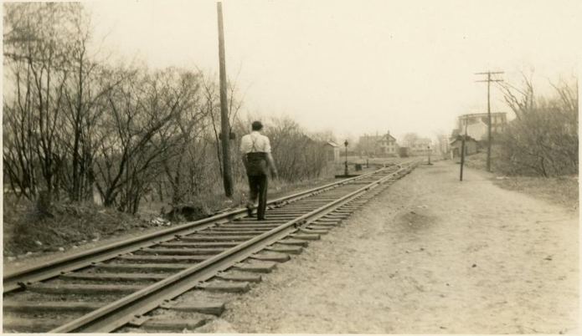
History
Follows the original railroad path established in 1870
Originally used for passenger service and freight operations on the Lexington and West Cambridge Railroad
Established as a multi-use path in 1985 by the MBTA, now maintained by Cambridge and Somerville
Photo: Arlington Historical Society

Slide 3
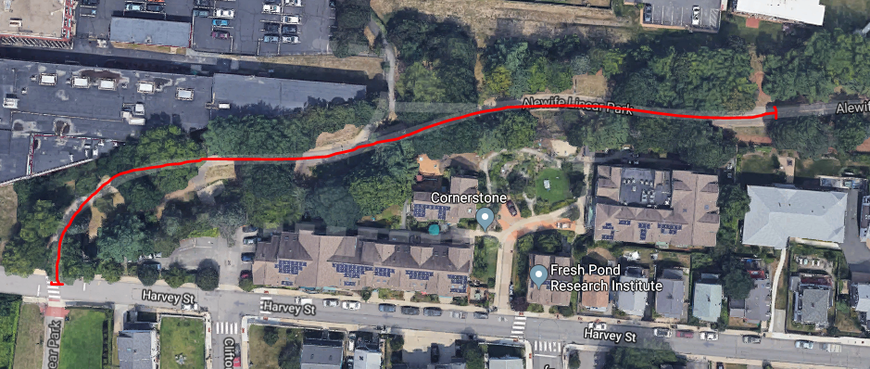
Restoration Plan
Tree Planting Opportunity
Photo: Google
Decline in tree canopy since the path’s development in 1980s
Several opportunities to develop a more robust canopy using improved planting methods
Identified areas between Harvey St. and Cedar St. entrances for a planting and maintenance program over several phases
Planting concept consistent with the original development plan

Slide 4
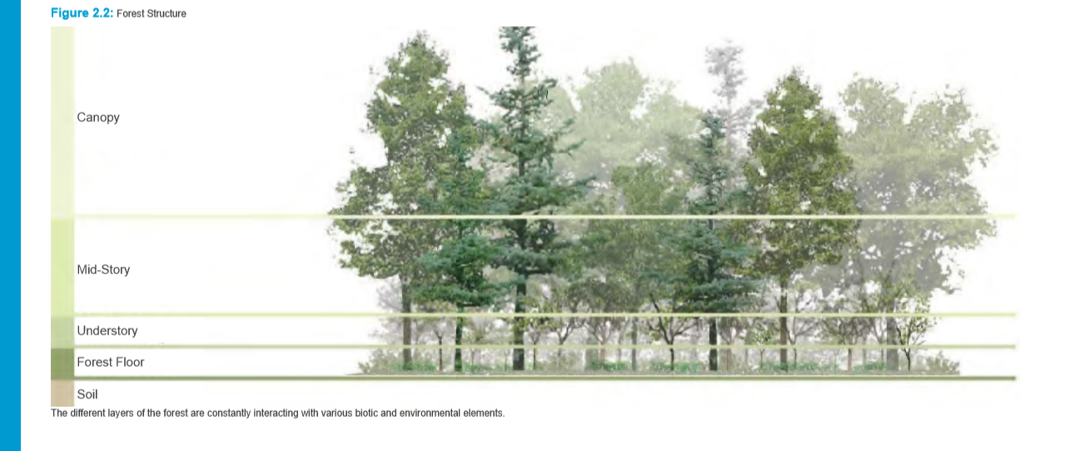
Planting Opportunities
Vertical diversity creates a multi-storied forest that enhances ecological function
Bare-root trees outperform b&b nursery stock and establish quickly
Soil remediation through air spading and soil amendments to alleviate compacted soil and poor growing conditions.
Plant native species that contribute to a healthy ecosystem.

Slide 5
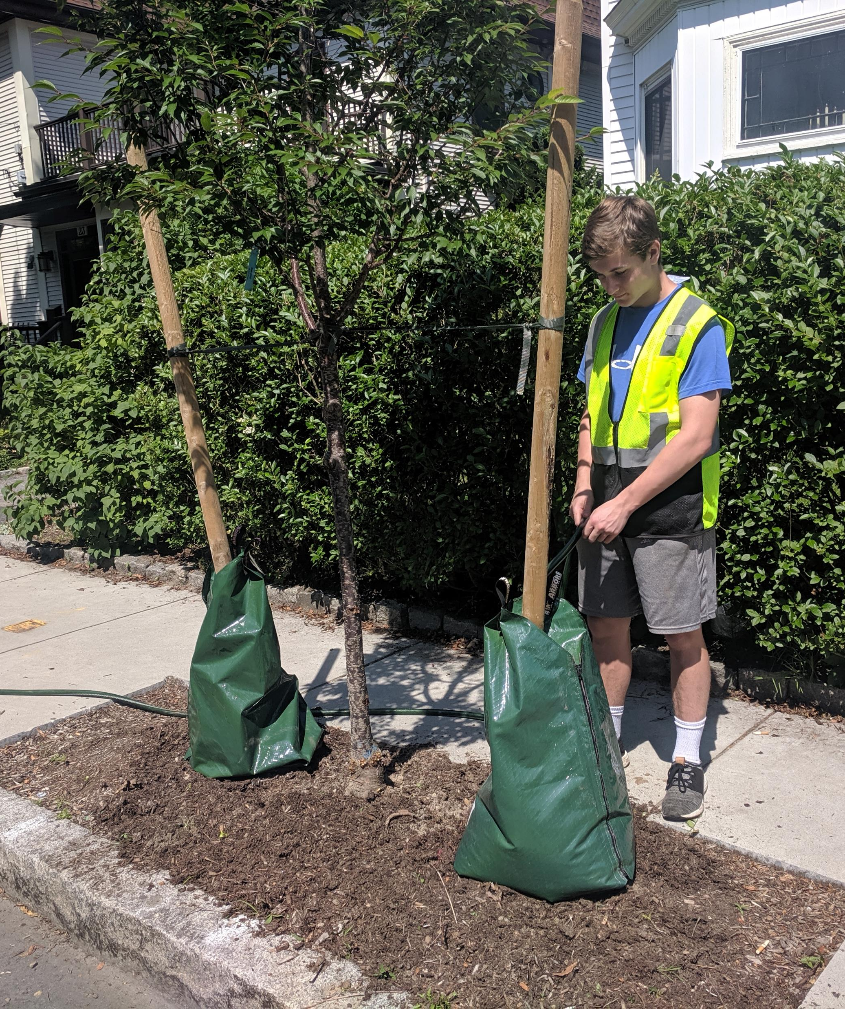
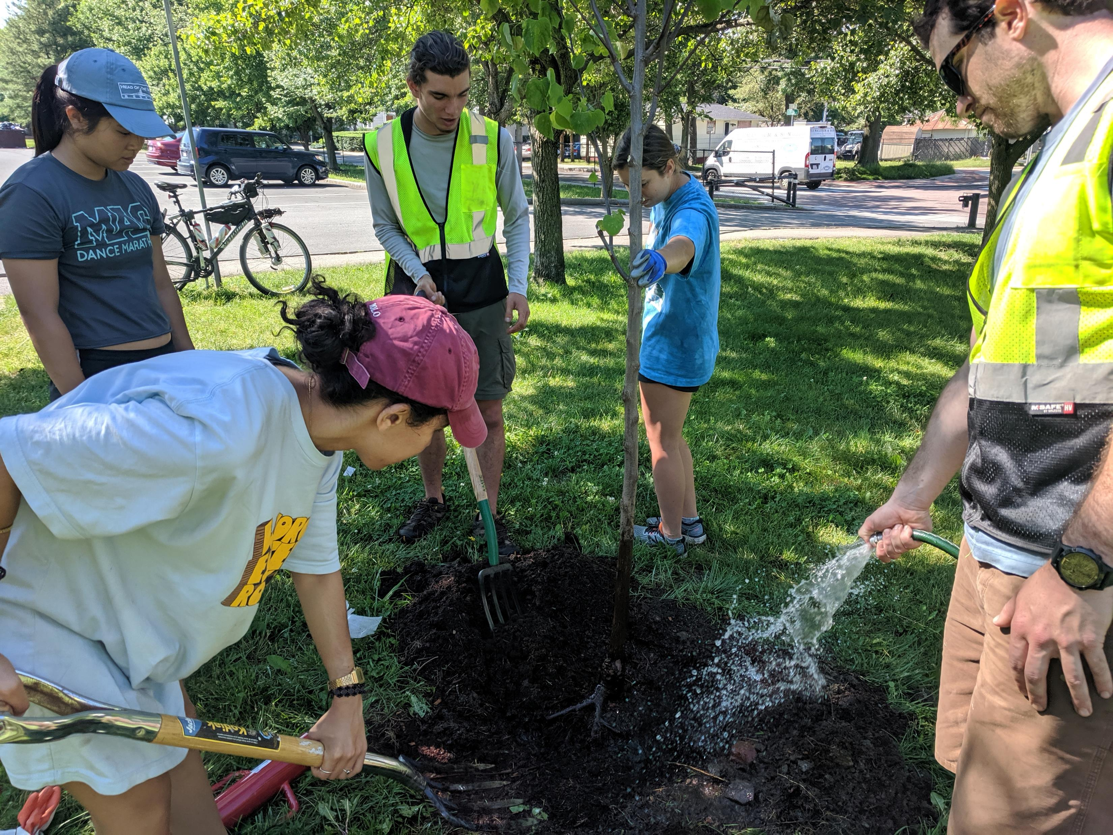
Maintenance Plan
Watering commitment through establishment. May - October
Possibly re-establish existing irrigation system for understory watering.
Performance Mulch- a 50/50 blend of compost and bark mulch adds nutrients and enhances soil structure.

Slide 6
Linear Park: Phase 1
November 2019

Slide 7
Phase 1 Fall 2019 (50 trees)

Slide 8
Original Plant List November 1983

Slide 9
Tree Planting Technique
Bare Root Trees
1.5 – 1.75” caliper

Slide 10
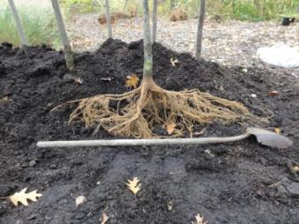
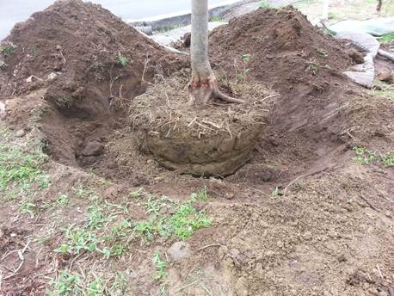
Bare Root Planting

Slide 11
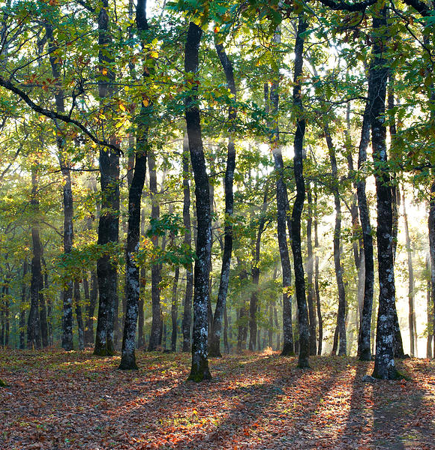
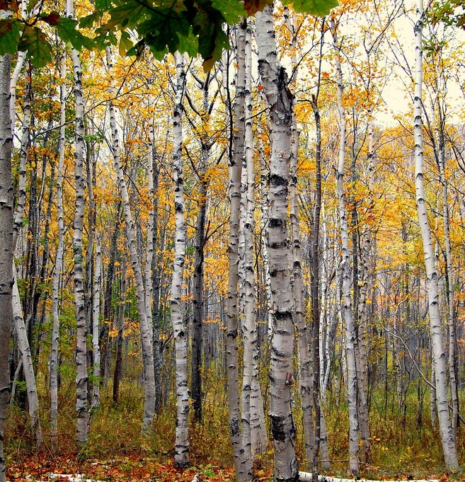
Grove Planting

Slide 12
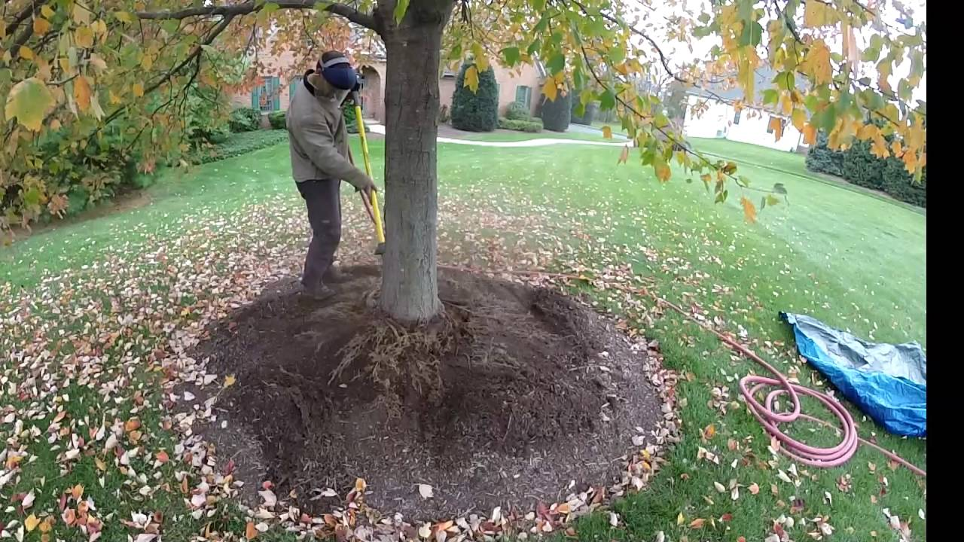
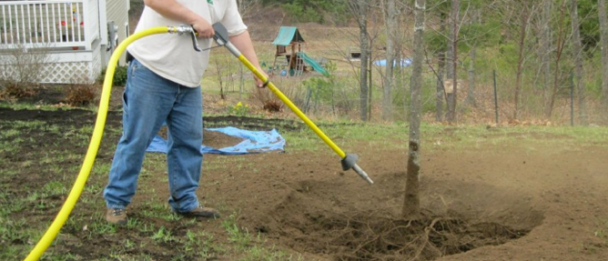
Air Spading
Process of excavating soil surrounding tree roots using compressed air to minimize damage

Slide 13
Tree Species
November 2019

Slide 14
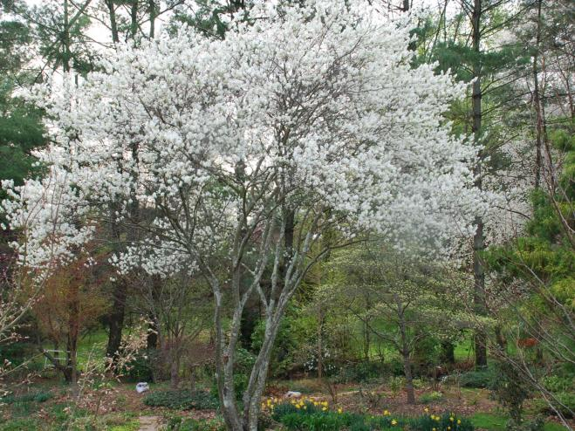
_{Serviceberry}
_{Amelanchier sp.}

Slide 15
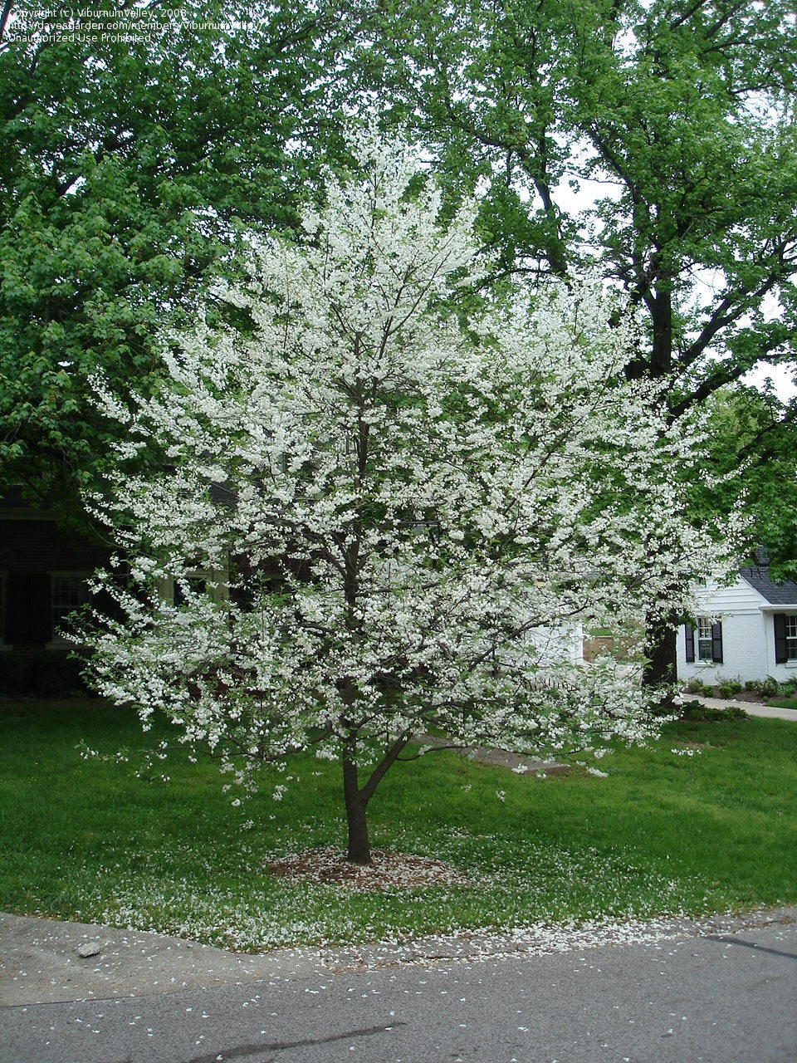
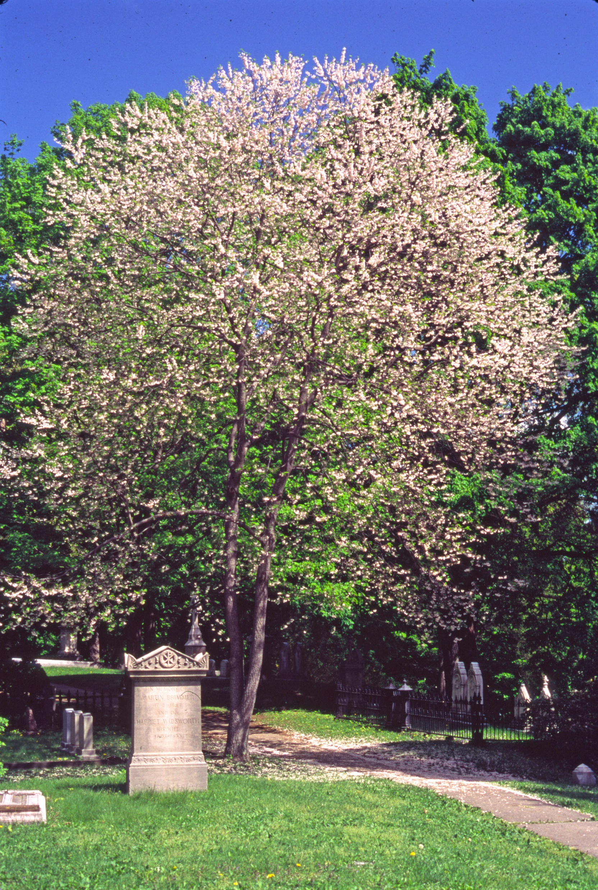
Sliverbell
Halesia sp.

Slide 16
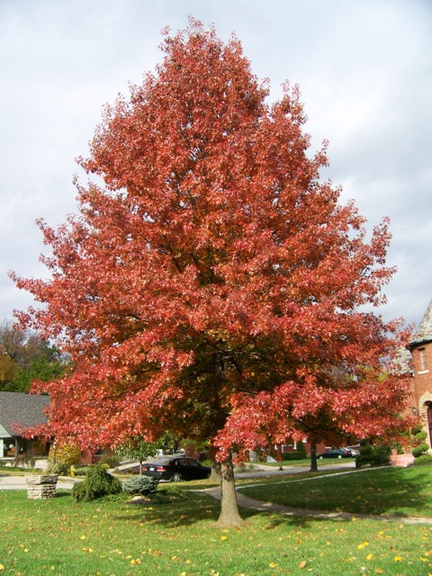
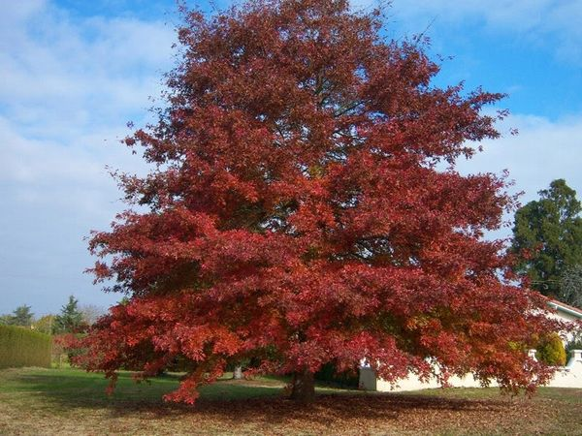
Pin & Red Oak
Quercus palustris + Quercus rubra

Slide 17
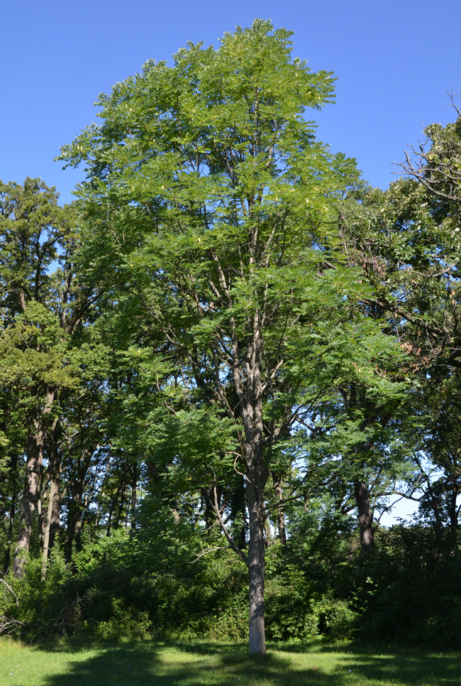
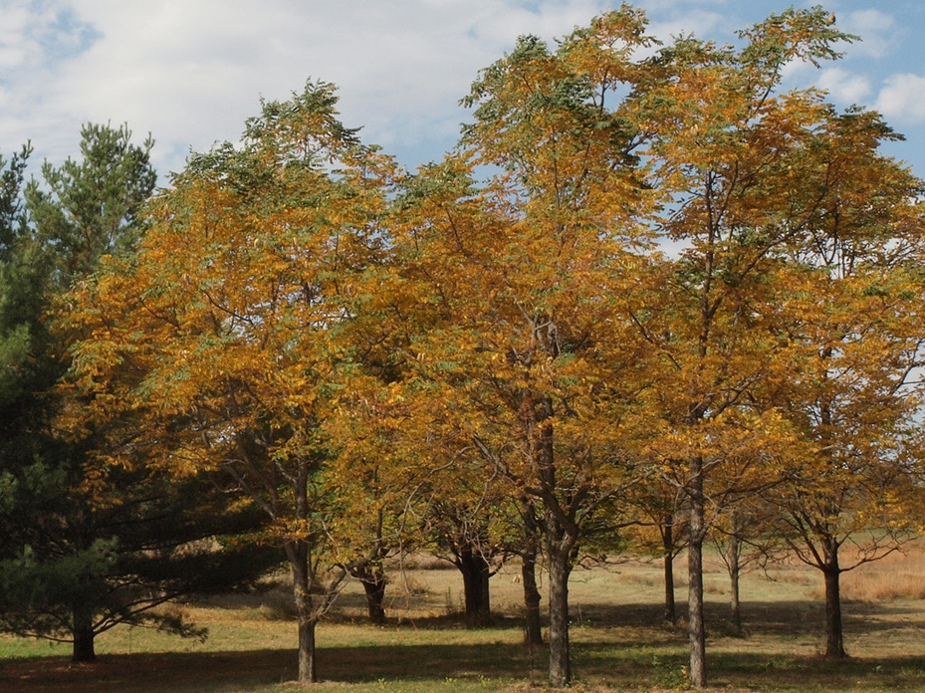
Kentucky Coffee Tree
Gymnocladus dioicus

Slide 18
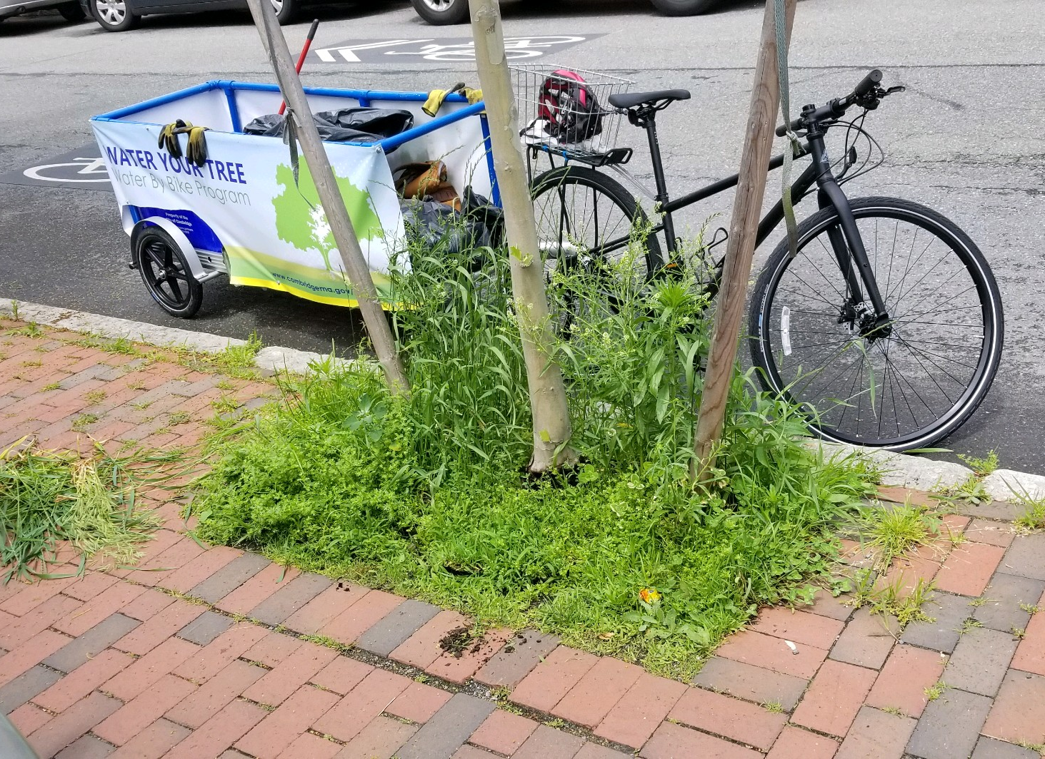
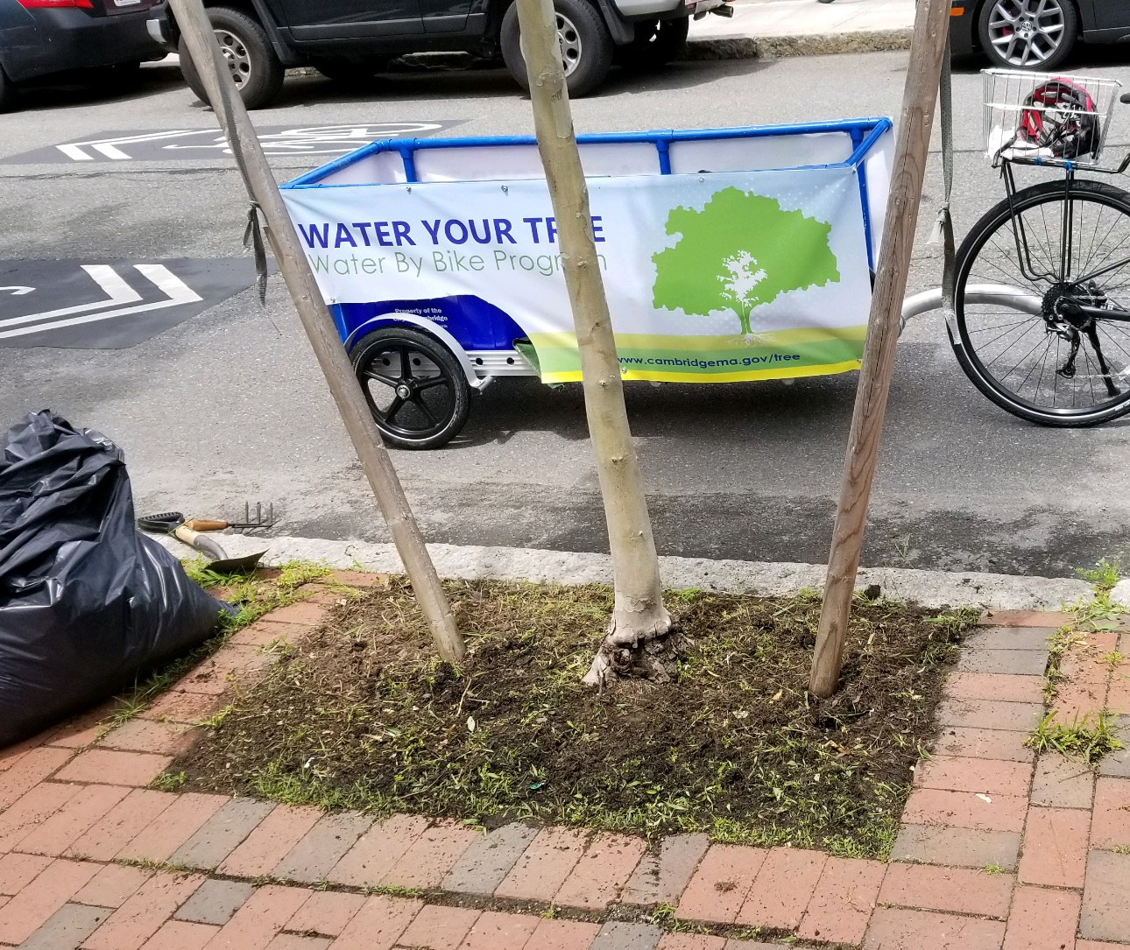
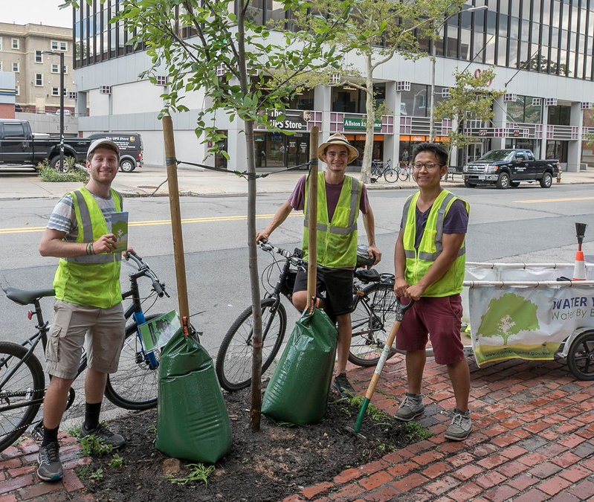
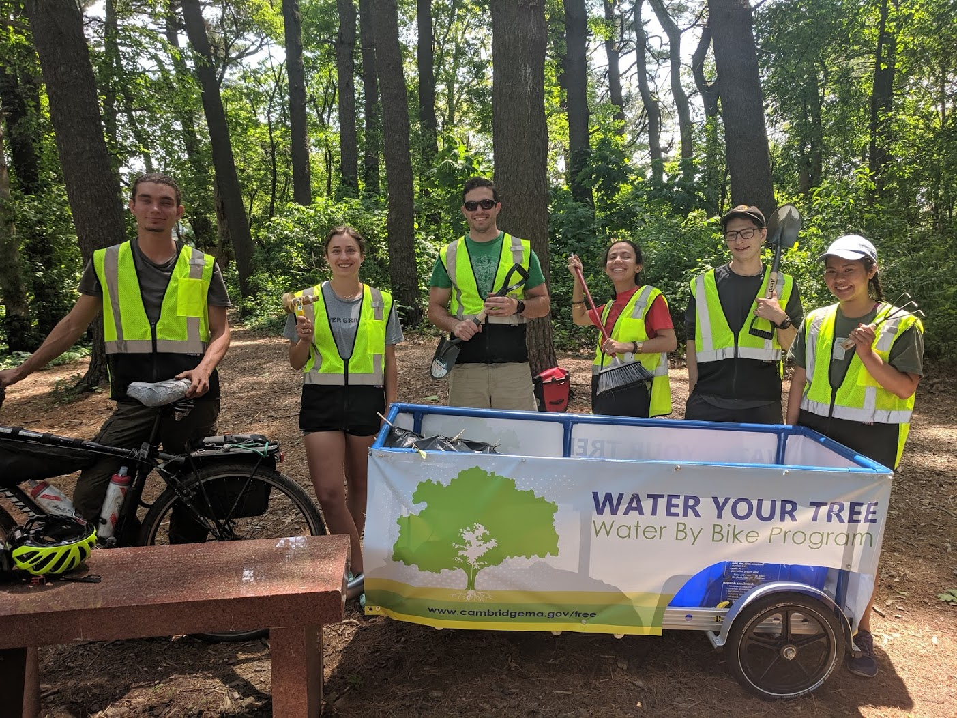
Water By Bike
Commitment to weed and water through full establishment

Slide 19
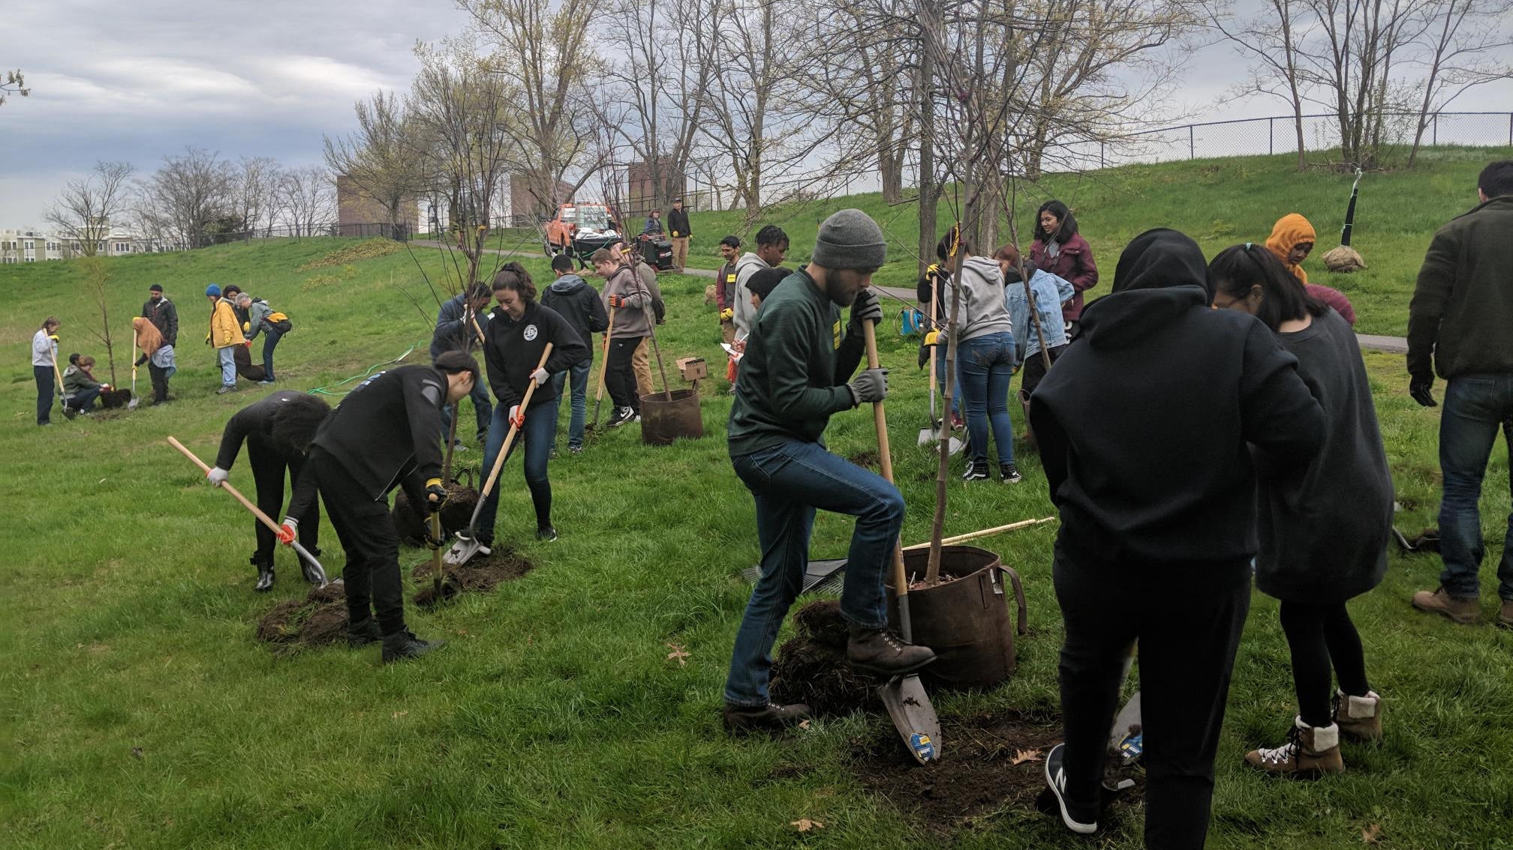
CRLS Student Participation

Slide 20
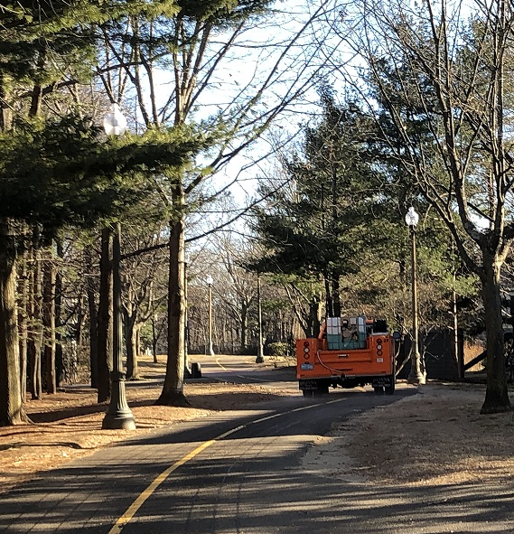
Maintenance Plan Snow Removal
Pre-treat roads with a saltwater solution in advance of a predicted storm
Inhibits the formation of ice
Solution uses a quarter of the salt normally used to treat roads

Slide 21
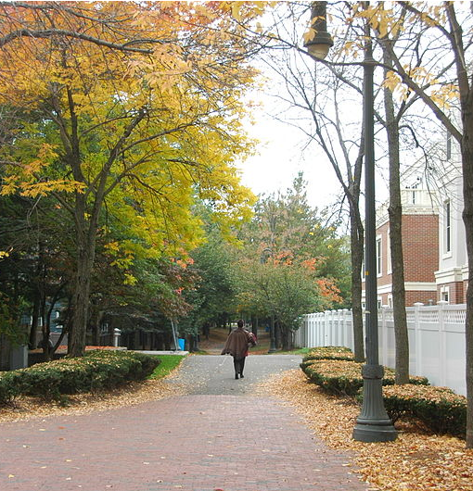
Feedback, Ideas and Questions?
To stay up-to-date via email, please sign in with your email address
For questions after the meeting contact
Kate Riley – Community Relations Manager
617-349-4870
kriley@cambridgema.gov

Slide 22
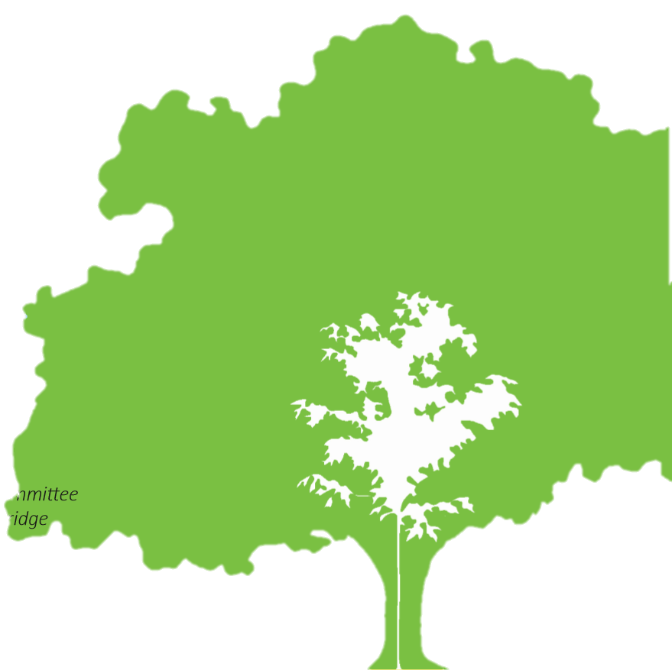
Adopt A Tree Program
I OUR
URBAN FOREST
Residents can sign up online and help a young tree get established through our Adopt-A-Tree program. To learn more, visit:
www.cambridgema.gov/adoptatree

