Slide 1
Cambridge Net Zero Energy Initiative
Net Zero Task Force Presentation
Notes:
Cambridge map

Slide 2
Introduction
Notes:
Break page to separate projects

Slide 3
Context
Net-Zero Definitions
Unique Aspects of Cambridge
Notes:
Break page to separate projects

Slide 4
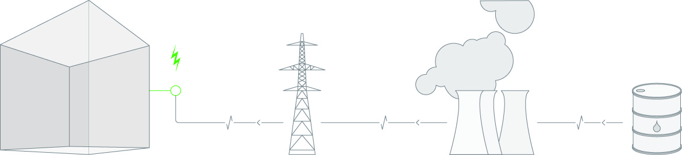

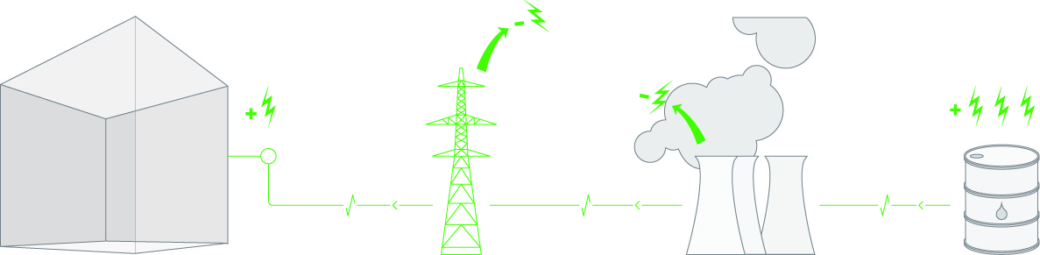

Net Zero Energy Building Definition
Net Zero Site Energy: produces as much as it uses
Net Zero Source Energy: produces as much as
it uses at sources
Net Zero Energy Costs: aims for an annual energy
bill of $0
Net Zero Energy Emission: aims for Carbon Neutral
Notes:
NREL Definitions: Go beyond net zero energy at site, heading to net zero emissions. Academic and institutional clients very interested in emissions (environmental footprint), ultimate carbon impact

Slide 5
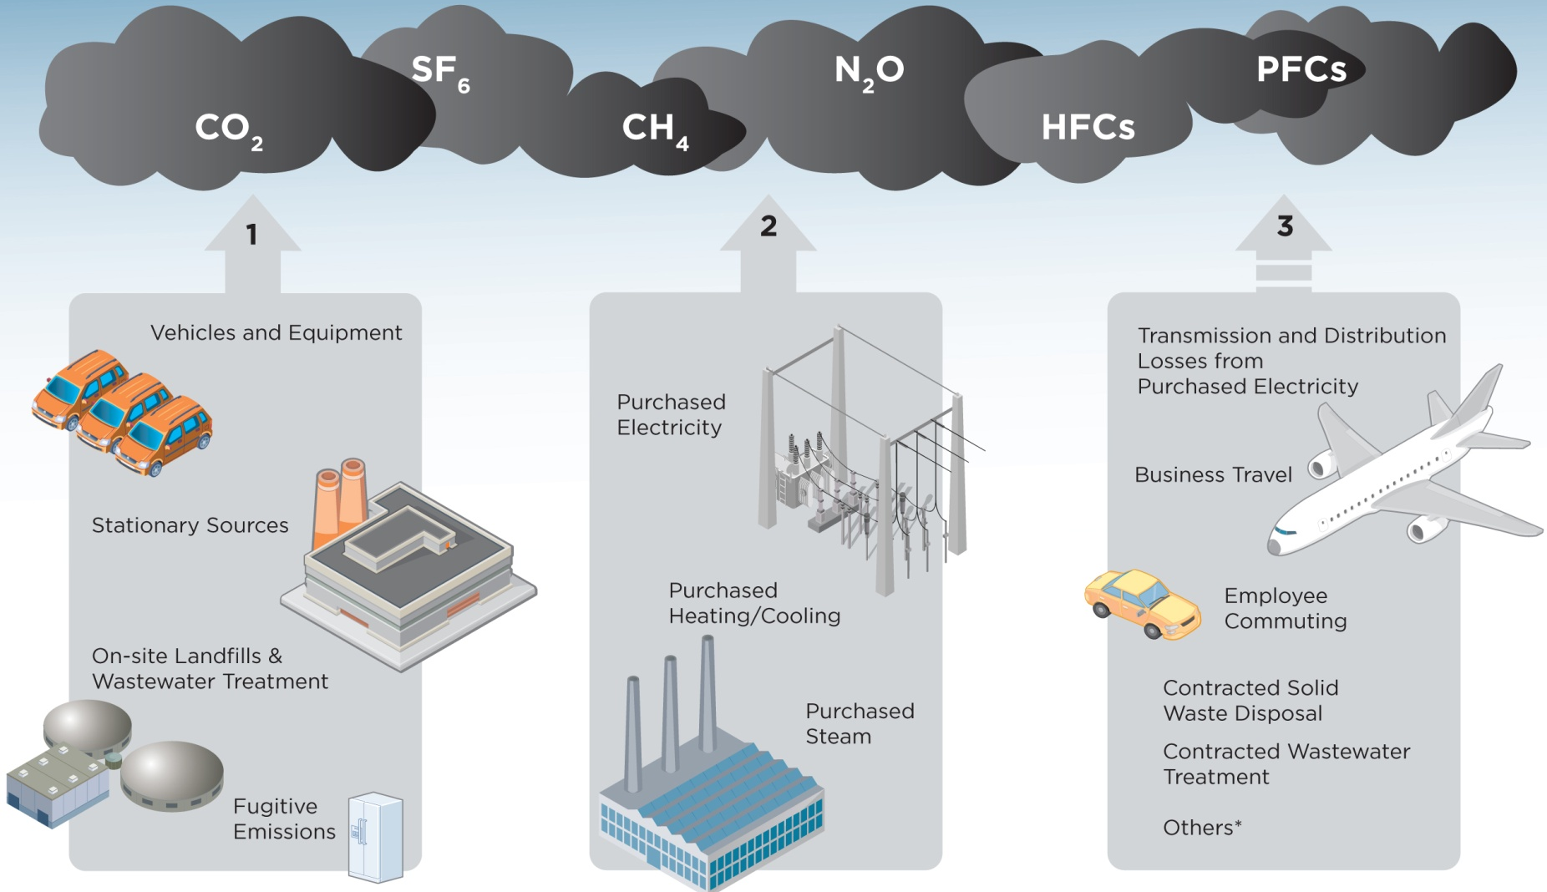
Scope and Carbon Emissions
Scope 1:
Scope 2:
Scope 3:
Greenhouse gas emissions from sources that are owned or controlled by Institute
Greenhouse gas emissions resulting from the generation of electricity, heat, or steam purchased by the Institute
Greenhouse gas emissions from sources not owned or directly controlled by the Institute but related to Institute activities
Notes:
Emissions discussion: Universities and institutions, going beyond NZTF scope to include all Scope 1, 2, and sometimes Scope 3. If concerned about overall environmental footprint, we should look at scope 3 = urban strategy

Slide 6
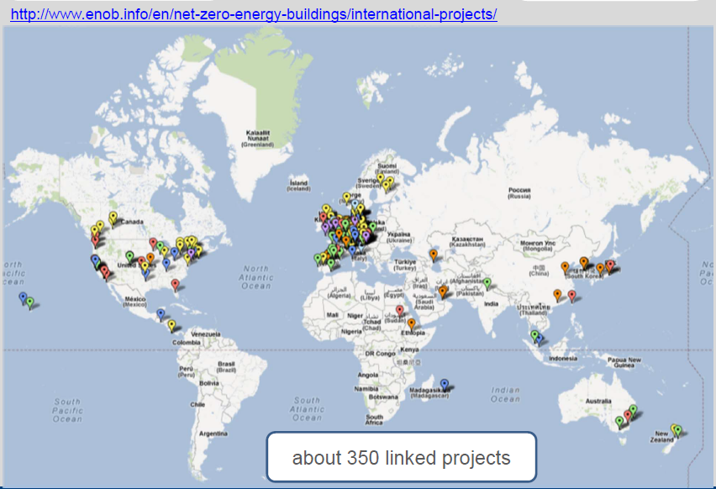
Net Zero Energy Buildings in the World
Notes:
Early Design and Design Development, not commissioning and controls

Slide 7
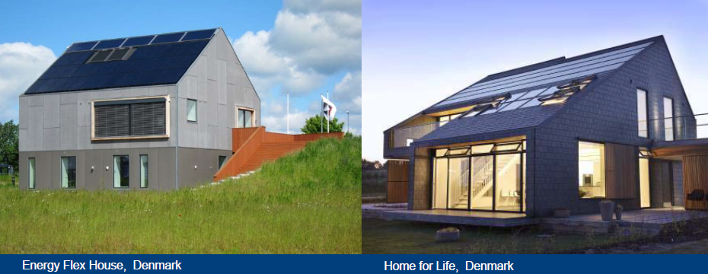
This is how most of them look.
Notes:
Early Design and Design Development, not commissioning and controls

Slide 8
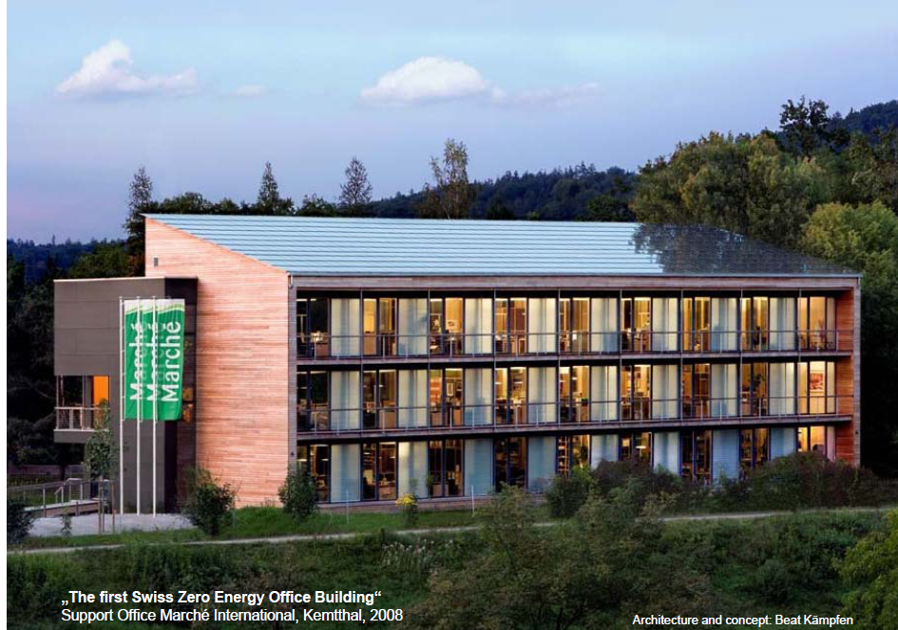
Highest Net ZEB in the world?
Slide courtesy of Karsten Voss
Notes:
Early Design and Design Development, not commissioning and controls

Slide 9
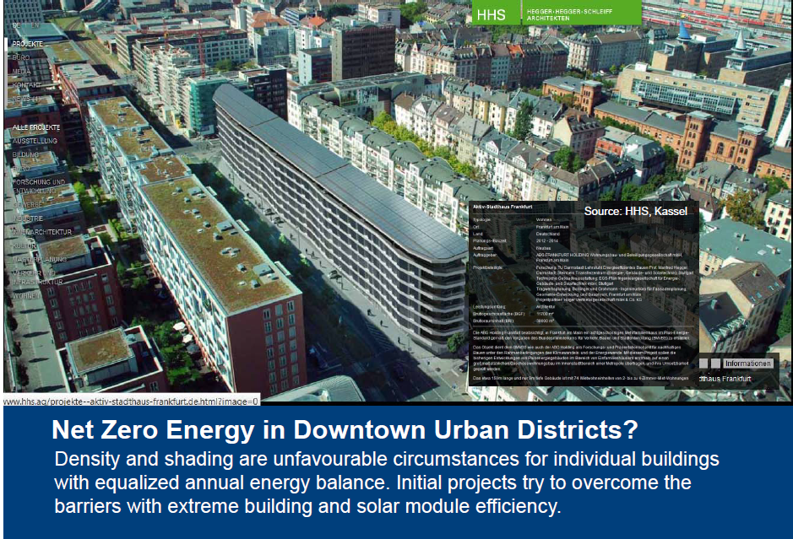
Highest Net ZEB in the world?
Slide courtesy of Karsten Voss
Notes:
Early Design and Design Development, not commissioning and controls

Slide 10

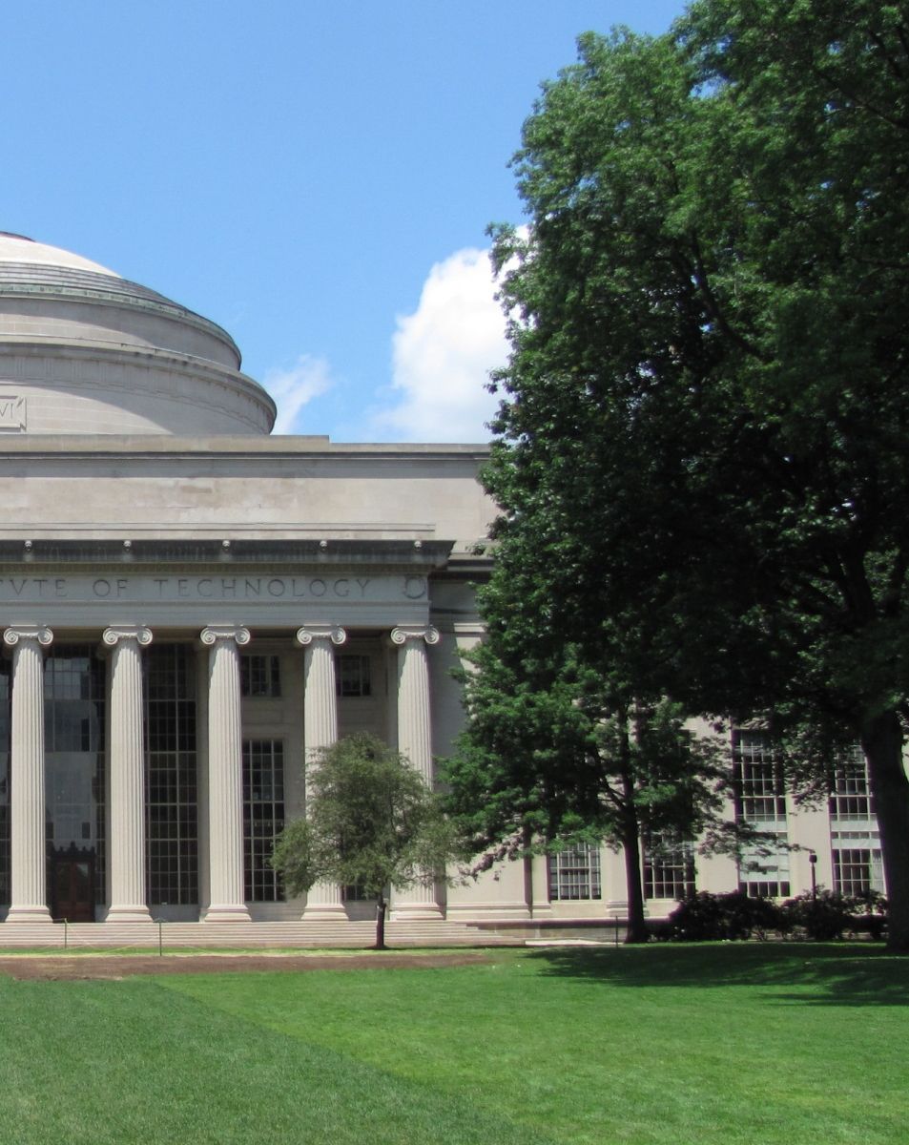
Climate
ASHRAE Design Conditions [2007 standards]
7°F
Winter Design Temperature
88°F
Summer Design Dry Bulb Temp
72°F
Summer Design Wet Bulb
Slide courtesy of Atelier Ten
Notes:
Unique situation for climate – limited in what we can achieve in natural ventilation, compared to climates where it is difficult to get to comfort range

Slide 11
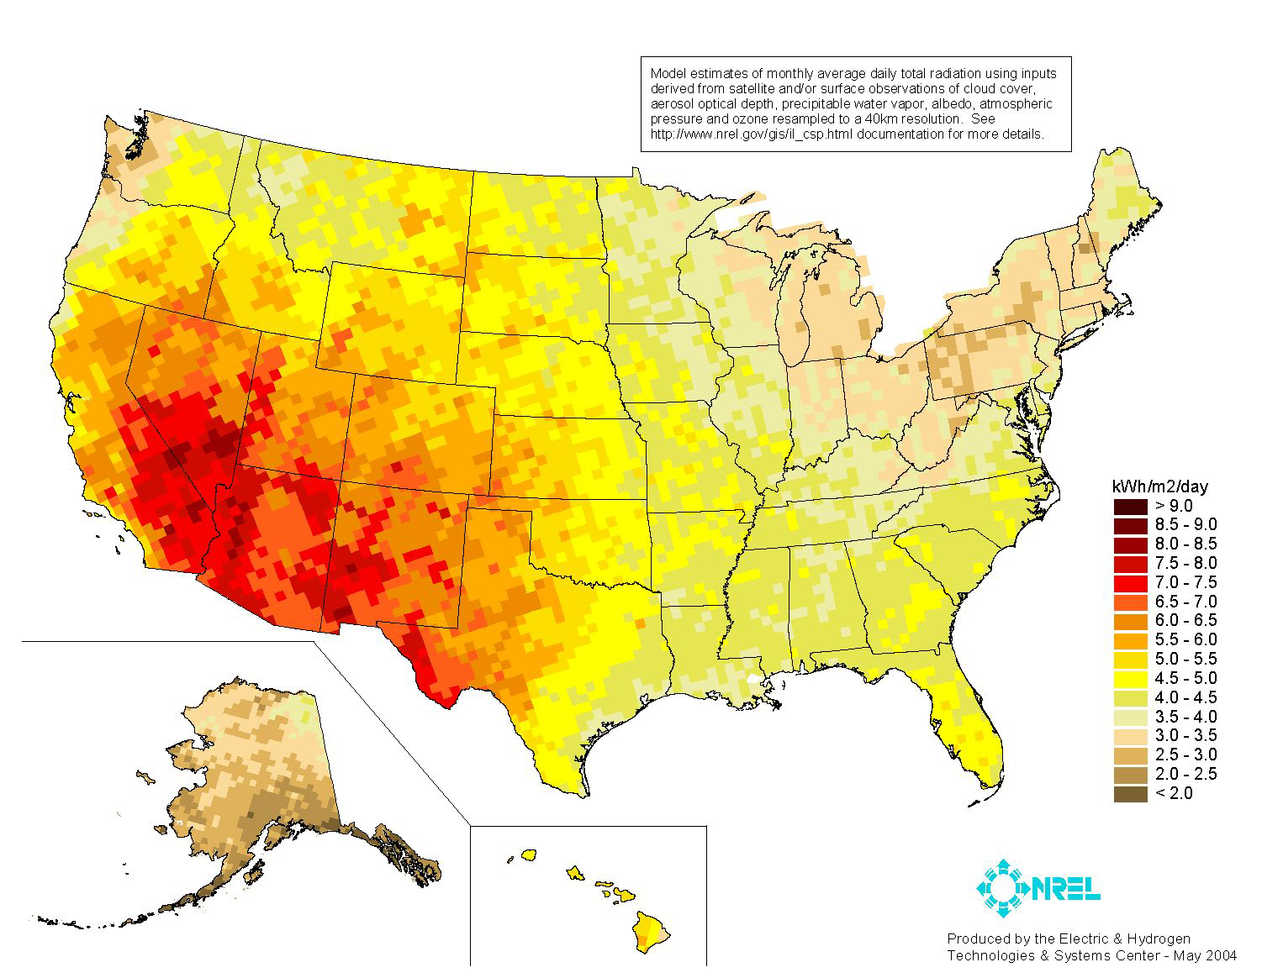
Climate
Annual Direct Normal Solar Radiation
Notes:
Extreme climate makes it difficult and renewables difficult
Heating cooling

Slide 12
Density and Transportation
Cambridge is one of the densest cities in the U.S.
16,400 people/square mile
MODE OF TRAVEL TO WORK (2010)
CAMBRIDGE GREENHOUSE GAS EMISSIONS (2010)
http://www.cambridgema.gov/CDD/factsandmaps/transportationdata/200610jtwtable.aspx
http://www.cambridgema.gov/~/media/Files/CDD/Climate/climateplans/climate_plan.ashx
Notes:
Sample Project Slide

Slide 13













Cambridge Ecosystem
Universities, laboratory, and tech
MassBio shows highest density of life sciences and information technology companies at 163 per square mile, contributing to job growth in Cambridge
Palo Alto with second highest density has 36 tech companies per square mile.
Significant amount of smaller/start-up businesses
Nearly 80% of lease transactions in 2013 were for small-mid size space (<60,000sf)
http://www.cambridgema.gov/CDD/factsandmaps/~/media/602BC67E976542DB841FFB099E91DFB0.ashx
MassBio Organization Report 2013
Notes:
Sample Project Slide

Slide 14
City as a Lab
Cambridge Solar Map
MIT Campus Model
Central Square Case Study
Notes:
Break page to separate projects

Slide 15
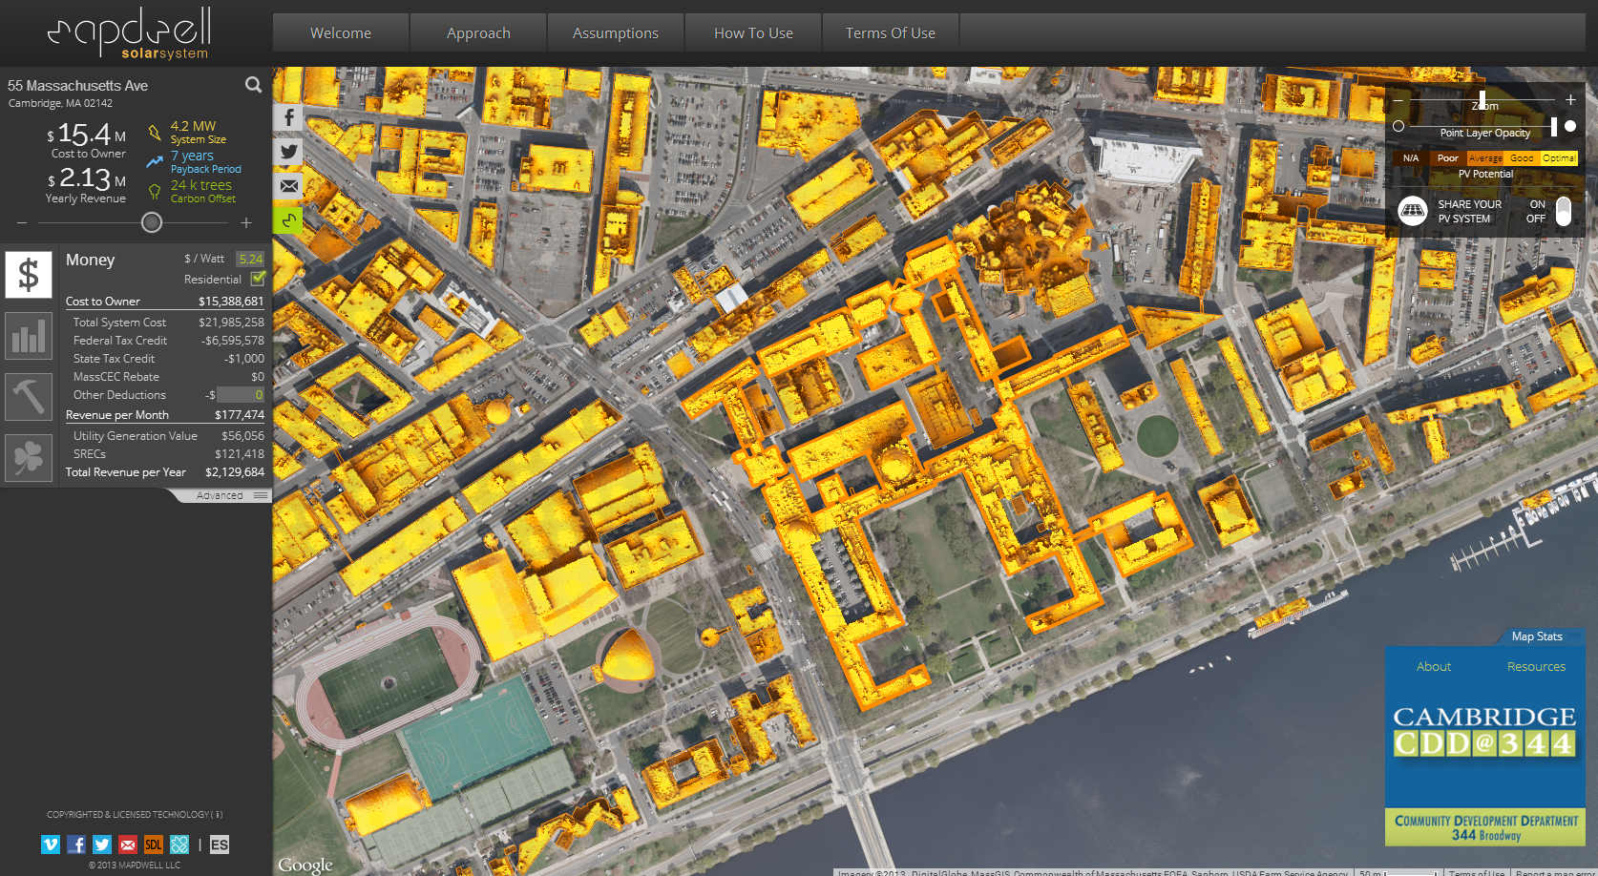

City as a Lab
Cambridge Solar Map
J A Jakubiec and C F Reinhart, A Method for Predicting City-Wide Electricity Gains from Photovoltaic Panels Based on LiDAR and GIS Data Combined with Hourly DAYSIM Simulations, Solar Energy, 93, pp. 127-143, 2013
Massachusetts Institute of Technology
Notes:
Sample Project Slide

Slide 16
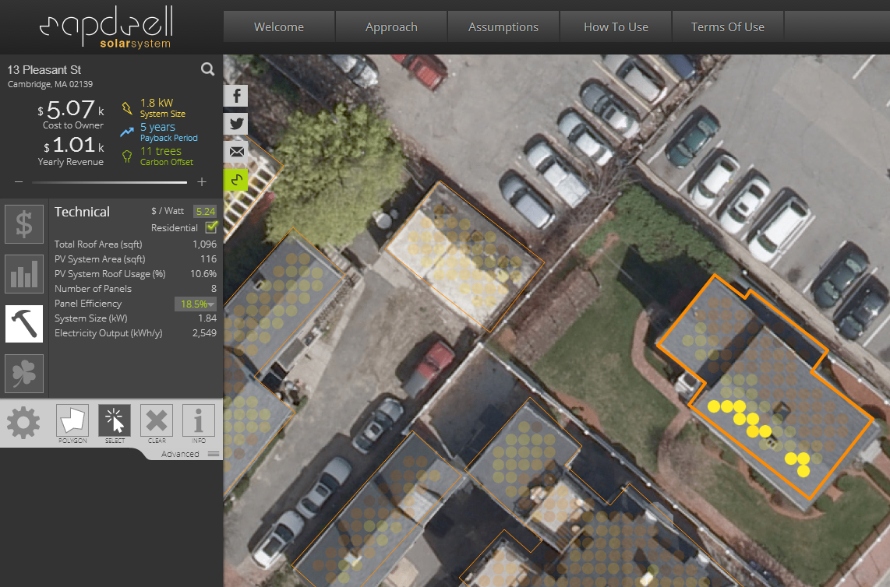
City as a Lab
Cambridge Solar Map
J A Jakubiec and C F Reinhart, A Method for Predicting City-Wide Electricity Gains from Photovoltaic Panels Based on LiDAR and GIS Data Combined with Hourly DAYSIM Simulations, Solar Energy, 93, pp. 127-143, 2013
Massachusetts Institute of Technology
Notes:
Sample Project Slide

Slide 17
MIT Campus Energy Model (in progress)
Class project: Aiko Nakano, Denise Rivas, Manos Saratsis, Julia Sokol
Notes:
Early Design and Design Development, not commissioning and controls

Slide 18
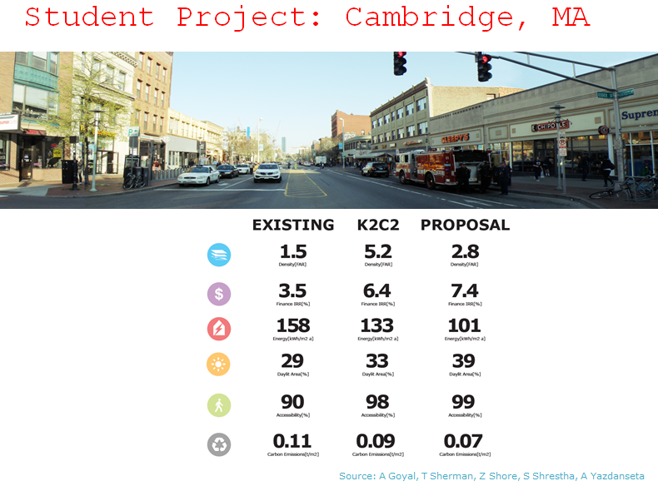

Slide 19
Portfolio
Notes:
Break page to separate projects

Slide 20
Portfolio Approach
Energy efficiency measures and programs
High-performance design standards
On-site renewables
On-site power generation
Laboratory design and protocol standards
Improvements to the grid
Behavioral change programs
Performance metrics
Partnerships with Utilities
Revolving Loan Funds
Notes:
Sample Project Slide

Slide 21
Driving questions
How do we measure and benchmark our performance?
How do we design, build, maintain and operate the most high performance buildings?
How do we create incentives within our institutions?
How do commercial entities work with tenants?
Where do the opportunities for the improvements lie?
How do we generate clean energy?
What is the strategy to address possible questions re: commercial?
Notes:
Sample Project Slide

Slide 22
Harvard University
Notes:
Break page to separate projects

Slide 23


Confronting the Challenge of Climate Change
Notes:
CONTEXT and PRESENTATION OVERVIEW:
Thank you for inviting us to present here today – excited to share our story and talk with you about challenges and opportunities for Cambridge
Look forward to working with this committee and to being a part of this effort to help Cambridge be a leader in addressing climate change in a way that reflects its unique focus on community, research, innovation, and learning.
Today I am here to tell you about Harvard’s strategy for reducing energy and emissions associated with our campus, as one example of how major institutions in Cambridge are confronting this challenge community in Cambridge.
President Faust has made addressing the challenge of climate change an institutional priority, both in research and teaching and in modeling an institutional pathway to a more sustainable future.
Our strategy has been based on
Setting an aggressive goal for reducing emissions and mobilizing the community around the goal
Focusing on energy efficiency first, and targeting high impact areas where we can have the greatest impact

Slide 24
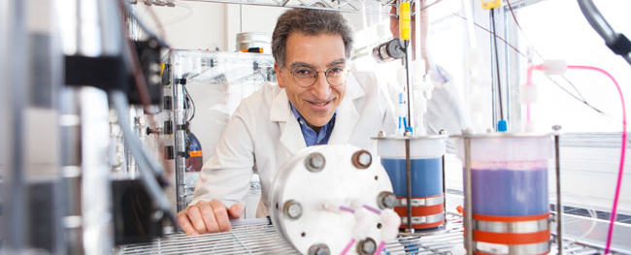
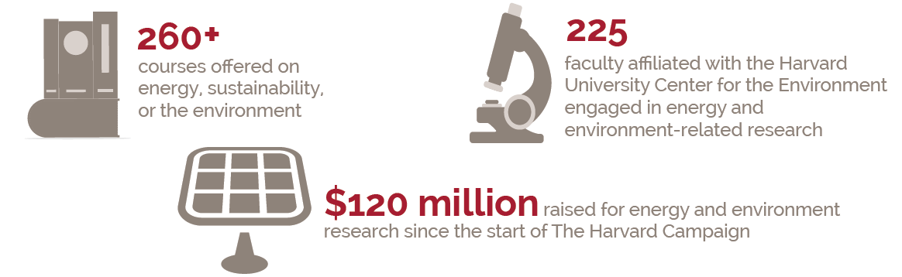
Generating Solutions to Climate Change
Notes:
Our primary mission is discovery and generating solutions across disciplines – and of course this will be our (as university) largest contribution to this global challenge.
For example - our engineering school has developed new battery technology that could allow for adoption of renewable energy on a much larger scale (Michael Aziz, Roy Gordon, Alan Aspuru-Guzik, SEAS)
The University is also expanding its research in this area – for example the recently launched Harvard Center for Green Buildings and Cities is going to push the envelope for high performance buildings and cities.

Slide 25
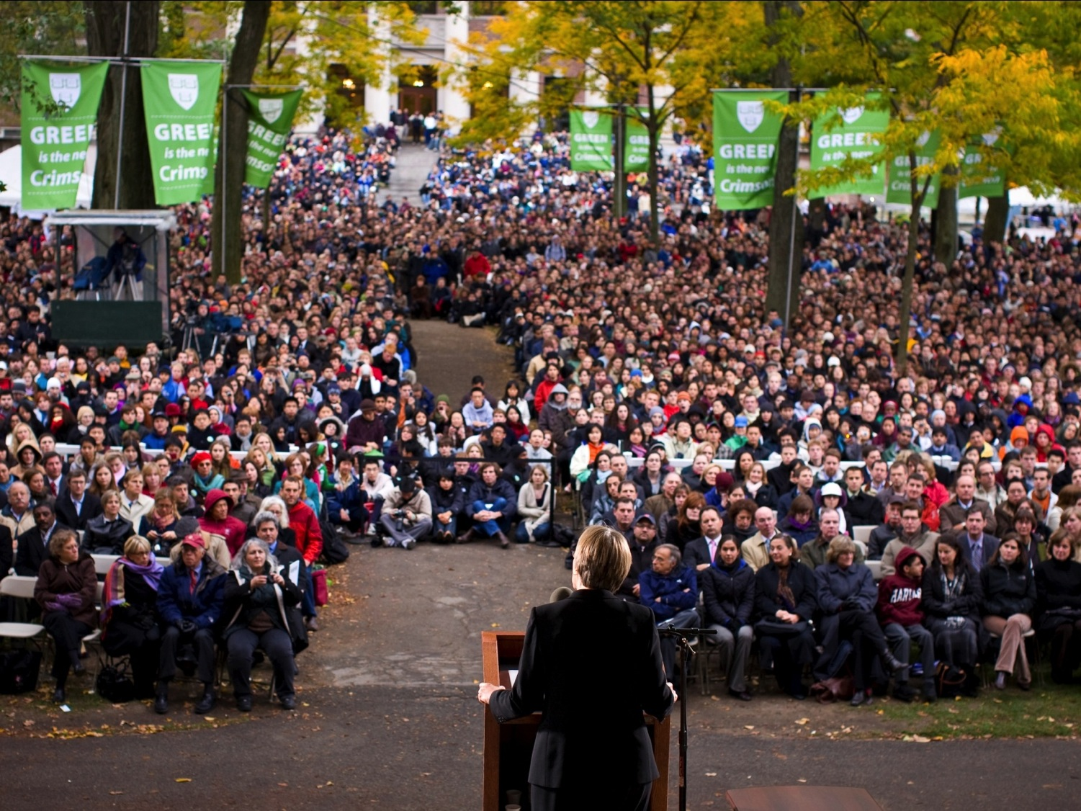
Goal: Reduce greenhouse gas emissions 30% by 2016, including growth, from a 2006 baseline
Notes:
In 2008 we set an aggressive short term institutional goal to reduce GHG emissions 30% by 2016 from a 2006 baseline, including growth and renovation and a long term goal to reduce emissions to the maximum practical rate.

Slide 26
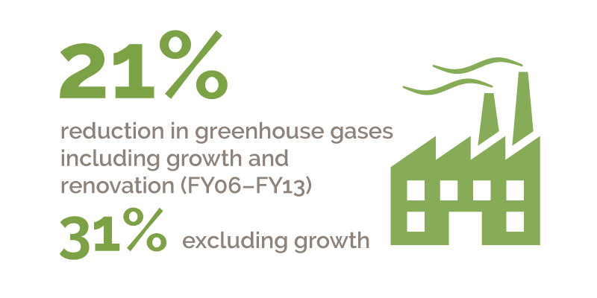
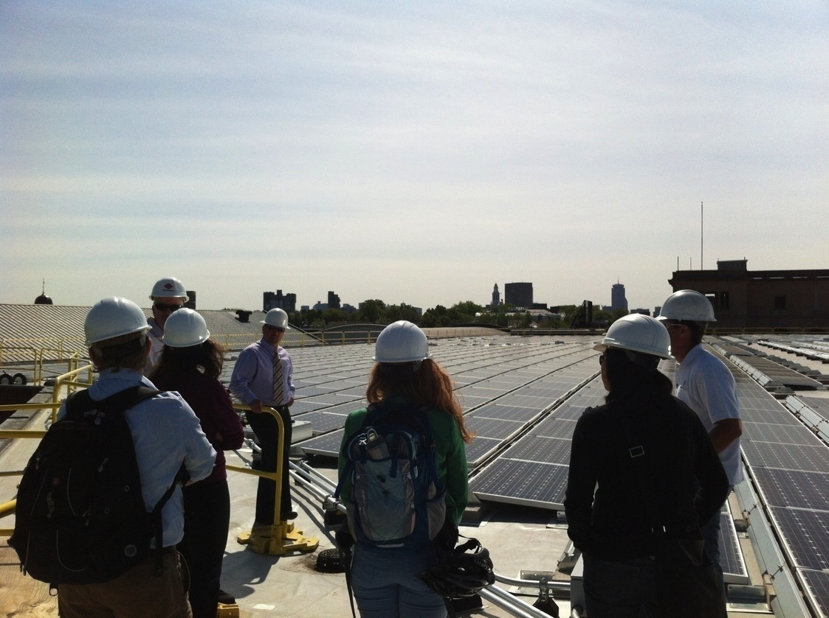
Notes:
To date we have reduced emissions 21% despite growth in square footage and re-purposing of existing space for more energy-intensive research or teaching needs.
Excluding growth in square footage this reduction would be 31%.

Slide 27
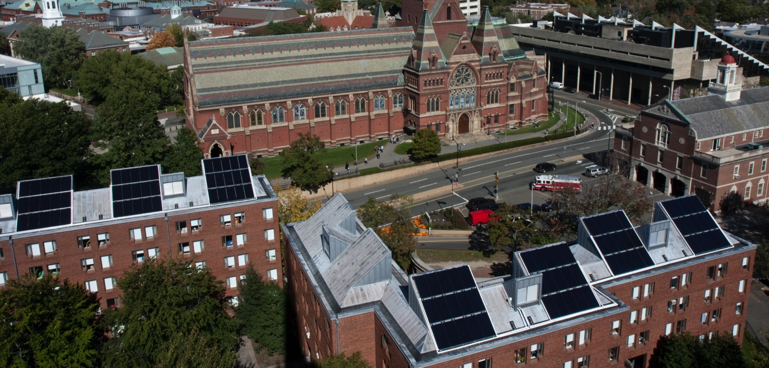
Greenhouse Gas Reduction Strategy
Institutionalize GHG planning
Maximize building efficiency
Green our energy supply
Target energy intensive sectors

Slide 28
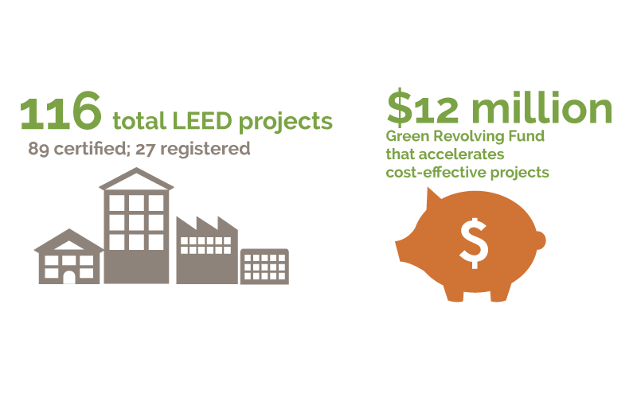
Institutionalize GHG Reduction
GHG/ECM integrated into 5-year capital planning
Financial framework – LCC and Green Revolving Fund
Green Building Standards
Comprehensive inventory and reporting
Notes:
- Over the past 5 years we have been working hard to integrate GHG emissions and energy planning established business practices.
For example:
We worked with the central finance office, Planning and Project Management, and School CFO’s to integrate GHG and energy planning into the 5 year capital planning process.
This ensures that emissions and long term energy costs are evaluated as part of capital planning and not just in the operations departments.
As part of this process, we developed a financial framework for assessing energy conservation projects, including a clear Life Cycle Costing tool and our Green Revolving Fund that provides a financing option.
And since 2009 we have had Green Building Standards for large projects, smaller renovations, and small fit-outs – these require LEED Gold – but more importantly require ADD FROM WEBSITE or CORP PPT

Slide 29
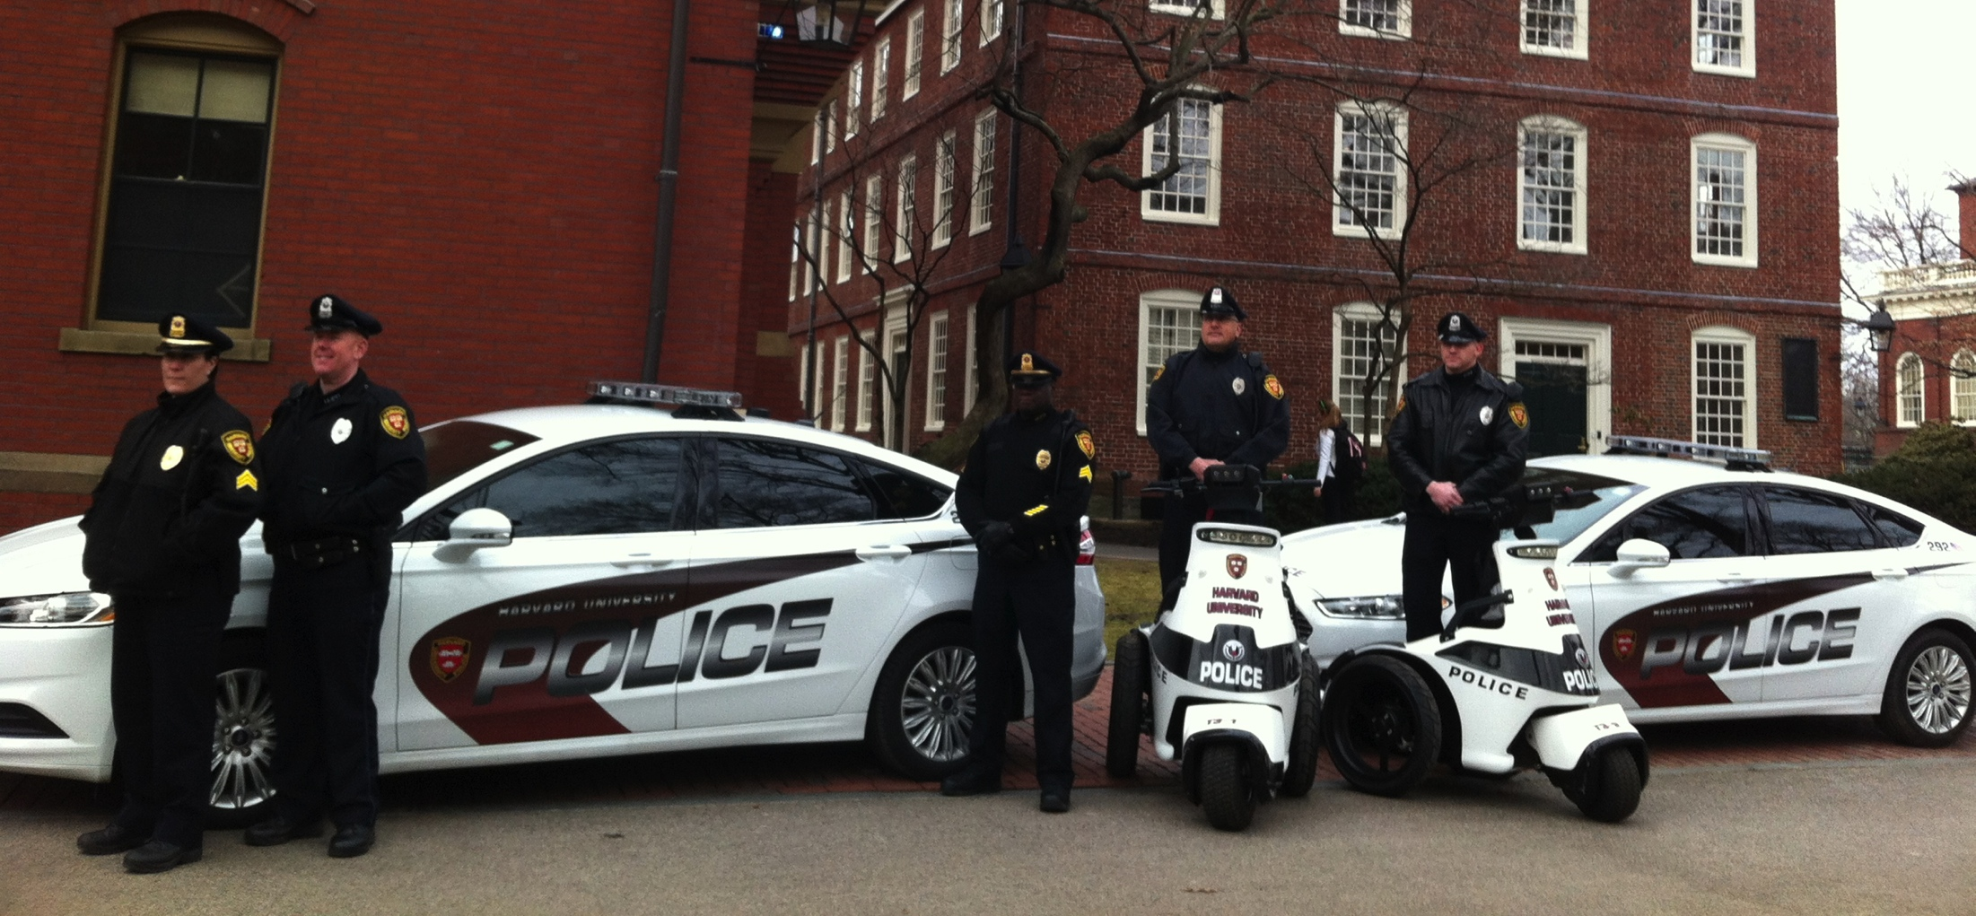
Institutionalize GHG Reduction
Green Building Standards
Financial framework – LCC and Green Revolving Fund
GHG/ECM integrated into 5-year capital planning
Comprehensive inventory and reporting
Notes:
- Over the past 5 years we have been working hard to integrate GHG emissions and energy planning established business practices.
For example:
We worked with the central finance office, Planning and Project Management, and School CFO’s to integrate GHG and energy planning into the 5 year capital planning process.
This ensures that emissions and long term energy costs are evaluated as part of capital planning and not just in the operations departments.
As part of this process, we developed a financial framework for assessing energy conservation projects, including a clear Life Cycle Costing tool and our Green Revolving Fund that provides a financing option.
And since 2009 we have had Green Building Standards for large projects, smaller renovations, and small fit-outs – these require LEED Gold – but more importantly require ADD FROM WEBSITE or CORP PPT

Slide 30
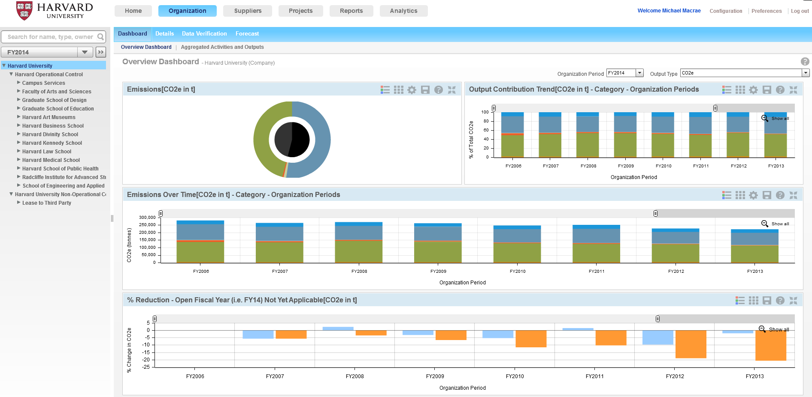
GHG Inventory Management System
Notes:
Screen shot of the greenhouse gas inventory to showcase how important reporting and data tracking is – JO to add more here
- Good data is critical for making good decisions
- Reporting at all levels – for building managers to make smart decisions, report to the public, senior leadership, etc.

Slide 31
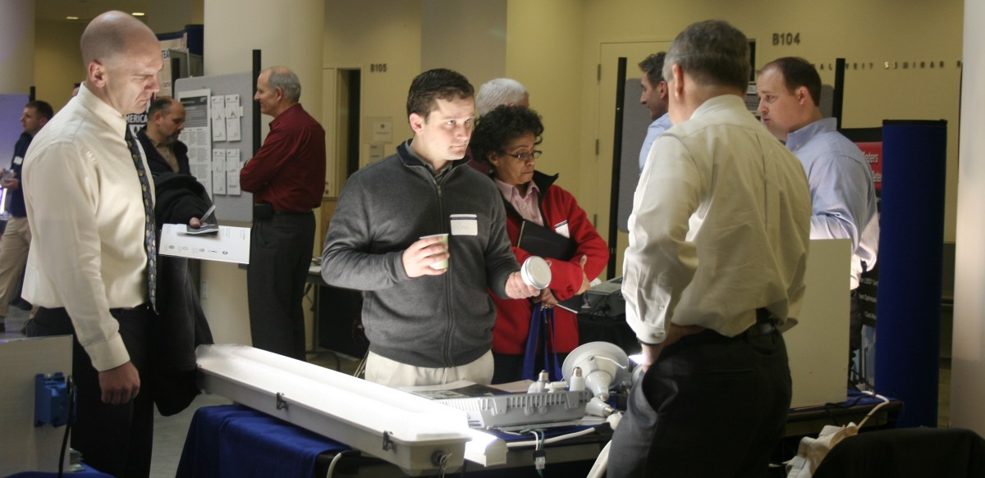
Maximize Building Efficiency
Energy audits on all energy intensive space
Exhaust all cost-effective energy efficiency opportunities
Optimize performance of existing buildings
Notes:
This means…..
Energy audits on all energy intensive space
Exhaust all cost-ef…..
For Harvard, a working group of faculty and staff thoughtfully developed a definition of what we consider “cost-effective” projects in order to streamline decision-making around implementation. Each school is committed to implementing all projects that meet this criteria – which is based on “net present value” of money (escalation, discount) – but in layman’s terms amounts to approximately all projects that have a 10-11 year payback or less.
Behavior Change
Optimize performance of existing buildings with continuous commissioning and other strategies

Slide 32
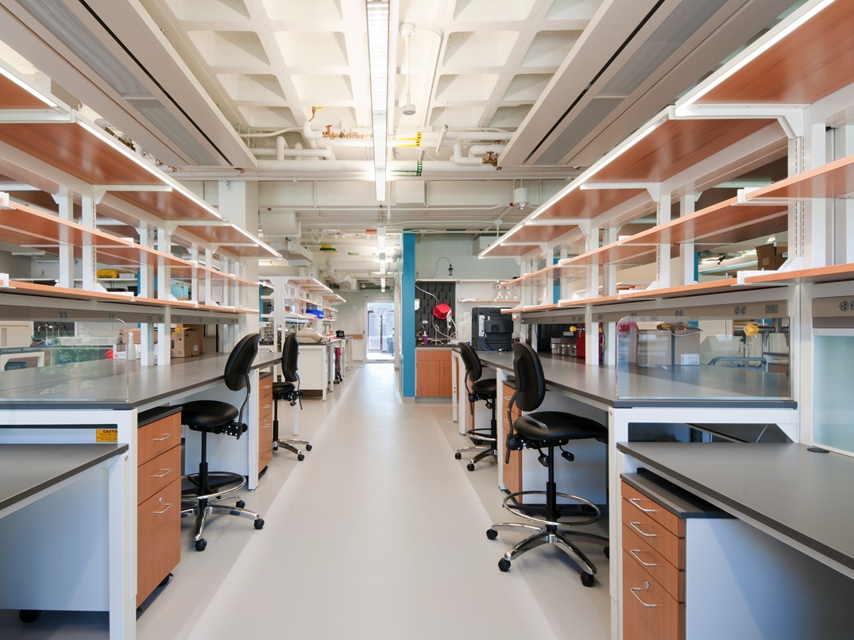
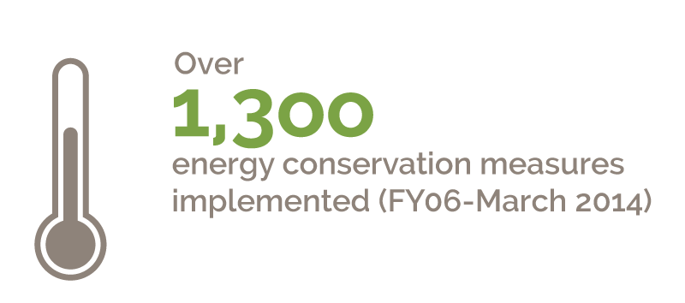
Notes:
To date – over 1,300 ECMs have saved an estimated $9 million a year.
Examples:
Commissioning projects at Northwest Labs and the Laboratory for Integrated Science and Engineering (LISE) building HAVE SAVED $3.15 million since 2009.

Slide 33
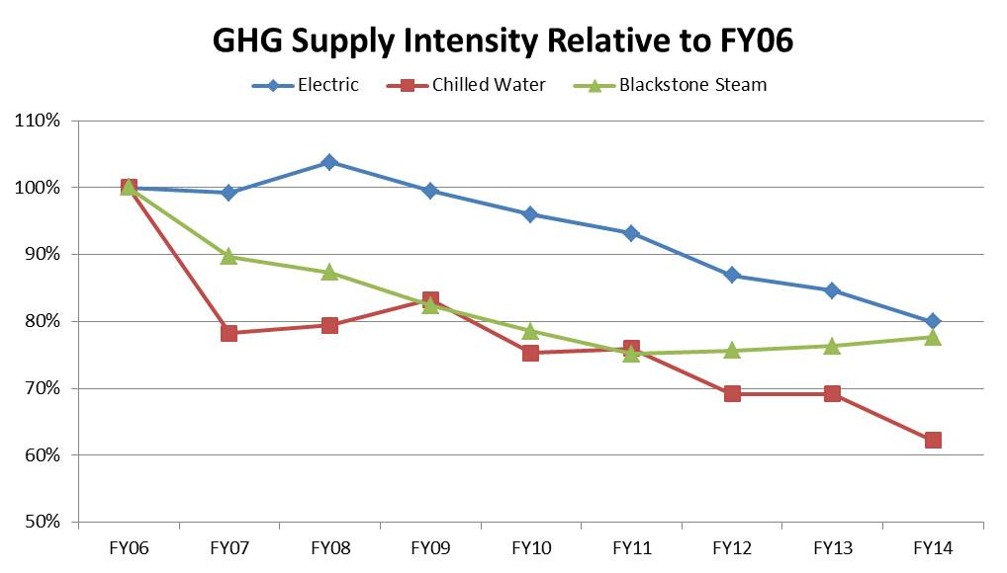
Transition to a Cleaner Energy Supply
28% of progress in meeting GHG goal from fuel-switching at Steam Plant
Notes:
Looking at our energy supply has been a critical component of our strategy from the beginning – I will not focus on this today since the MIT team is focusing on these areas, but I want to make sure it is clear that our overall strategy includes both efficiency and supply.
Almost a third of our way to achieving the goal has been realized from fuel-switching to natural gas at the Blackstone Steam Plant.
An existing co-generation unit and boiler to date have further reduced MTCDE. A planned co-generation unit would further reduce emissions.
In addition, 17% of Harvard’s electricity comes renewable energy sources, mostly to meet state regulatory requirements, plus 1MW of installed solar photovoltaic panels on campus, including on roof of Canaday Hall and Gordon Indoor Track and Tennis Center.

Slide 34
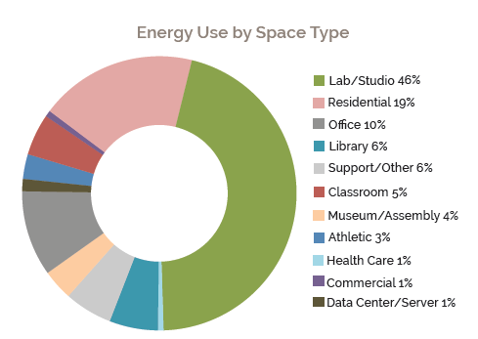
Target Energy Intensive Sectors
Notes:
4th piece of our strategy is to target energy intensive sectors
Labs are 46% of our energy use and only about a quarter of our square footage
Residential is the second largest use type – which highlights the importance of our occupant engagement and behavior change campaigns with the students
Since 2002 electricity use in houses is down XXXXXX%

Slide 35
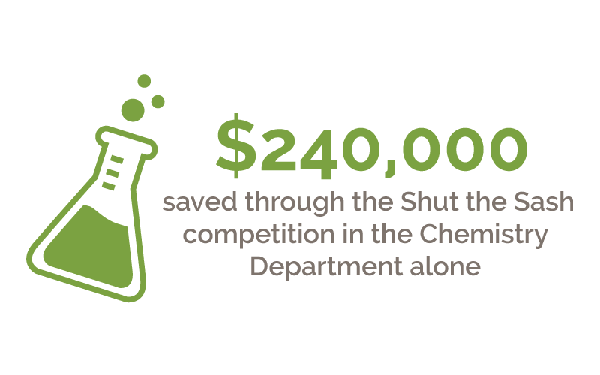
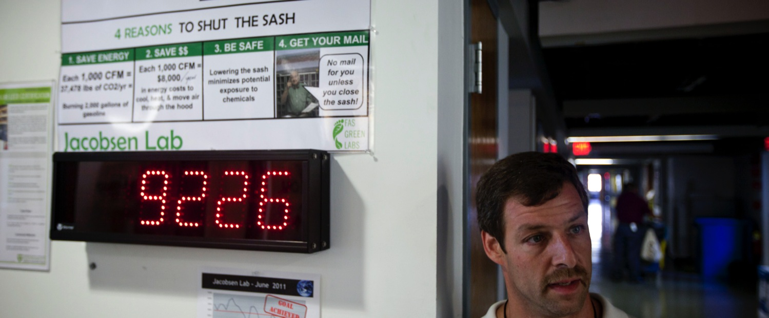
Green Labs Initiative
Notes:
In addition to these efforts we’re working with our community to target our most energy intensive sectors – labs and research computing. Our strategy has focused on a few key areas beyond lab renovations and fume hood upgrades:
Some of our biggest successes (and future opportunities) have been a combination of behavior and technology projects such as Shut the Sash and Freezer management programs.
Labs remain a huge opportunity and challenge for us.

Slide 36

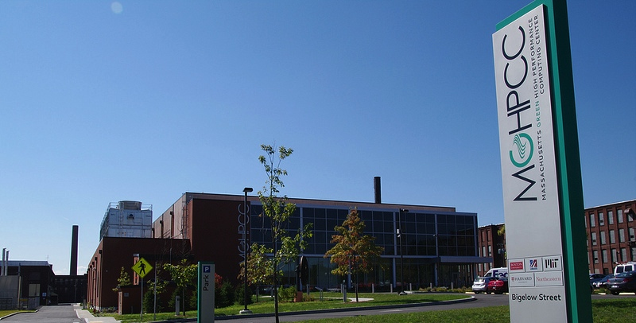
MA Green High Performance Computing Center
A joint initiative: Boston University, MIT, Harvard,
Northeastern, U Mass
90,000 square foot, 10 MW state-of-the-art research computing center
Notes:
The MGHPCC is an excellent example of how a community partnership can have a big impact
Five of the most research-intensive universities in Massachusetts partnered to build a super efficient high capacity green hpcc….: BU, Harvard , MIT, Northeastern and U Mass).
OTHER NOTES – I’m NOT PLANNING TO TALK ABOUT
November 2012, located on an 8.6 acre former industrial site in Holyoke, MA.
Machine room contains infrastructure needed to house 10, 000 high-end computers (computationally intensive research).
The measure of energy efficiency for data centers is the Power usage effectiveness ( or PUE) is a measure of how efficiently a data center uses energy; specifically, how much energy is used by the computing equipment (in contrast to cooling and other overhead). Harvard’s existing data centers are ~2, and, this one after a year of data is operating @ about 1.5. Stanford ‘s PUE for datacenters is 1.8 a “very good” rating by the industry.
You may have heard of the recent finding by a Harvard-led group of researchers that found evidence of the big bang – so-called cosmic inflation. That team was one of the first research groups to use the Harvard cores at this super-efficient facility. Of the 5.1 million CPU hours used, close to 3 million were computed at MGHPCC.

Slide 37
BioMed Realty
Notes:
Break page to separate projects

Slide 38
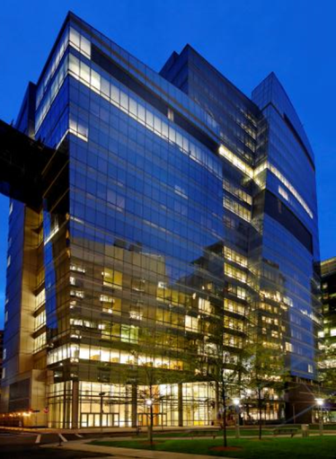
Sub Metering
Supporting best practices for operating research labs at the Center For Life Science Boston
Supporting best practices for OPERATING research LABS AT THE
CENTER FOR LIFE SCIENCE BOSTON

Slide 39
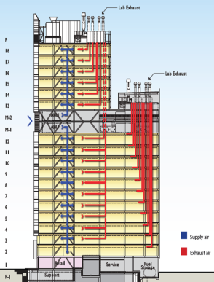
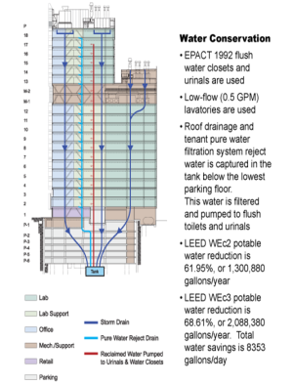
Supporting best practices for OPERATING research LABS
Greenhouse Gas Reduction Strategy
Initial design program to LEED Gold with common lab services including supply and general exhaust air
704,017 SF of high density research lab space covering 18 floors
Tenants composed of institutions BIDMC, Children’s Hospital Boston, Wyss Institute, Pfizer and Kowa
All shared base building services are heavily sub metered to provide clarity on consumption to each user
Delivered in 2008 benchmarked against ASHRAE 90.1-1999 with a 30% plus reduction in energy for a design cost baseline of $7.66/SF
All storm and condensate water from the building is recaptured and used by the building’s grey water system to support restrooms
CENTER FOR LIFE SCIENCE BOSTON

Slide 40
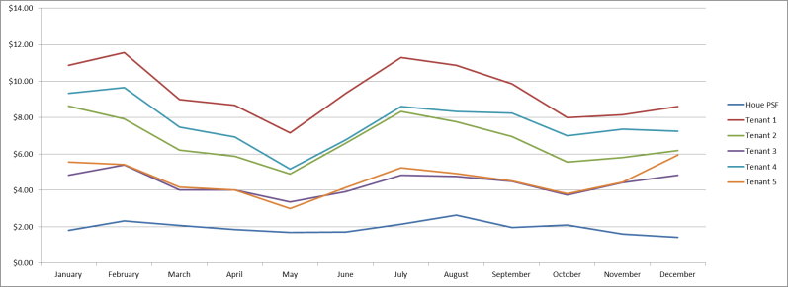
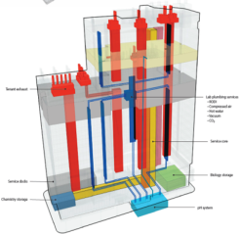

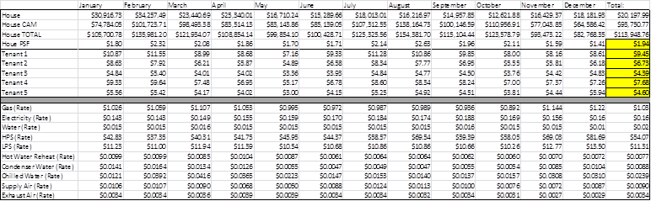
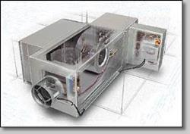
Benchmarking Lab Operations Annually
Integral to shared lab services program was the notion of metering consumption by tenant
Measuring base building services consumed by tenant allowed each user to benchmark operating expenses year to year by lab and across labs in other buildings
User’s first focus was on ensuring lab zones were fully operational and able to operate at peak load
Second focus was on how to operate at stable, efficient levels
Availability of clean data provided basis for investment in operational improvements including Aircuity
Ability to operate at reduced airflows but with access to additional capacity was critical
CENTER FOR LIFE SCIENCE BOSTON

Slide 41
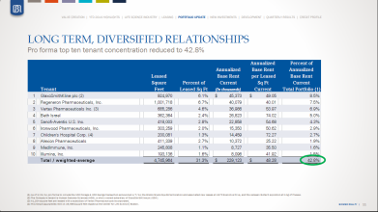
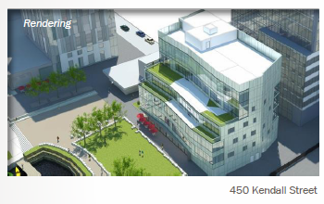
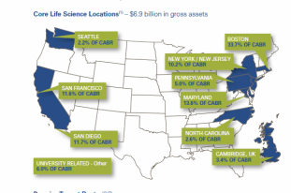
Supporting Best Practices for
Operating Research Labs
Biomed realty’s cambridge portfolio

Slide 42
Alexandria
Notes:
Break page to separate projects

Slide 43
MIT NZE Cogen & Efficiency Forward
Notes:
Break page to separate projects

Slide 44
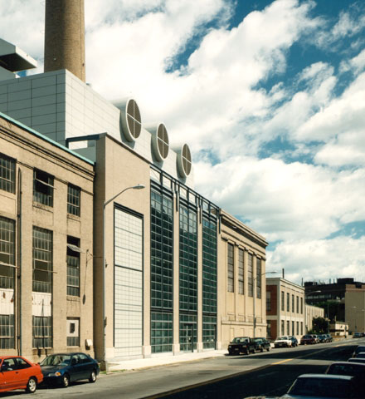
History of Decarbonization of Campus Grid
Central CHP Plant begins operation
electricity
electricity
electricity
oil no.2/6
coal
oil no.6
natural gas
natural gas
natural gas
32% GHG reduction (60,000mt) and regulated pollutants by 45%
Notes:
Sample Project Slide

Slide 45
Central Plant & Grid Supply
GRID
BUILDINGS
ELECTRICITY
OIL
ELECTRICITY
CENTRAL
UTILITY
PLANT
CHILLED WATER
CUP-
CONNECTED
GAS
STEAM
ELECTRICITY
STAND-
ALONE
GAS
Notes:
Sample Project Slide

Slide 46
Central Plant & Grid Supply
GRID
BUILDINGS
ELECTRICITY
OIL
ELECTRICITY
CENTRAL
UTILITY
PLANT
CHILLED WATER
CUP-
CONNECTED
GAS
STEAM
ELECTRICITY
STAND-
ALONE
GAS
Notes:
Sample Project Slide

Slide 47
2010-2012
21M kwh more 2013-15

Slide 48
Efficiency Forward: By the Numbers
Funds invested in Efficiency Forward projects over 3 years: $11,649,139
Operational savings over 3 years: $2,540,763
More than 20,000 metrics tons of CO2 reduced annually– that’s about the same as the emissions from the electricity use of 3,000 homes for one year
Calculations show that the cost of each Efficiency Forward project will be recouped through energy savings within 1-6 years
Note: CO2 calculated with national emission rate, New England 2009 EGrid rate is 60% of the national.

Slide 49
Campus Energy Delivered to Buildings
Avoided

Slide 50
How do we scale up that which is already taking place?
Notes:
Break page to separate projects

Slide 51
Portfolio Approach
Energy efficiency measures and programs
High-performance design standards
On-site renewables
On-site power generation
Laboratory design and protocol standards
Improvements to the grid
Behavioral change programs
Performance metrics
Partnerships with Utilities
Revolving Loan Funds
Notes:
Sample Project Slide

Slide 52
How can the City of Cambridge enable us to accomplish that which we cannot do today e.g. regulatory; incentives?
Notes:
Break page to separate projects

Slide 53
How do we leverage the power of these collective institutions towards reduced emissions and increased efficiencies?
Notes:
Break page to separate projects

