Slide 1
NZTF October 8th
Residential Sector & Initial Prioritization
By Dave Ramslie MSc, MCIP RPP LEED AP
Principal, Integral Group
October 8th 2014

Slide 2
Agenda
October 8, 2014
6:00 pm Welcome & Takeaways from the Sept. 23rd Net Zero Public Forum
6:05 pm Presentation by Caitriona Cooke, Program Director, Conservation Services Group:
· Single family housing barriers & opportunities
6:20 pm Presentation by Jane Carbone, Director of Development, Homeowners Rehab:
· Multi-family housing barriers & opportunities
6:35 pm Presentation by Harvey Michaels, Energy Efficiency Lecturer & Research Scientist, MIT:
· Response to residential sector actions
6:50 pm Q&A
7:05 pm Review results of prioritization exercise
· Discussion to determine approach for big / complex actions
7:45 pm Public Comment & Next Steps
8:00 pm Adjourn

Slide 3
The Present, Issues, Opportunities, and the Future for Multifamily Buildings
Cambridge Zero Energy Task Force
Notes:
Alternate title, Past, present, and future – what is most relevant to NZE!!!
Check out tax incentives for ETO – bld owners must
ACEE MF programs – NJ MF DER award winning program
SecuriSync – check our report Adam sent – Apartment hunters

Slide 4
The Present
Mass Save Multifamily (MF) Program is good, improvement is always possible
PROGRAM | AUDITS | UNITS SERVED
HES 1-4 (2014 to date) | 1,291 | 264
Multifamily (2013 – to date) | 1236 | 362
Notes:
1236
362

Slide 5
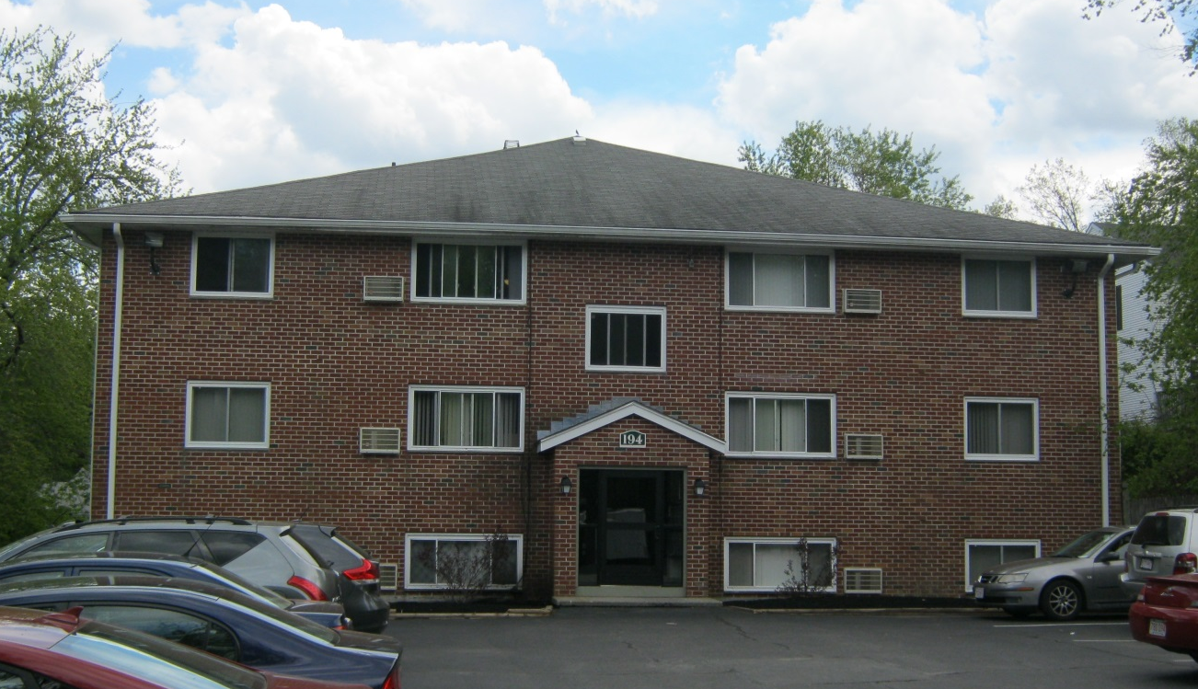
Case Study: Mass Save MF Program
16,200 sf, 18 units

Slide 6
Incentives and Savings – All Measures
Total Project Cost: | $142,911
Total cost to owner: | $2,646
Annual savings @ $0.14/kWh: | $28,222
Payback: | ~1 Month

Slide 7
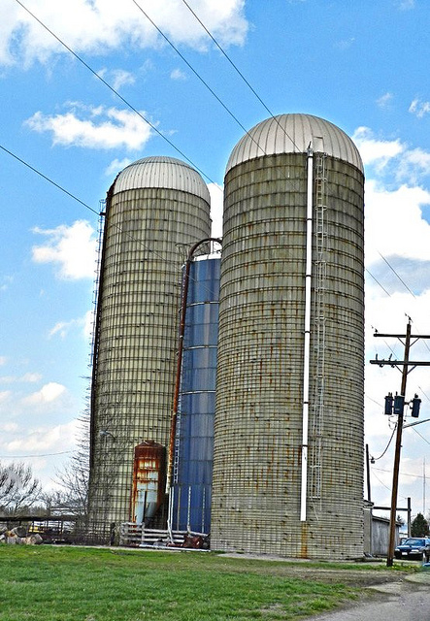
Commercial
Residential
Don O’Brien https://creativecommons.org/licenses/by/2.0/

Slide 8
Owner Pays
Tenant Saves
???

Slide 9
Currently – Measure Based
No savings = No incentives
Lighting
Insulation
High Efficiency HVAC
Ventilation?
Maybe Not

Slide 10
Performance Approach
Lighting $25K
Insulation $45K
High Efficiency HVAC $20K
Ventilation ($15K)
$75K

Slide 11
The Future Energy Efficiency and Beyond

Slide 12
Opportunities
“Things that are measured tend to improve” John Kenneth Galbraith
Benchmarking
More emphasis on performance
All New Construction NZE
Existing buildings - Deep Energy Retrofit

Slide 13
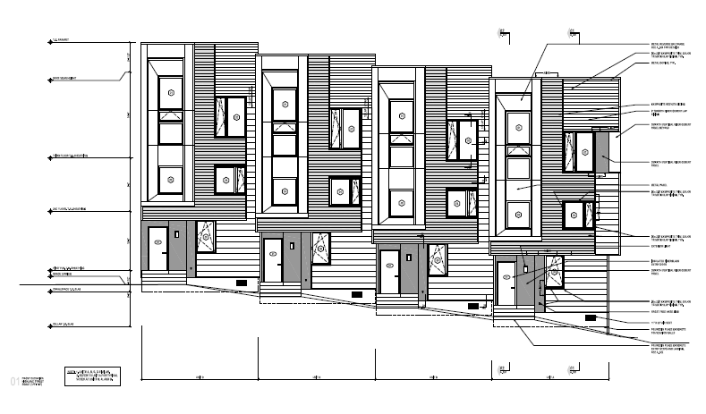
Net Zero Energy New Construction

Slide 14
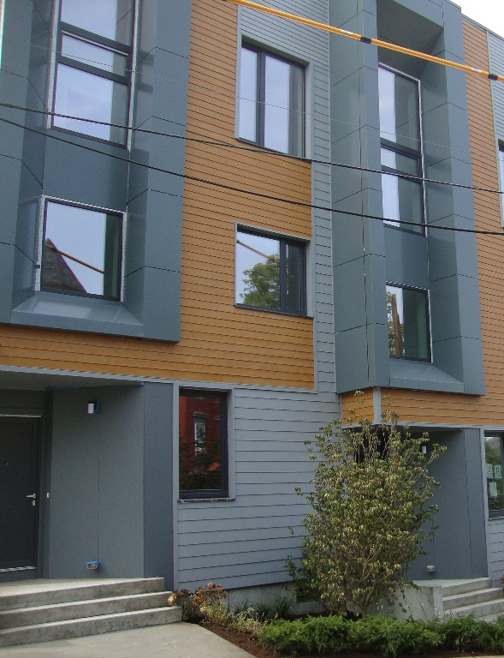
Net Zero Energy New Construction

Slide 15
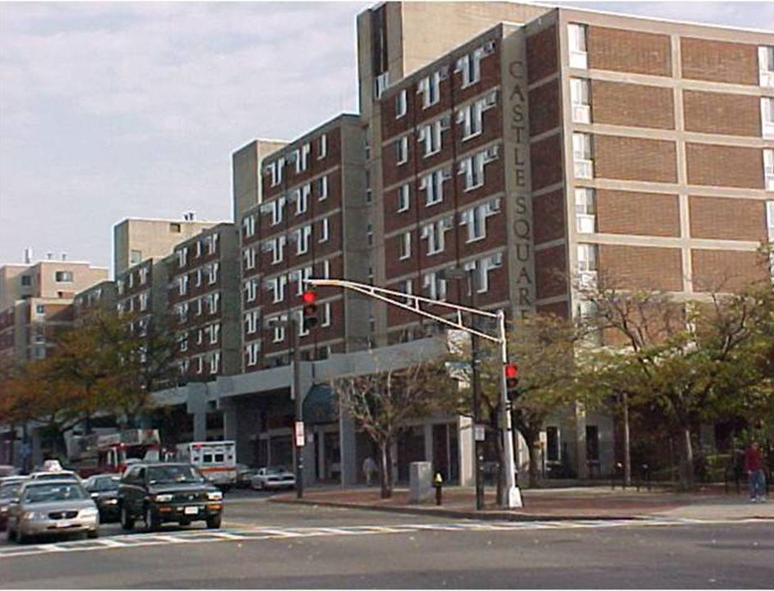
http://www.castledeepenergy.com

Slide 16
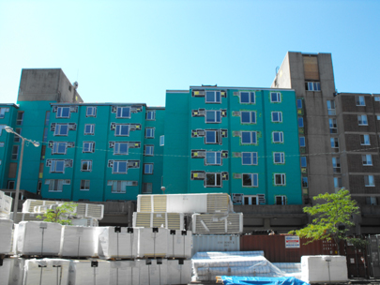
http://www.castledeepenergy.com

Slide 17
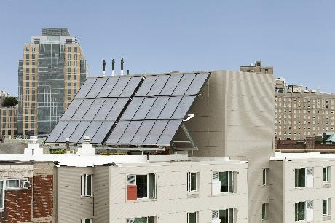
http://www.castledeepenergy.com

Slide 18
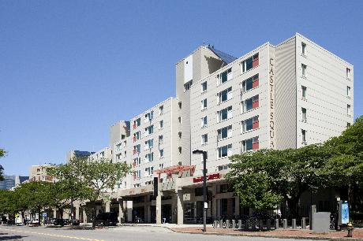
http://www.castledeepenergy.com

Slide 19
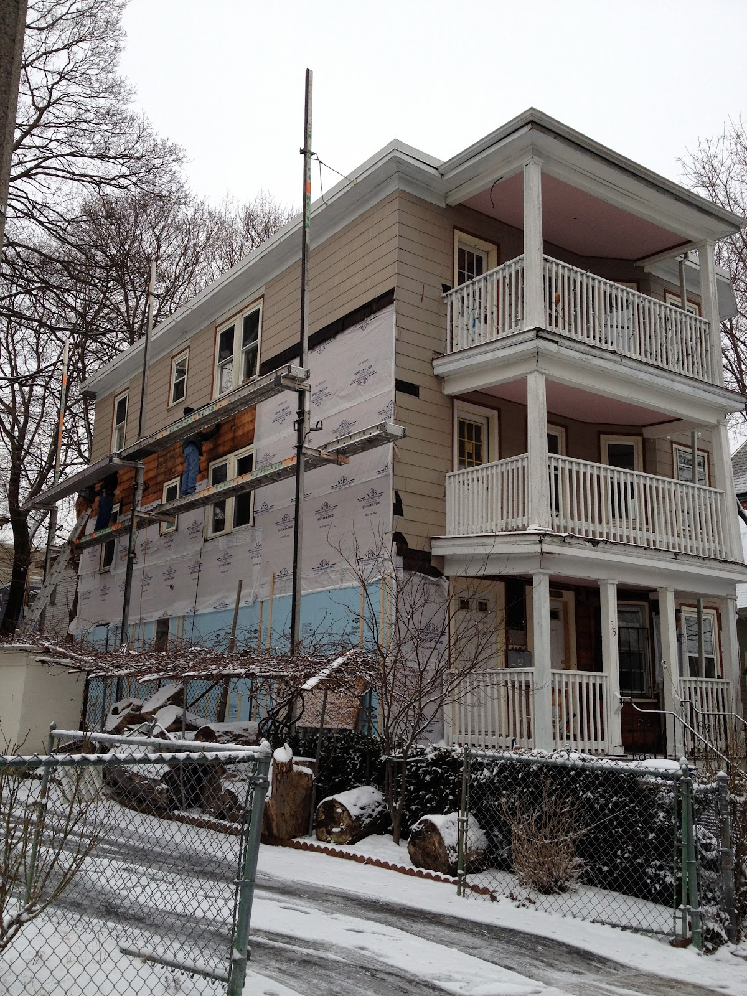
Boston’s “Green Triple Decker” Pilot Program
http://buildingoursustainablefuture.blogspot.com

Slide 20
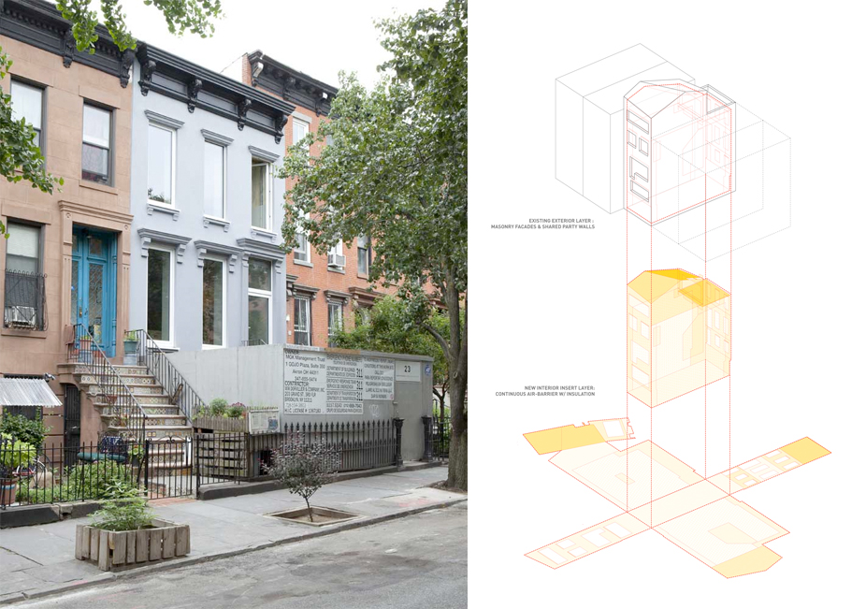
Brooklyn Passive House - Multiple Goals
Exceptional energy performance targeting the Passive House Standard
Durability/longevity
Maintenance of historical architectural elements
http://www.zeroenergy.com/md_brooklyn-passive-house.html

Slide 21
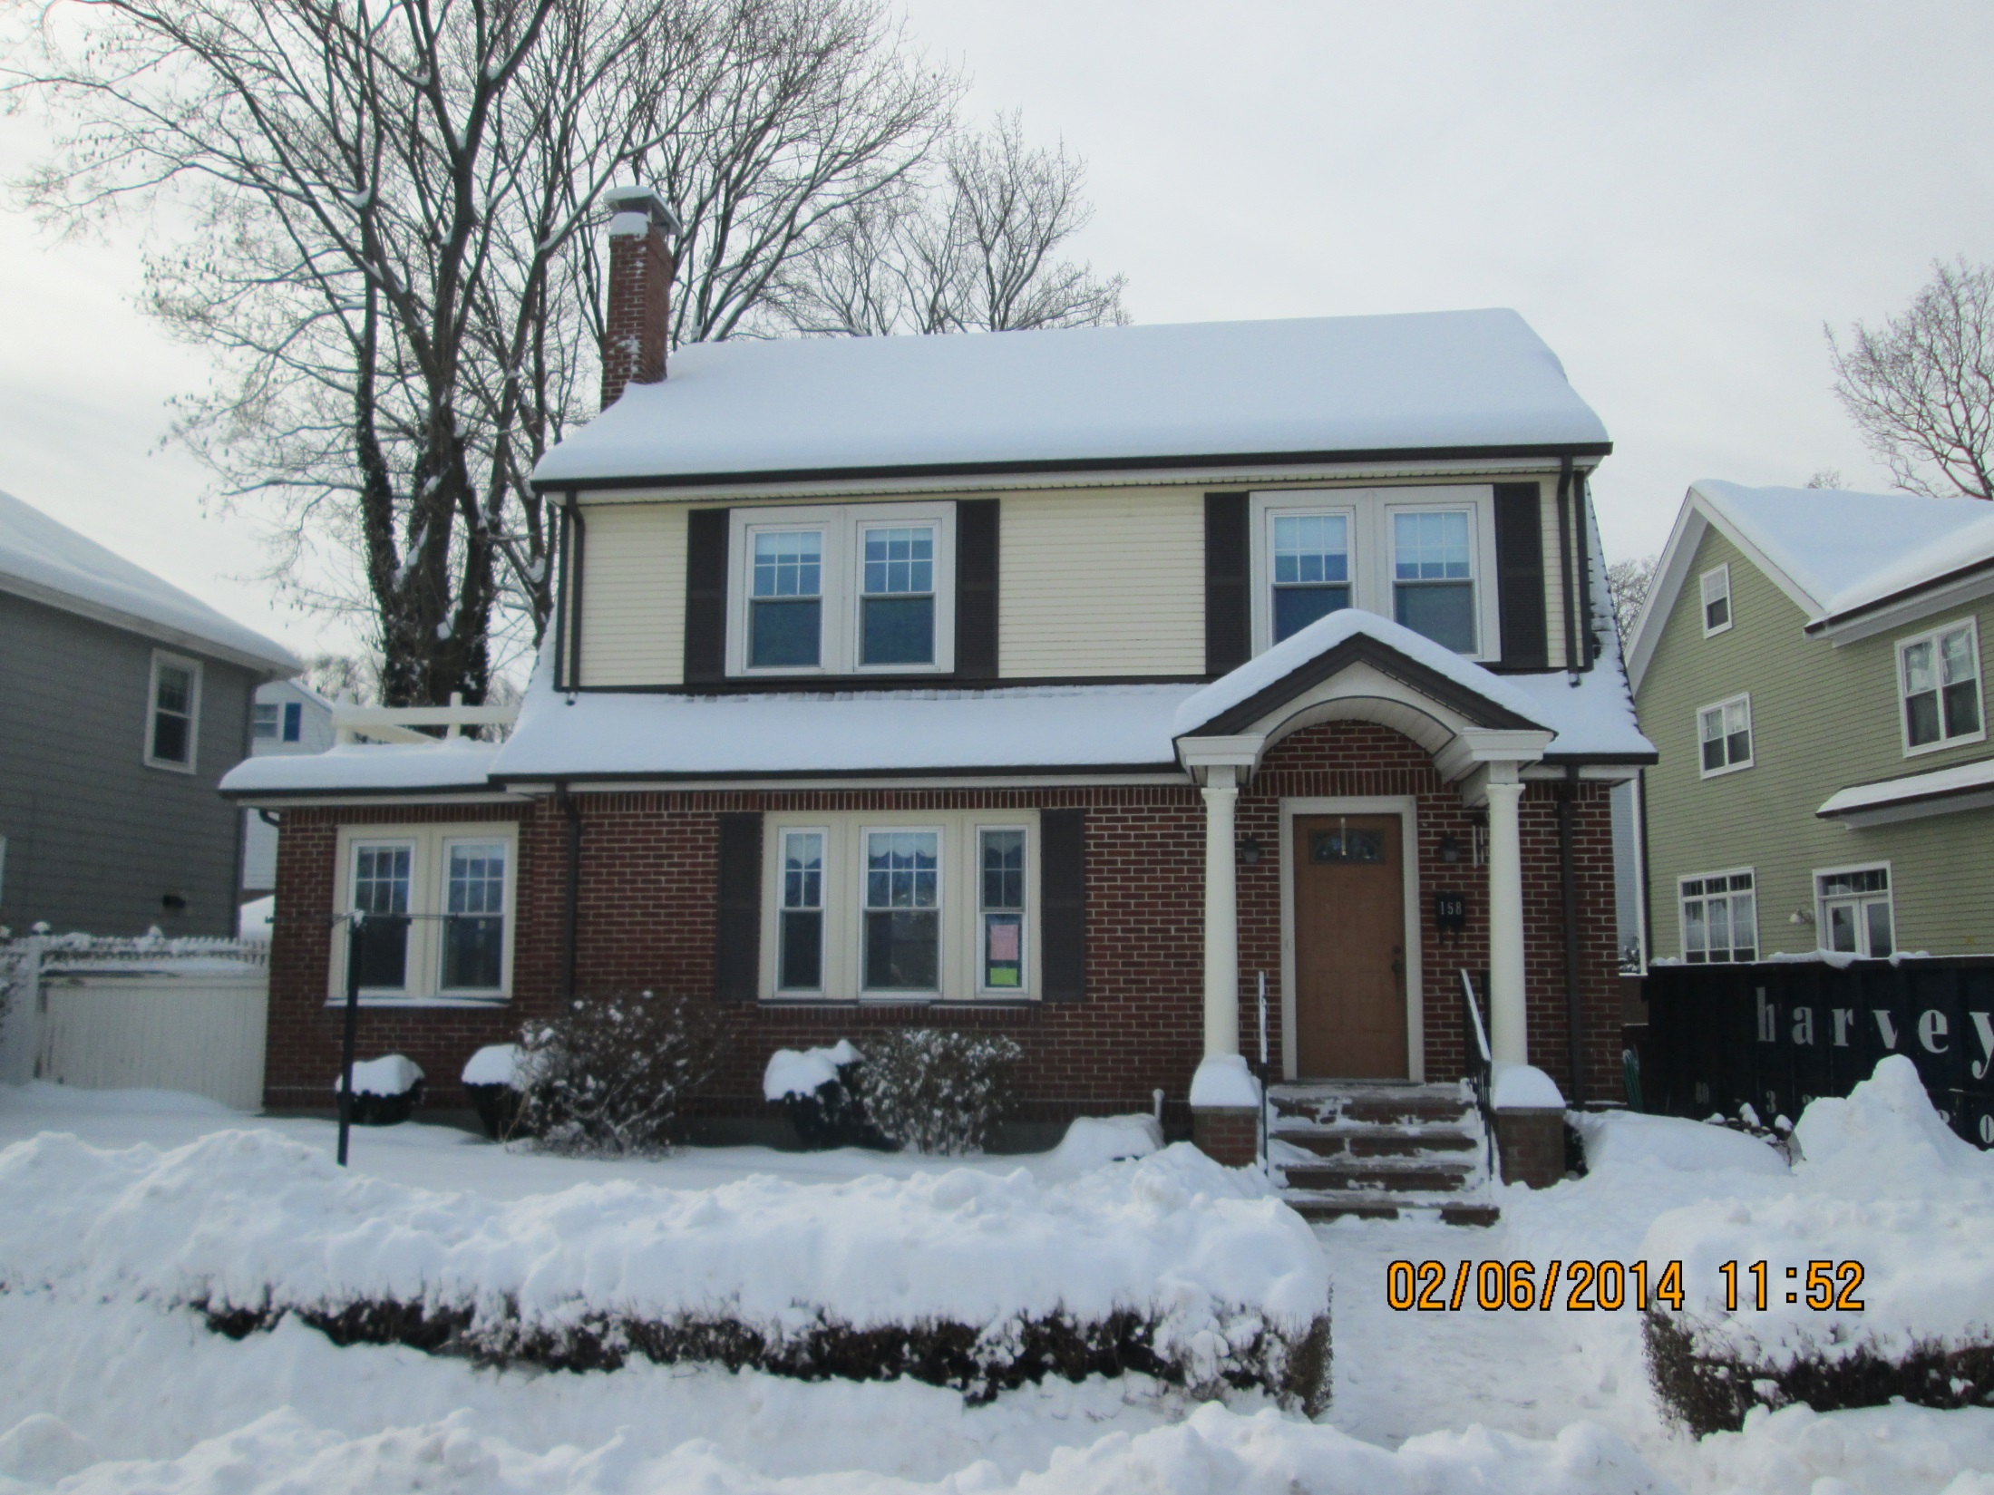

Slide 22
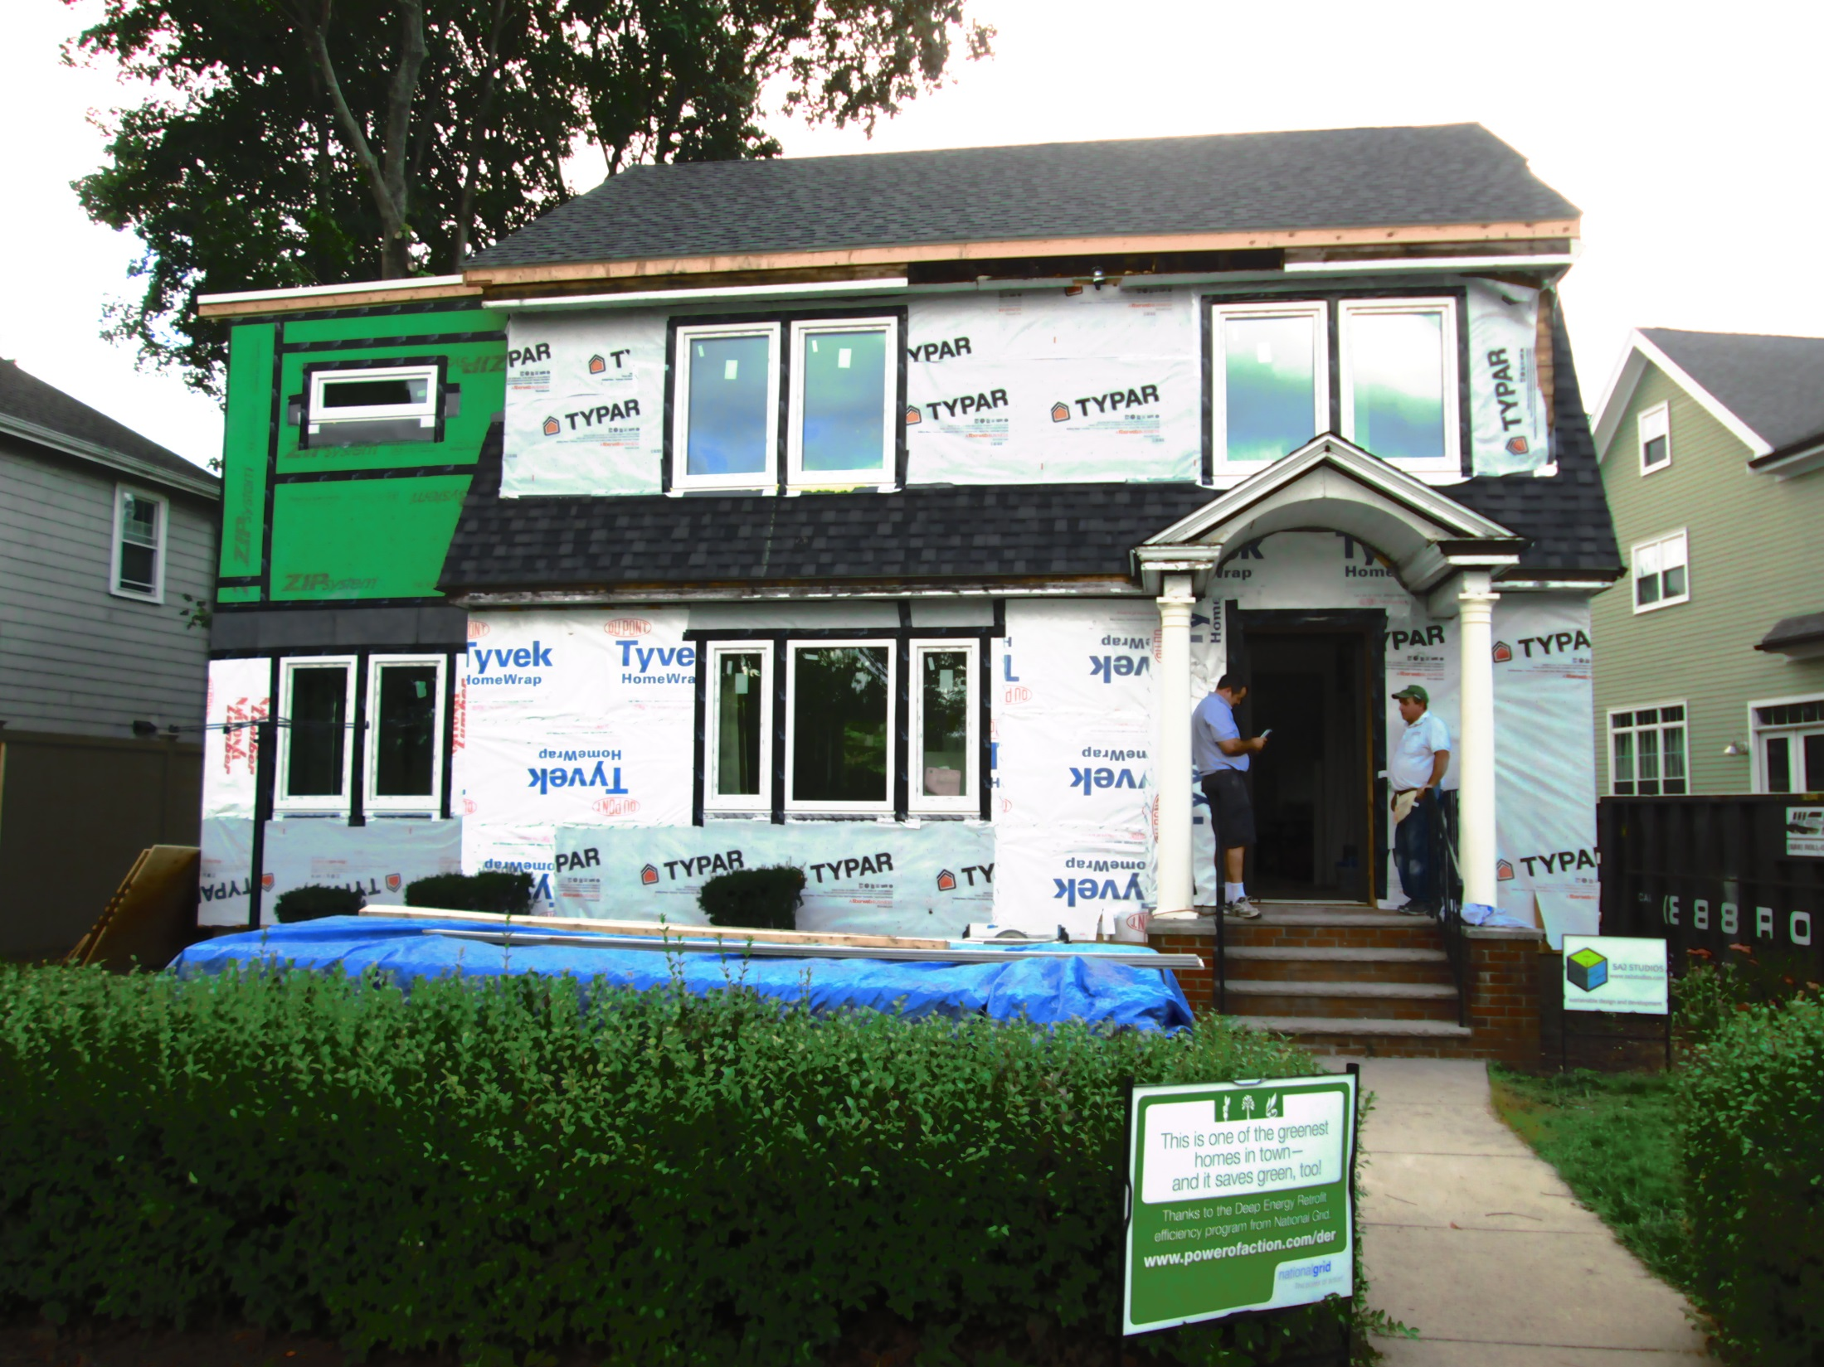

Slide 23
Deep Energy Retrofit Program MA
1-3 unit buildings
Total DER project cost
Range - $20 - $104
Average - $48/SF
Notes:
lowest to highest
Total DER Project Cost = $20- $104
Total Energy-Related DER Measures = $16-$54Total energy-related DER measures
Range - $16-$54
Average cost = $35/SF

Slide 24
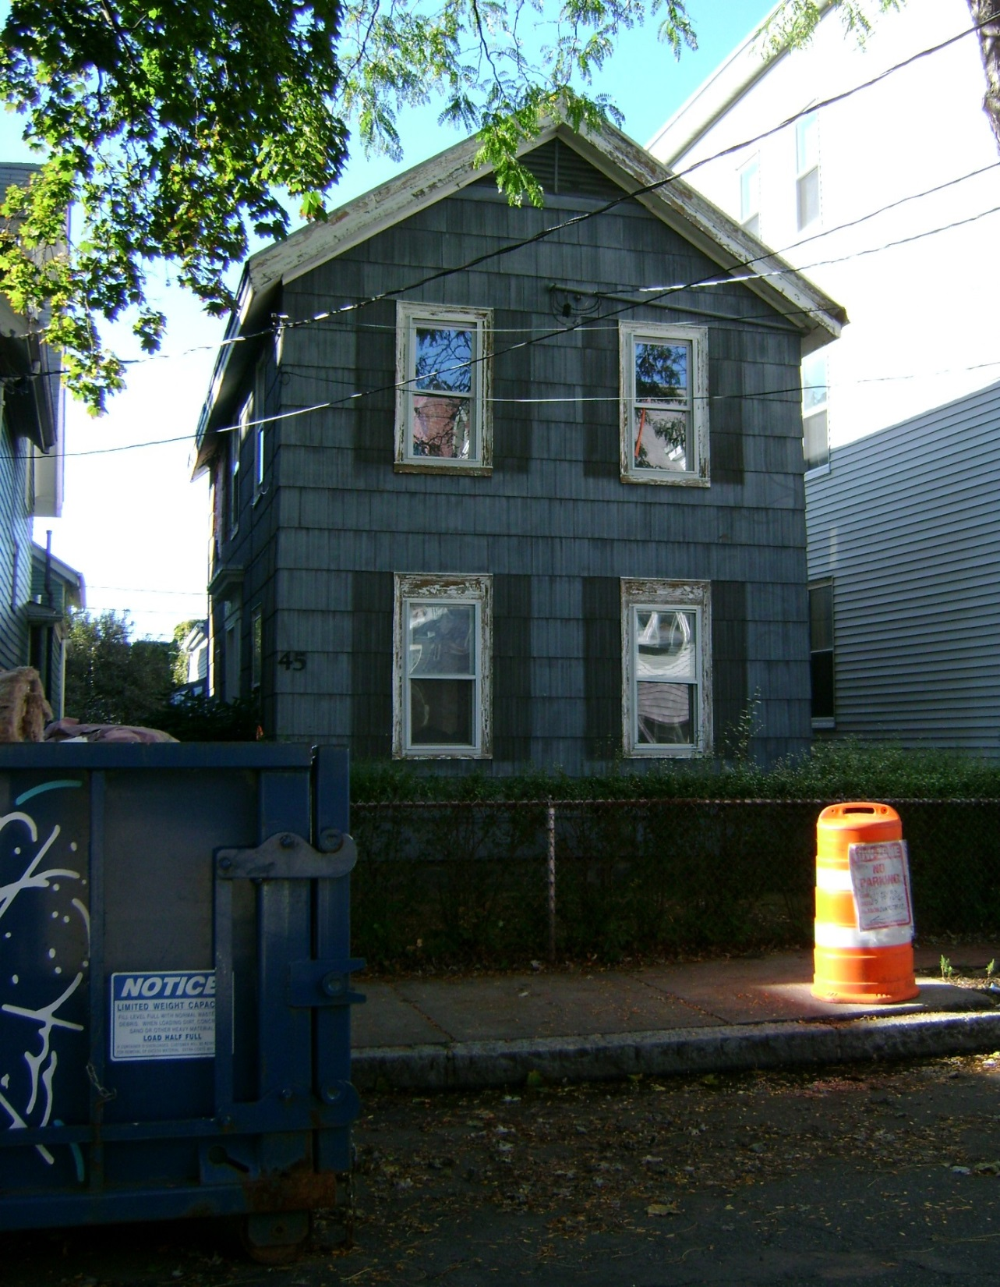

Slide 25
Installed Measures - Two Stage Process
Attic air sealing and insulation
Low flow showerheads/faucet aerators
Lighting: in-unit & common area lighting

Slide 26
Incentives and Savings – All Measures
Total Project Cost: | $142,911
Total Incentive: | $140,265
Annual KWh Savings: | 201,581 kWh
Total cost to owner: | $2,646
Annual savings @ $0.14/kWh: | $28,222
Payback: | ~1 Month

Slide 27
Incentives and Savings: Lighting Measures
Total project cost: | $131,892
Total Incentive: | $131,352
Annual KWh Savings: | 186,984 kWh
Total cost to owner: | $540
Annual savings @ $0.14/kWh: | $26,178
Payback: | <3 months

Slide 28
: Insulation and Water Saving Measures
Total project cost: | $11,019.08
Total Incentive: | $8,913.03
Annual KWh Savings: | 14,597 kWh
Total cost to owner: | $2,106.05
Annual savings @ $0.14/kWh: | $2,044
Payback: | <13 months

Slide 29
Challenges in Current System
Silos
Commercial/residential
Electric/Gas
Split incentive
Building owners pay for improvements, benefits to tenants
No performance option
each measure must be cost effective

Slide 30
Net Zero Task Force
Homeowners Rehab, Inc. (HRI)
Reducing Our Carbon Footprint

Slide 31
Homeowner’s Rehab, Inc. (HRI)
22% Reduction in Carbon Footprint
Benchmarked portfolio of 73 buildings (different Building Types)
Identified energy and water hogs
Conducted energy audits on energy hogs
Conducted heating , lighting , and water retrofits
Measured savings in WEGOwise
2 Existing Renovation Developments–close to Net Zero
1 New Construction Development – close to Net Zero

Slide 32
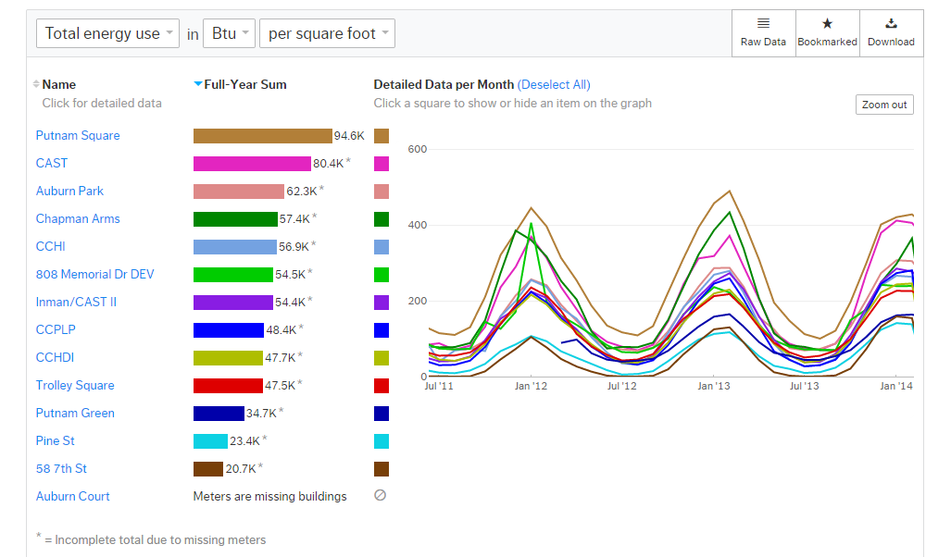
Three Tiers of Energy Usage

Slide 33
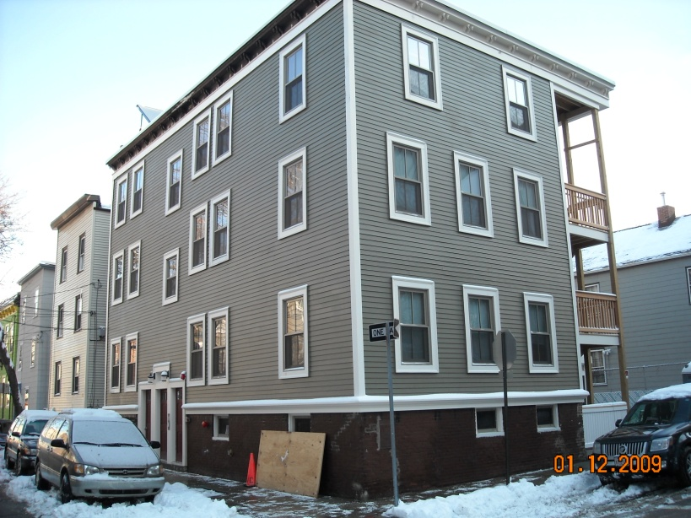
Opportunity for Deep Energy Retrofit 58 7th Street
Building Envelope Improvements
Walls- R19 icynene in stud cavity
1” Rigid insulation on exterior
Roof – R40
Low E Glass windows
HERS rating of 38

Slide 34
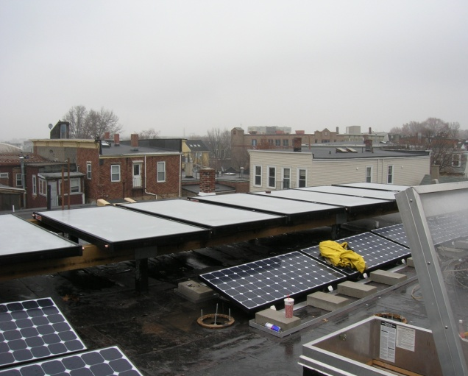
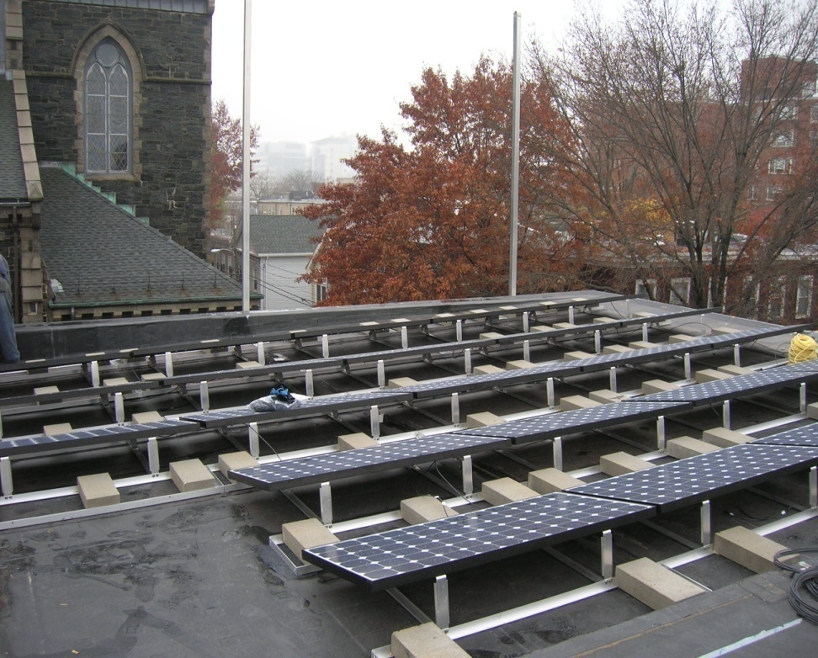
Getting to Net Zero
Renewable Energy
7kw system- PV- common electric
8, 4x8 panels for Domestic H2o. For all hot water needs
Tenant Education -Green Guide

Slide 35
7th St. -76% Natural Gas Reduction 3.3 BTU/Sq. Ft./HDD

Slide 36
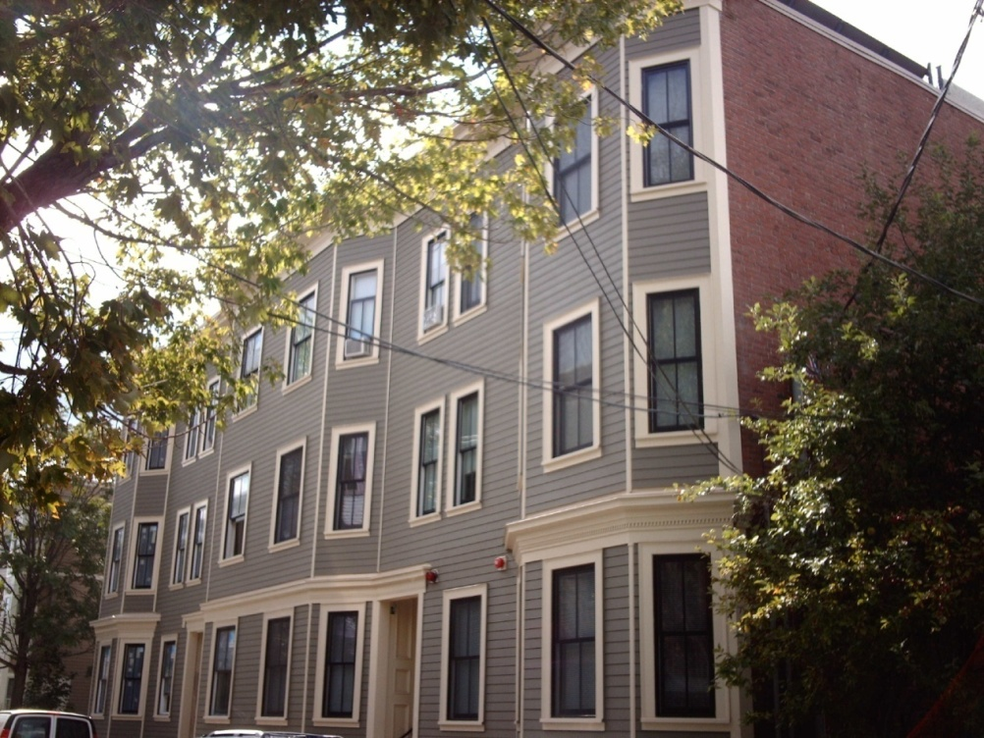
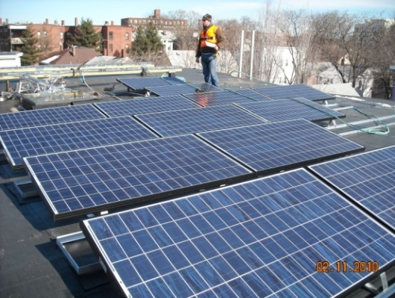
95-97 Pine Street
12 Units (relocation of residents)
Gut-Rehab - 1st USGBC LEED for Homes Platinum in MA.
Walls R-20
2” rigid at exterior
Icynene insulation stud cavity.
Roof - R40
Renewables
Solar PV/Solar Domestic

Slide 37
67% Decrease in Natural Gas 4.8 BTU/Sq. Ft./HDD

Slide 38
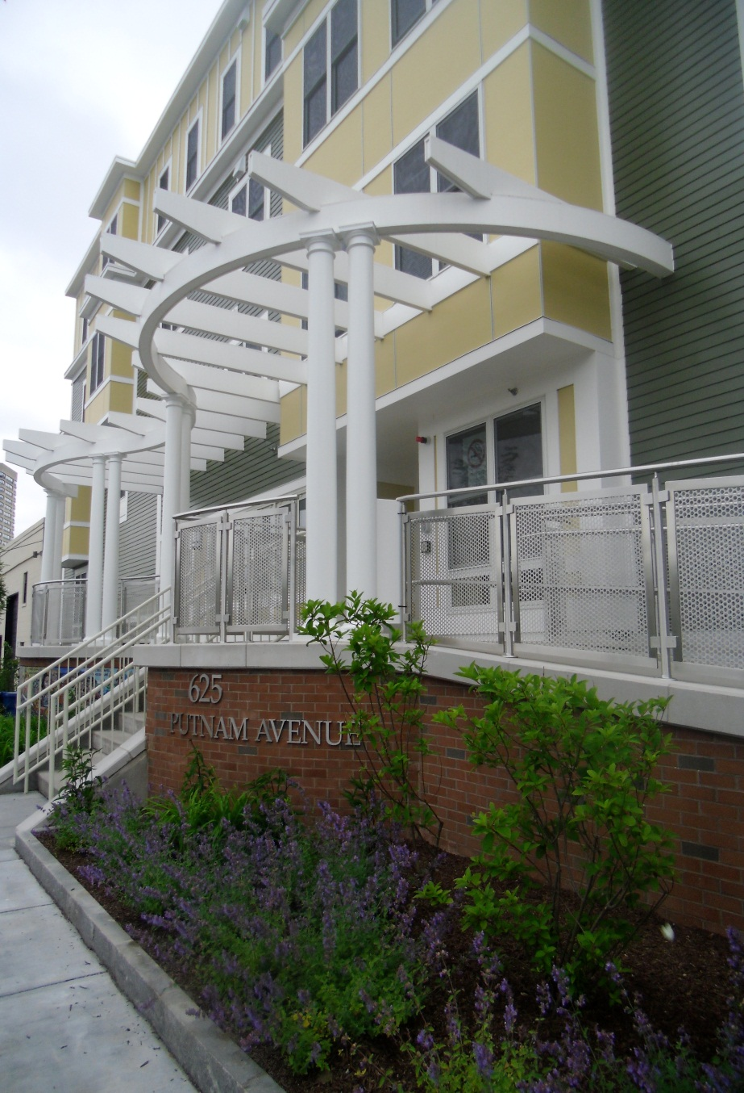
PUTNAM GREEN New Construction SIPS Panels - Greener Goals
Putnam Green: 40 unit development two building types
Higher R value walls 38-40
Reduced thermal bridging
Ease of installation/Assembled in factory
Challenges
Quality control/field installation

Slide 39
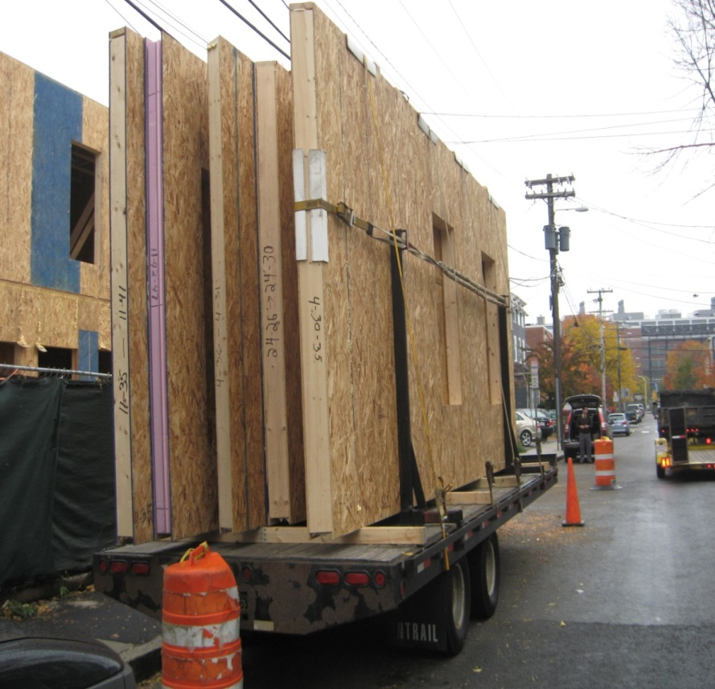
Putnam Green
BTU Meters
Both buildings collectively
Performing well
4.1 BTU/Sq. Ft./HDD
Early measurements show
SIPS building using ½ energy
Intensity of large building

Slide 40
2 BUILDINGS Compared

Slide 41
Future Opportunities
Urban solar farm – RACE TO SOLAR – City of Cambridge
26 KW-105 panels – 20 unit property ,
Generate 4.5xs the demand for 20 unit common space
Excess credited to other buildings
HRI Office building
26% power generated by panels
157 Allston St.
6 unit property – Deep Energy Retrofit /Getting to Net Zero
Learn from Passive Haus

Slide 42
Lessons Learned
Aiming for Net Zero
Challenges
Lack of roof space for renewables
incremental cost for renewables/other bldg. materials
Plug loads not included
Design constraints re: envelope
Benefits
Cost per unit for utilities is significantly lower than other units
Deeper reductions in carbon emissions

Slide 43
Implementation & Prioritization
First Draft
Objectives:
To define the “big moves” in the recommendations
To identify the areas that need more discussion/definition
Define “quick moves”
Prioritize actions overtime (Example: 1-3 years)

Slide 44
Draft Framework
“Big Moves”
- New Strategic Actions
Set Trajectory
Would not happen were it not for this process
“Quick Moves”
1-3 Year Actions
Regular Business
“Tweaks”
4-10 years
10 years +

Slide 45
Draft Framework
“Big Moves”
Retrofits
Promote Retrofit programs
Prioritize Retrofits based on disclosure data
Energy Management
requirements
Regulate Retrofits
Develop regulatory tools

Slide 46
“Big Moves”
First Draft
1. Create a compelling incentive program for Net-Zero Buildings
Define Net-Zero
Height and/or FAR bonus?
Fee-bate model?
Set a date for types of new construction to be Net-Zero
2. Energy Supply Strategy:
Planning areas are identified that are conducive to specific uses: renewables, storage, micro-grids, co-gen, district energy

Slide 47
“Big Moves” First Draft
3. Study and evaluate the development of a “Carbon Fund”
- Functions like locally generated offsets (retro-fits, renewable energy)
- Provides an ability to achieve net-zero now to projects
- Optional but can be used to meet regulatory requirements
4. Develop a retro- fit & Continuous Optimization Strategy,
- Incentive program for commercial, and multi-family
- Energy Management Plans - Requires property owners (X-sqft and above) to submit (once every 3 years?) a plan showing how they are going to reduce/manage their energy consumption, increase renewables
- Makes use of energy disclosure data and prioritizes the in-efficient users

Slide 48
“Big Moves” First Draft
5. Develop an approach to community renewable energy that catalyzes local investment.
Explore 3rd party vehicles to invest in community renewable Energy projects
Recruit participation from local leaders
6. Develop an MOU with the Utilities to work on Net-Zero Emissions Target and programs
Collaborate on micro-grids
District energy expansion in Kendall Square
Incentive program promotion and harmonization

Slide 49
“Quick Moves” First Draft
1. Revise LEED Policy to: (FD)
Achieve LEED Gold
Explicitly require energy performance
Ensure the correct standard is being used
Develop something for 1-3 family residential
2. Communications strategy on Net-Zero
Brand development
Engagement of Businesses and Residents
Partnership building (Cambridge Compact)
Recognition and rewards programs
3. Solar Ready roof requirements moving to Renewable Requirements (FD)
For residential
For commercial
Includes structural loading, access to mechanical room
Sets context for Renewables requirements in the future

Slide 50
“Quick Moves” First Draft
3. Develop Ongoing Capacity to Maintain Project:
Ongoing reporting and management (Dashboard)
Annual reporting and oversight by 3rd party (CPAC?)
4. Multi-family retrofit pilot program
Test new retrofit models discussed tonight

Slide 51
Next Steps Recommendations
Further develop actions for Taskforce review
Consolidate and group actions further
Run additional iterations of the model
Stakeholder engagement
Utilities & Regional Authorities
Commercial Tenants
Public

Slide 52
Public Comment:

