Slide 1
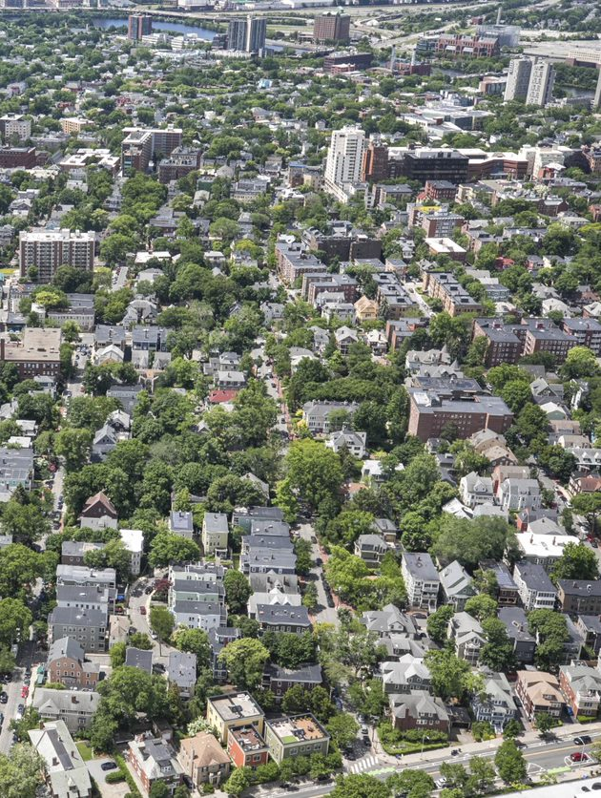


Fossil Fuel Free Building Demonstration Program - Overview
City of Cambridge Community Development Department
July 2023

Slide 2







Welcome
Susanne Rasmussen, Director of Environmental and Transportation Planning
Nikhil Nadkarni, Energy Project Planner
Jennifer Ballew, Sustainability Project Planner
Brad Pillen, Energy Engagement Associate Planner
This meeting is being recorded

Slide 3

Instructions for asking a question or making a comment
We’ll be answering questions after the presentation.
You will join the meeting with video and microphone off
You can type written questions or comments in the Zoom Q&A Panel
Bottom Panel of Zoom Screen
Ask a Question
For technical issues, please email: jballew@cambridgema.gov
City of Cambridge - Community Development Department
July 2023 3

Slide 4
Agenda
Background:
  Cambridge actions to address climate change
New regulation:
  The Massachusetts Fossil Fuel Free Demonstration Program
Proposed requirements:
  Eliminate use of fossil fuels in new buildings and major renovations
Timeline and next steps for adopting regulation
Questions & answers

Slide 5
Agenda
Background:
  Cambridge actions to address climate change
New regulation:
  The Massachusetts Fossil Fuel Free Demonstration Program
Proposed requirements:
  Eliminate use of fossil fuels in new buildings and major renovations
Timeline and next steps for adopting regulation
Questions & answers

Slide 6
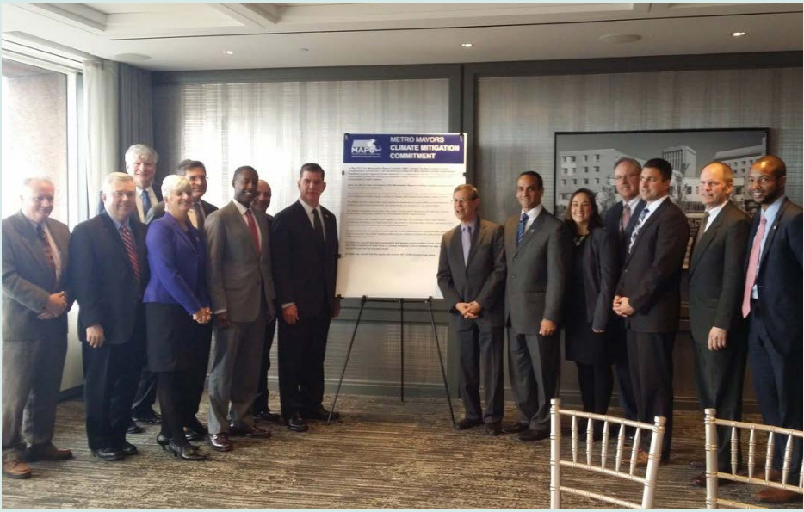
Cambridge has long been committed to taking action on climate change
Cambridge is taking action both to:
bring our greenhouse gas emissions to zero by 2050
prepare for climate impacts
Cambridge is part of a larger coalition of cities in the Boston area that has committed to meeting the 2050 target.

Slide 7
Buildings produce the most greenhouse gas (GHG) emissions in Cambridge
Waste
Building emissions come from onsite fossil fuel use (gas, oil, etc.) and from electricity use.
Electricity is getting cleaner each year and is expected to be mostly renewable by 2030.
Transportation
Buildings

Slide 8
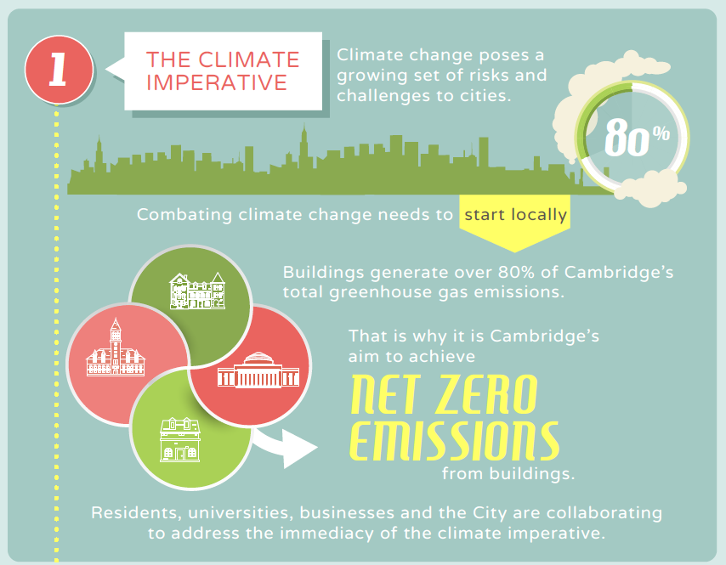
Cambridge has a long-range Net Zero Action Plan to reduce emissions from buildings
The Net Zero Action Plan was first adopted in 2015 and updated through a community-led process in 2021.
It identifies policies and programs to eliminate greenhouse gas emissions from buildings by 2050.

Slide 9
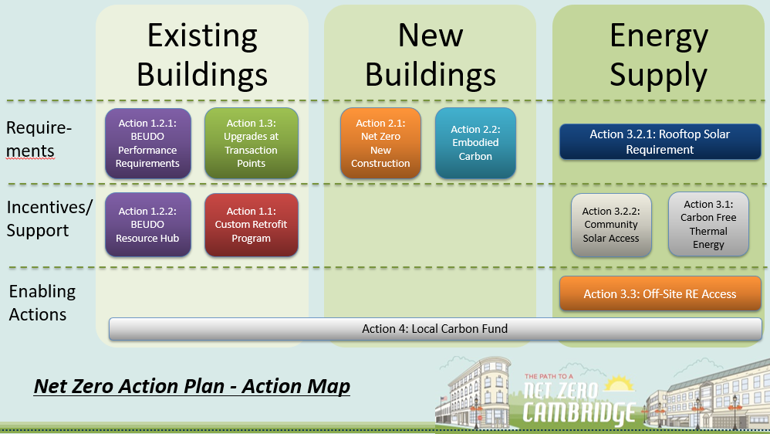
The Net Zero Action Plan has actions to address emissions from both existing and new buildings

Slide 10
The Net Zero Action Plan has actions to address emissions from existing and new buildings
Action 2.1 calls for new buildings to be net zero from the start, including:
Cambridge should advocate for state net zero codes, since Massachusetts sets building codes
Adopt the code as soon as the state makes it possible
Eliminate pathways for fossil fuel use in new construction – it’s the best opportunity for full building electrification
Monitor outcomes

Slide 11
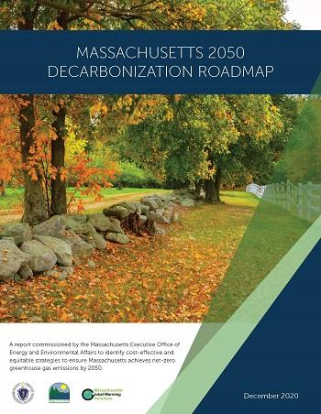
Massachusetts has identified policies and programs to get to net zero by 2050
From the state Decarbonization Roadmap:
  “New construction offers the easiest and most economically attractive way to start decarbonizing the buildings sector…”
  “Almost all new buildings can cost-effectively pursue an efficient electric design that increases occupant comfort and pays for itself...”
Massachusetts created the Specialized Stretch Code
  Sets high performance standards, but still allows new buildings to be built with fossil fuels
  Adopted by Cambridge in January 2023

Slide 12
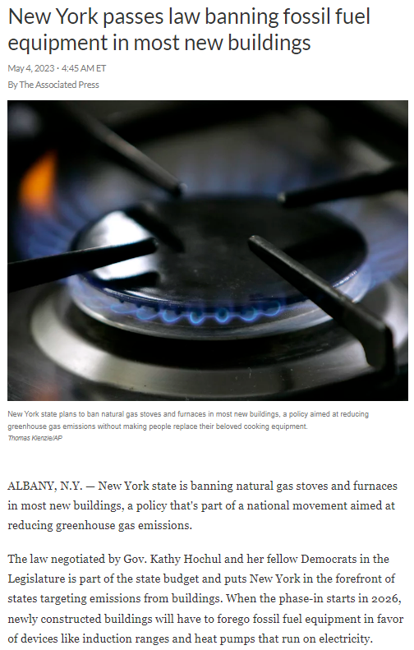
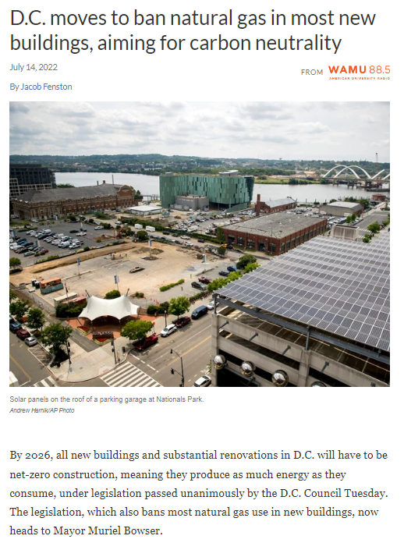
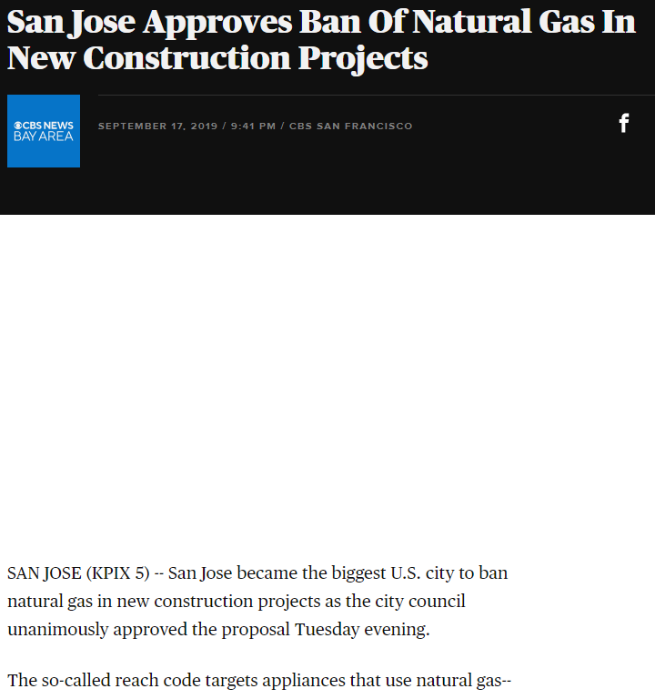
Meeting our climate targets means phasing out fossil fuels in new construction
  This means that new buildings are built without fossil fuel systems like gas furnaces or gas-fired water heaters.
  Applies to gas, oil, and other fossil fuels
  Several other cities and states with climate commitments have passed ‘no new gas’ requirements for new buildings.

Slide 13
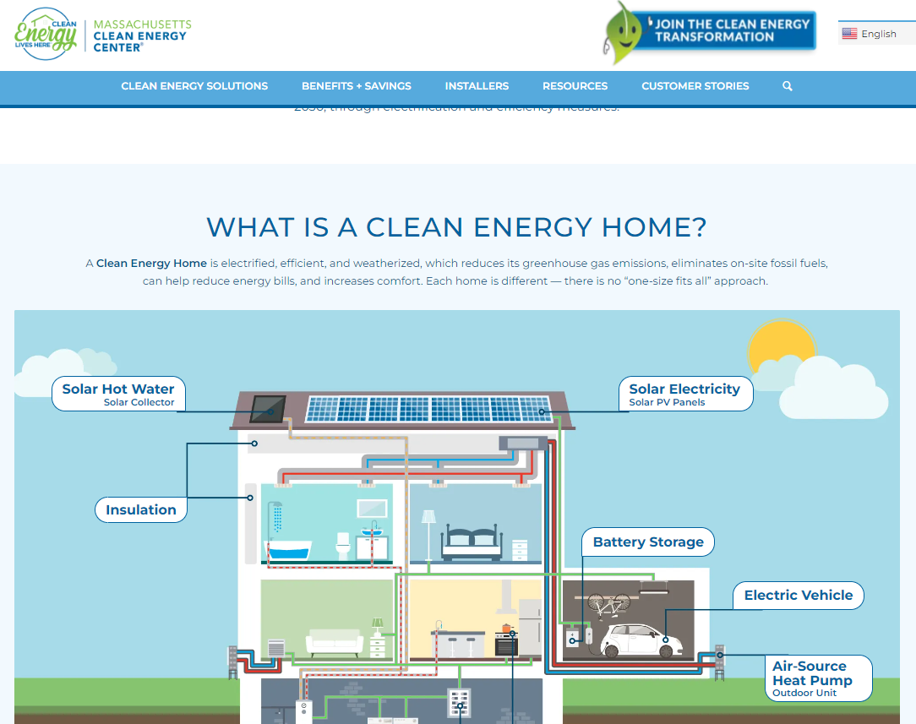
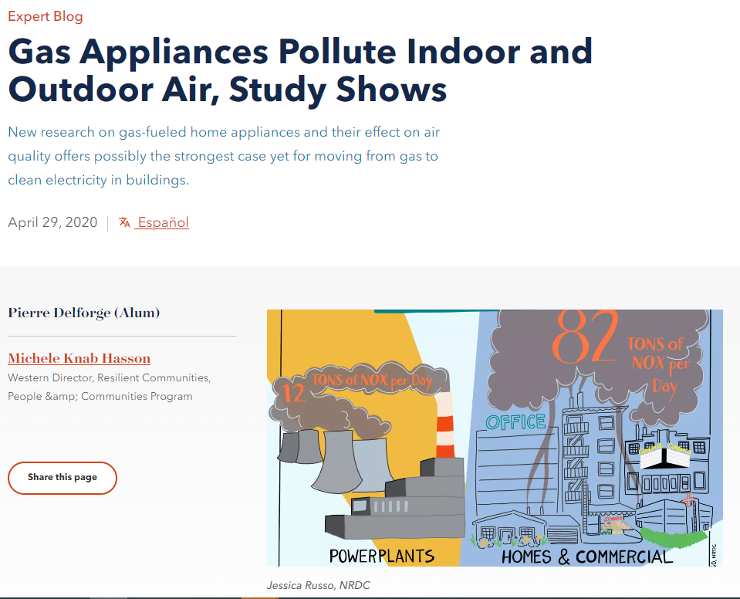
Builders are required to install clean, all-electric systems instead
Fossil fuel free means that new buildings need to be built using systems like heat pumps and heat pump water heaters.
The clean air and indoor air quality benefits are well-documented.
This also prevents developers of new buildings from installing new gas infrastructure that would have to be removed later on.

Slide 14
Agenda
Background:
  Cambridge actions to address climate change
New regulation:
  The Massachusetts Fossil Fuel Free Demonstration Program
Proposed requirements:
  Eliminate use of fossil fuels in new buildings and major renovations
Timeline and next steps for adopting regulation
Questions & answers

Slide 15
Massachusetts Has Created a Fossil Fuel Free Demonstration Program
The Massachusetts Legislature has authorized 10 communities to implement fossil-fuel free requirements for new construction and major renovation.
  Part of an Act Driving Clean Energy and Offshore Wind (2022)
The Massachusetts Department of Energy Resources has developed regulations and a suggested ordinance (‘model rule’).
  Cambridge provided input to DOER in developing the regulations this winter.
  Final regulations were sent to Legislature in May.

Slide 16
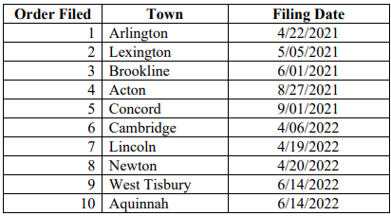
Cambridge has been allowed to participate in the Massachusetts demonstration program
Cambridge submitted a home rule petition requesting this authority in April 2022, so we are a Prioritized Community.
A city or town must meet 10% affordable housing requirement or MBTA Communities Multifamily Zoning
If a Prioritized Community drops out, DOER may select a substitute community. Somerville and Boston have both voted to move home rule petitions forward.
= City/Town has voted to adopt fossil fuel free requirements
(as of July 10, 2023)

Slide 17
Agenda
Background:
  Cambridge actions to address climate change
New regulation:
  The Massachusetts Fossil Fuel Free Demonstration Program
Proposed requirements:
  Eliminate use of fossil fuels in new buildings and major renovations
Timeline and next steps for adopting regulation
Questions & answers

Slide 18
The Demonstration Program requires new buildings and major renovations to be fossil fuel free
New buildings are covered by Fossil Fuel Free.
Major renovations are covered and defined in the state regulation (commonly 50% or more of a building’s floor area).
Exempted per state regulation: hospitals, medical offices, and laboratories
Specific definition of Major Renovation includes:
For 1-2 family homes, townhouses:
  renovation of 50% of the building, if over 1,000 square feet
  addition of 1,000 square feet, or doubling the existing building
  change of use of 1,000 square feet
For all other building types:
  renovation of 50% of the building floor area, if more than 20,000 square feet
  addition of 20,000 square feet or doubling the existing building
  change of use of 20,000 square feet or the whole building

Slide 19
The Fossil Fuel-Free Demonstration Program has a suggested or “model” ordinance
What the model ordinance covers
A building cannot use coal, oil, natural gas, or other fossil fuels in its operation
This is generally understood to include heating, hot water systems, lighting, cooking, and clothes drying, and potentially commercial process loads (e.g., restaurants, dry cleaners)
  A city or town may propose limited exemptions or changes to model ordinance with justification
The model ordinance is based on the new “Specialized” building code (which Cambridge has adopted) and basically eliminates options that allow for fossil fuel use, with two clarifications:
  It allows gas or propane use for multifamily water heating until 2027
  It spells out that major renovations cannot install new fossil fuel equipment for heating, hot water, cooking, etc.

Slide 20
The state will be conducting an evaluation of outcomes
Cities and towns are required to provide building permit records to DOER, including any energy score reports.
DOER will access energy use from the utilities and report on emissions reductions.

Slide 21
Agenda
Background:
  Cambridge actions to address climate change
New regulation:
  The Massachusetts Fossil Fuel Free Demonstration Program
Proposed requirements:
  Eliminate use of fossil fuels in new buildings and major renovations
Timeline and next steps for adopting regulation
Questions & answers

Slide 22
Timeline for Prioritized Communities
Cambridge must submit its final application (including proposed ordinance and date effective) to DOER by September 1, 2023.
  Failure to do so will result in elimination from the program
  Municipalities can submit their applications earlier to DOER for feedback

Slide 23
We’re sharing information about the program with Cambridge residents and building owners
  Information presented at this webinar and a webinar on July 24th
  Engaging with building professionals at this week’s Specialized Code webinars
    Tuesday July 11 at 4pm: Commercial Specialized Code
    Wednesday July 12 at 4pm: Residential Specialized Code
  Flyering at community spaces throughout Cambridge
  News items and online info
  Outreach to resident associations and business associations
  Information to large building owners and building professionals working in Cambridge

Slide 24
We want your feedback on how new buildings and major renovations in Cambridge can be fossil fuel free
In addition to getting feedback at the webinars, an online survey has been launched to gather input from Cambridge residents and building owners, covering:
Specific types of buildings that we should focus our research on
Specific uses or building systems that we should further research
How major renovations can be fossil fuel free
Other topics that we should research
Survey responses are due by July 17th to be incorporated into the research work.
https://bit.ly/FFFupdates

Slide 25
Next Steps for Cambridge
We are working with a research consultant to explore if any changes to the model rule are appropriate, by doing the following:
  Examining the types of buildings that are built or renovated in Cambridge
  Understanding any technical limitations to all-electric equipment for specific building types or end-uses
  Reviewing how the requirements would affect process loads in Cambridge
  Reviewing input received from the survey to include in the research
The City Council will discuss proposed ordinance language at the August 1 Ordinance Committee meeting and vote on final language on August 7.

Slide 26
Questions and Answers
You will join the meeting with video and microphone off
You can type written questions or comments in the Zoom Q&A Panel
Bottom Panel of Zoom Screen
Ask a Question

Slide 27
For More Information
Visit our webpage at https://bit.ly/FFFupdates
Complete the survey by July 17th
July 24 webinar
Contact Brad at bpillen@cambridgema.gov

Slide 28
Thank You!

