Slide 1
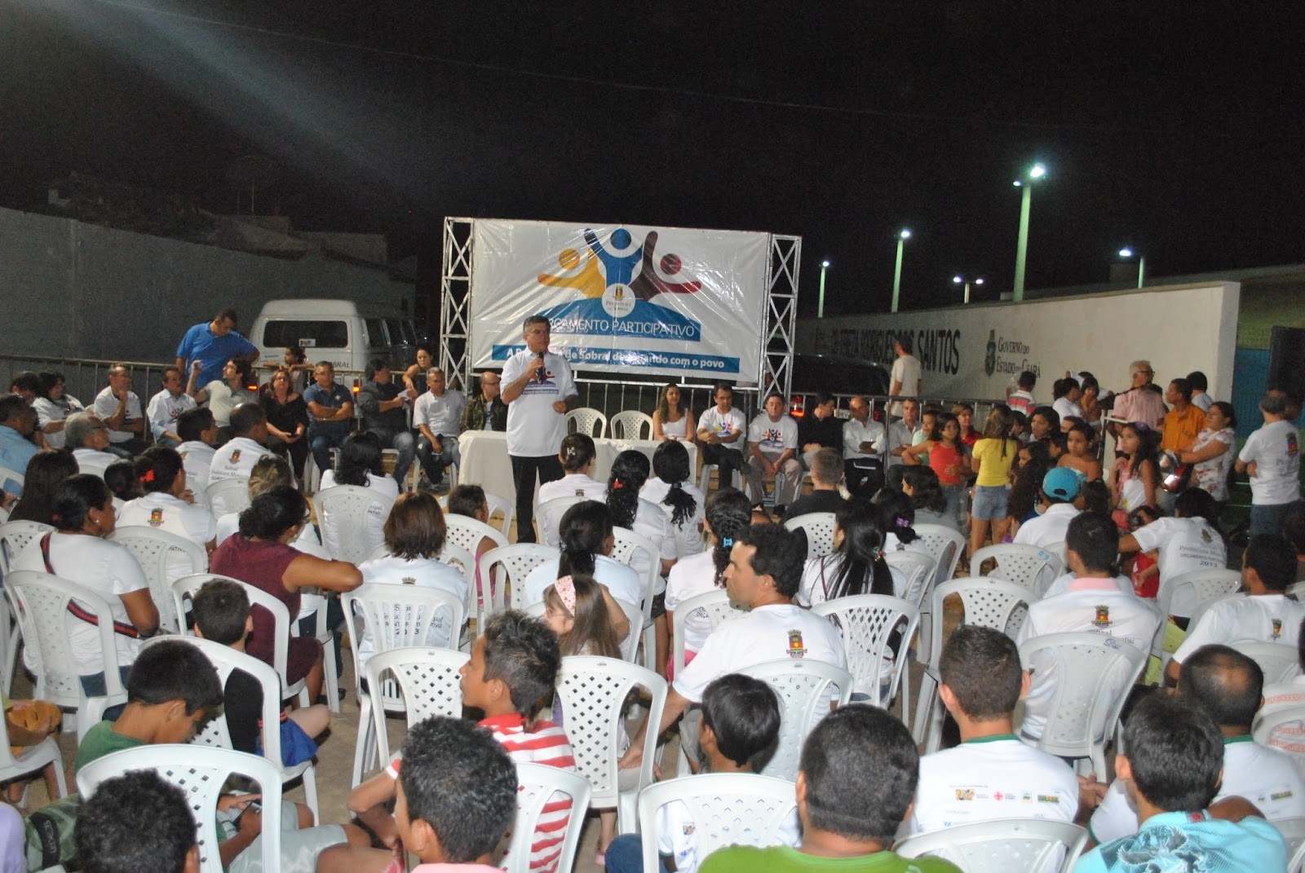
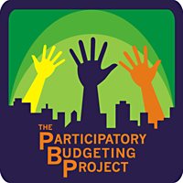
Real Money! Real Power!
Participatory Budgeting
Cambridge
Notes:
Update logos

Slide 2
Agenda
Welcome & Introductions
Introduction to PB in Cambridge
The Steering Committee: Who & What
Q & A
Next Steps
Notes:
2

Slide 3
What is participatory budgeting?
A democratic process in which
community members directly decide
how to spend part of a public budget
Real Power over Real Money!
Notes:
Photo: Toronto Community Housing
To clarify, I’ll explain what PB is not

Slide 4
What is participatory budgeting?
How it works
Brainstorm ideas
Develop proposals
Fund and implement projects
Vote

Slide 5
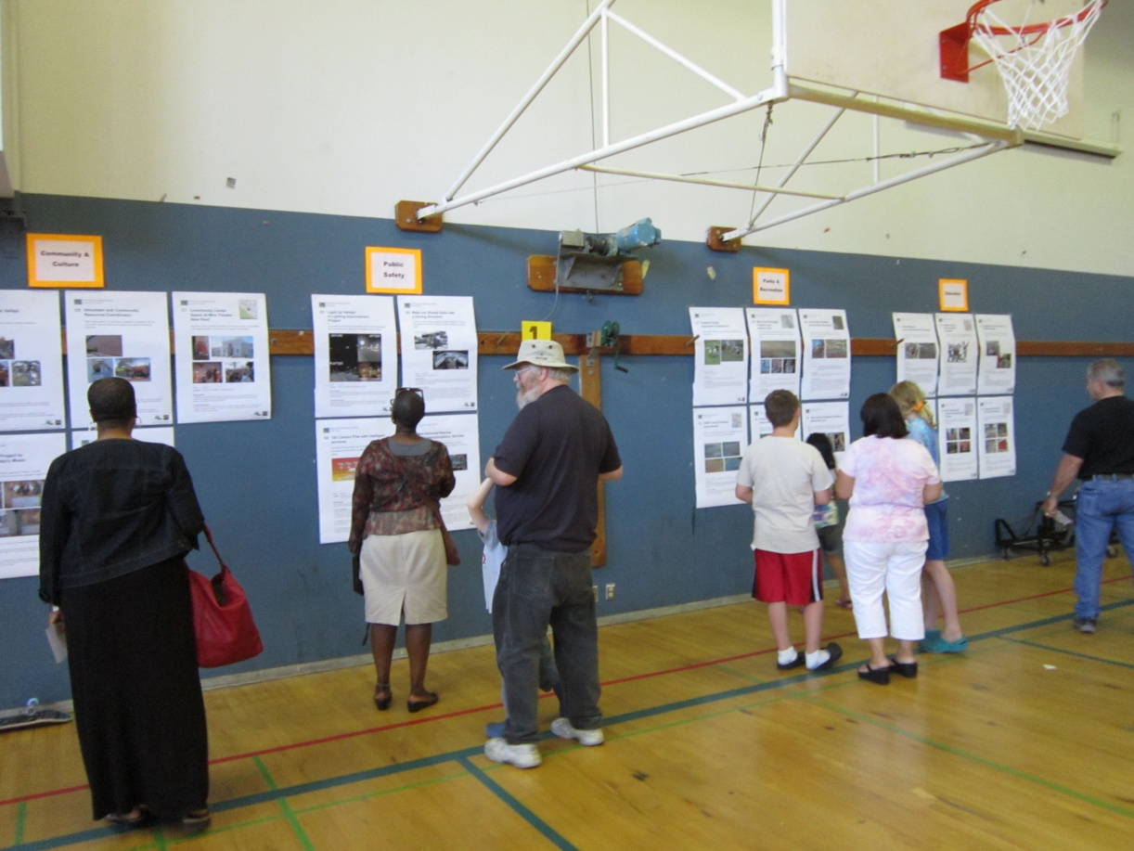
Why participatory budgeting?
Transparency
Accountability
Deeper democracy
More equity in public spending
More informed and empowered citizens
Stronger communities

Slide 6
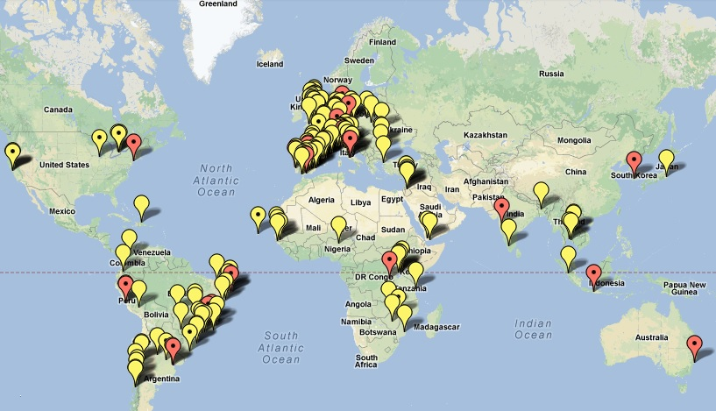
Where has PB worked?
1,500+ PB processes in the world!
Europe
Cities,
States,
Counties, Public housing, Schools,
Community organizations
North America
Asia
Latin America
Africa
Porto Alegre, Brazil

Slide 7
PB in Cambridge
Basic Info:
Cambridge residents will decide how to spend $500,000 in capital funds for the FY16 Capital Budget
Examples: Bike racks, playground/park improvements, sidewalk repairs, public safety equipment, community gardens, etc.
A Steering Committee will oversee the process
The Participatory Budgeting Project (PBP) will work with the City of Cambridge and the Steering Committee to implement the process
Notes:
Delete or update slide

Slide 8
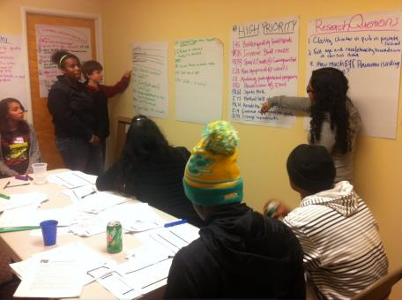
PB in Cambridge
Rough Timeline:
Review the Rules: Nov 2014
Collect Ideas: Dec 2014
Develop Proposals: Jan-Feb 2015
Vote: March 2015
Notes:
Update dates

Slide 9
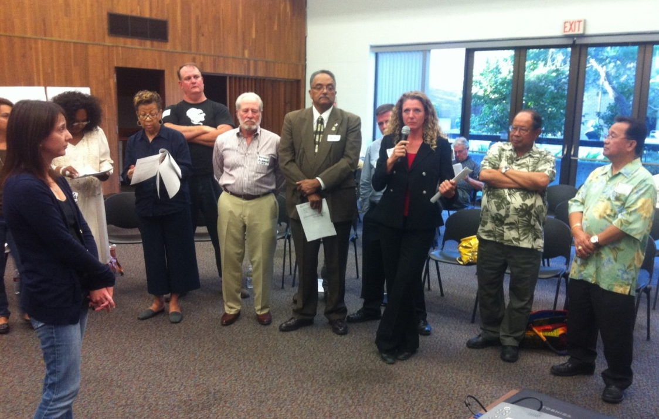
Steering Committee
What it does:
Review the Rules and Answer Key Questions
Leadership & Oversight
Targeted Engagement
Logistical Support
Voting Facilitation
Vallejo, CA

Slide 10
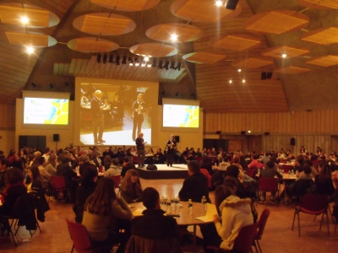
Steering Committee
Who it includes:
Community members
Local community-based and non-profit organizations
Key experts
Poitou-Charentes Region, France

Slide 11
Key Dates
November 5th at 5pm: Deadline for Steering Committee applications
November 10th: Steering Committee members announced
Monday, November 17th: First Steering Committee meeting from 6-8pm in the Sophie Room at City Hall.
Monthly Steering Committee meetings from December-April
Notes:
Update dates
PBP
· Provide you with educational materials
· Come and speak at community stakeholder meetings to introduce PB
· Come and speak at meetings you may have with local school officials

Slide 12
Other Ways to Get Involved
Participate in PB assemblies and meetings, and vote!
Volunteer
Host PB assemblies or meetings
Engage your friends and neighbors
Spread the word to your networks!!
Notes:
PBP
· Provide you with educational materials
· Come and speak at community stakeholder meetings to introduce PB
· Come and speak at meetings you may have with local school officials

Slide 13
Stay Connected!
City of Cambridge
Website: www.cambridgema.gov/yourbudget
Facebook: www.facebook.com/CambridgeMA.Gov
Twitter: @CambMA
The Participatory Budgeting Project
Website: www.participatorybudgeting.org
Facebook: facebook.com/ParticipatoryBudgetingProject
Twitter: @PBProject
Notes:
Update Cambridge Info

