Slide 1
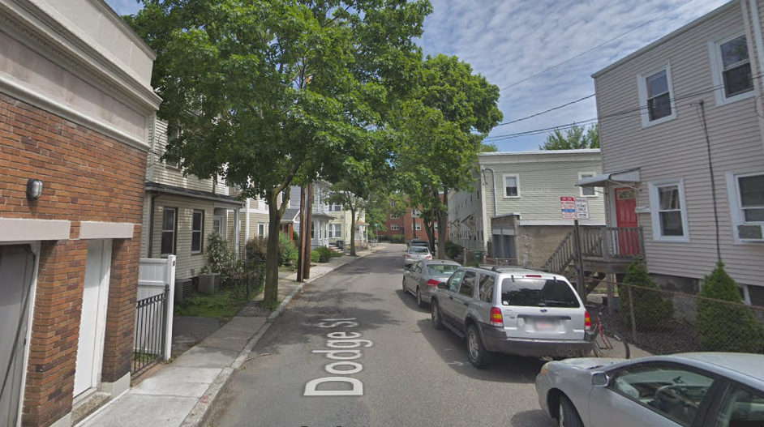
Dodge Street Western Avenue to Callender Street
Reconstruction Project

Slide 2
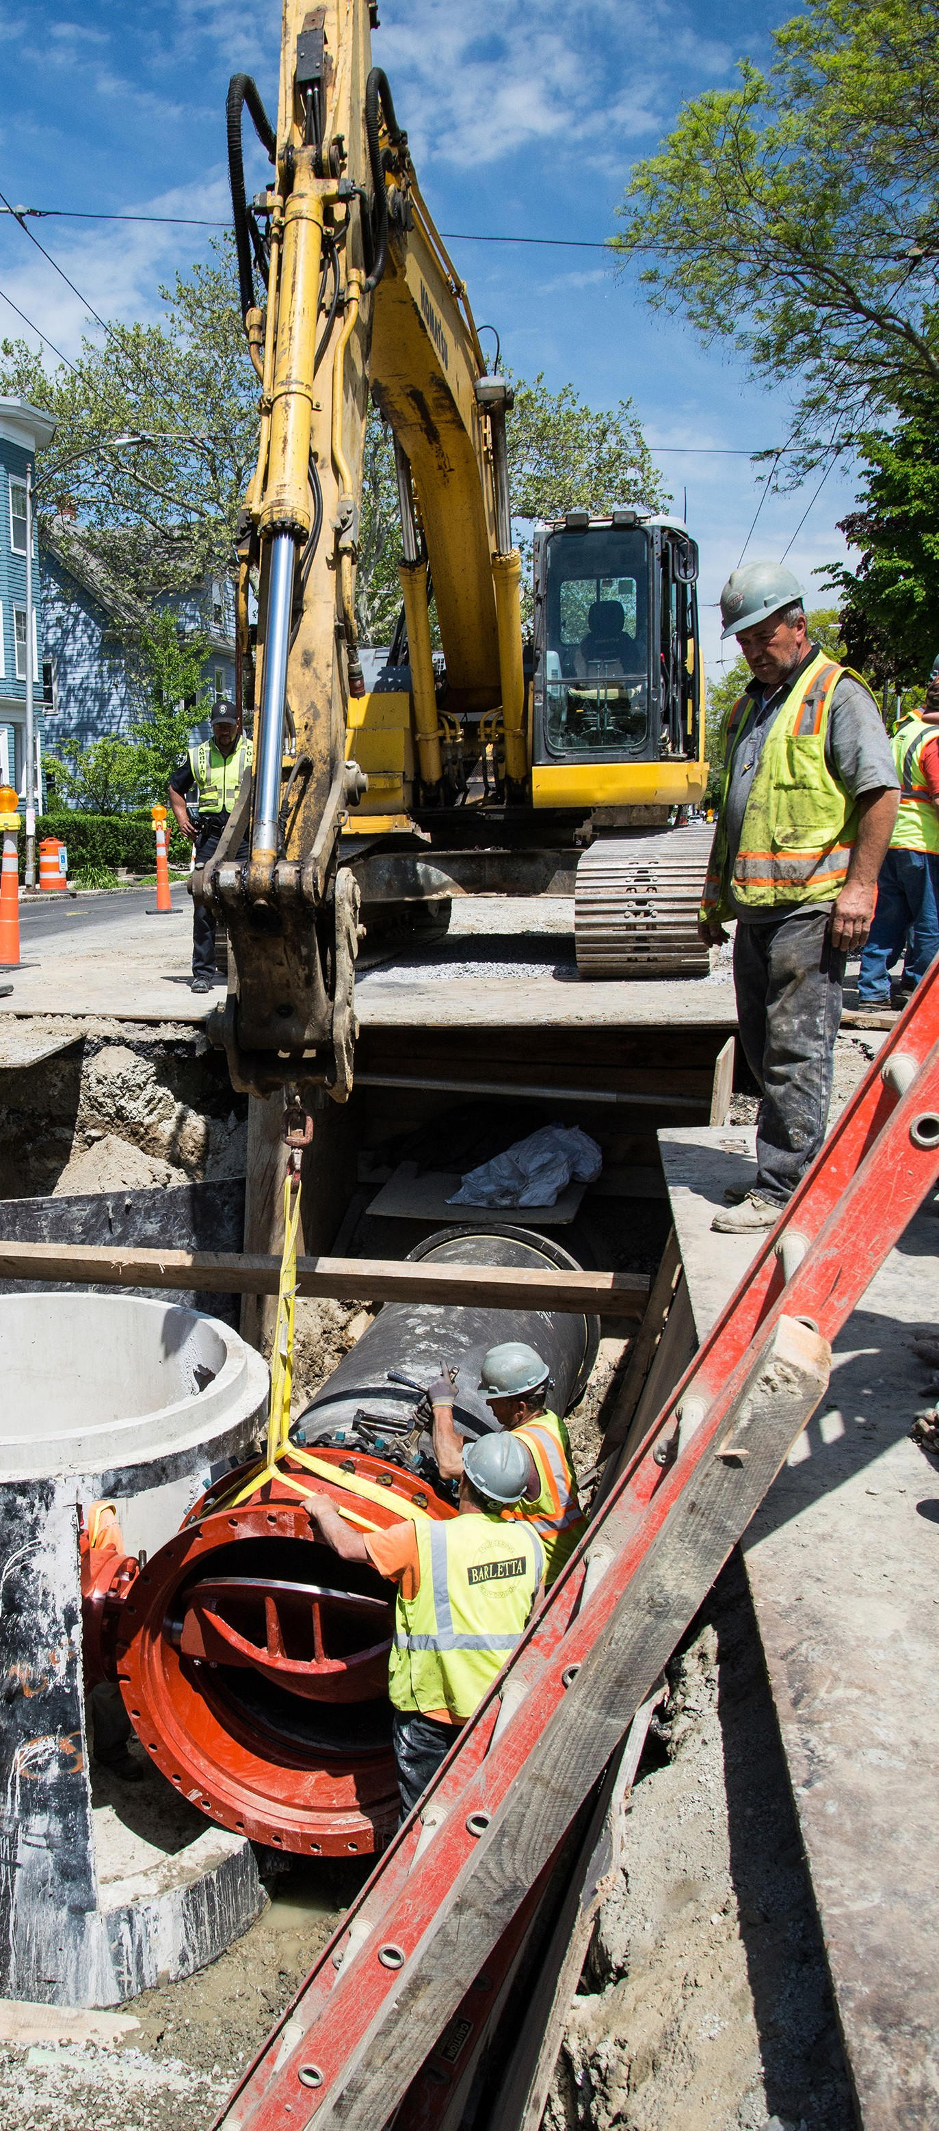
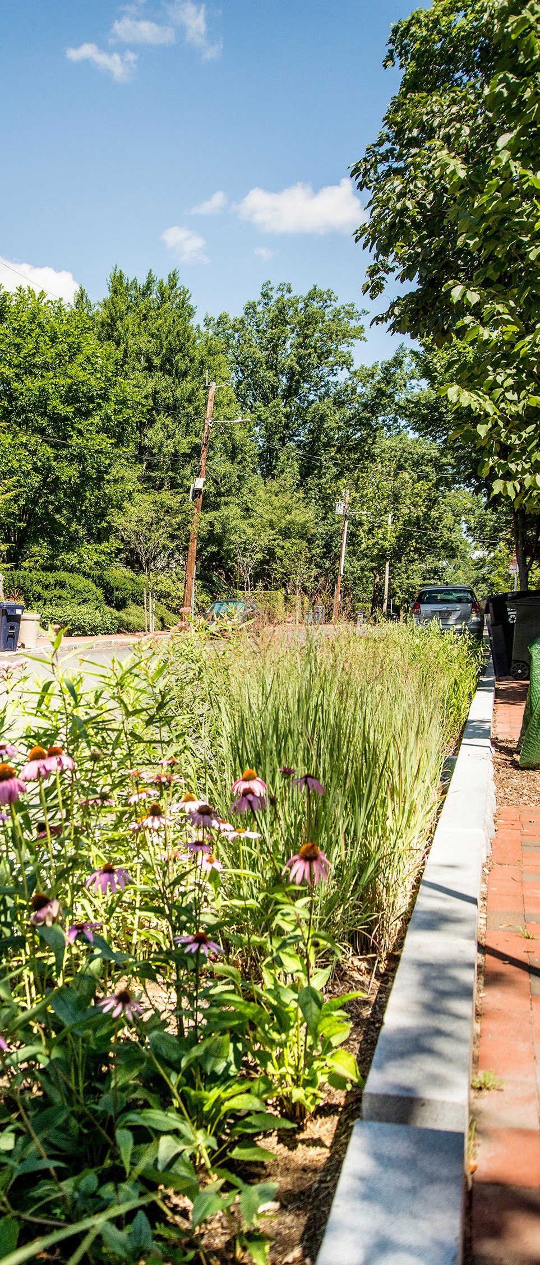
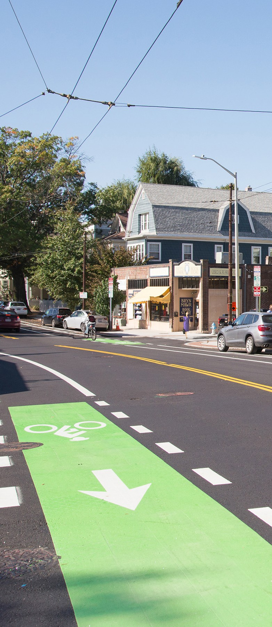

City of Cambridge
Department of Public Works
Five Year Sidewalk and Street
Reconstruction Plan
5.1.2018
Notes:
Introduction – Background.
City has a 5 year Sidewalk and Street Plan that identifies streets and sidewalks that will be reconstructed over the next 5 years.
Here tonight to discuss XXXX street, which is in the 5 year Plan for 20XX.
The goal is to work with the community to develop a plan for your street.
Before we begin the design process, I want to take a few minutes to review some background material and the city’s policies and plans that are part of the design process.

Slide 3
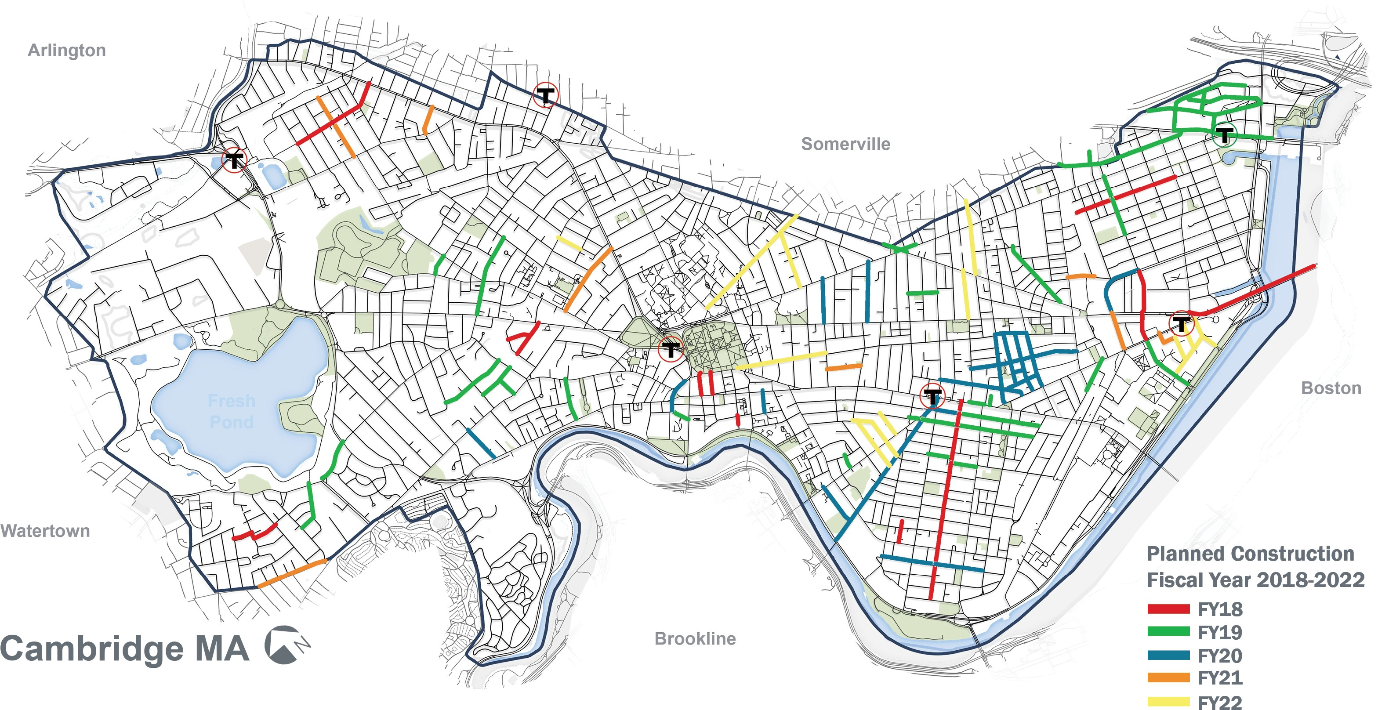
5 YEAR PLAN PLANNED CONSTRUCTION
15
Interactive construction map: www.cambridgema.gov/theworks/constructionmap
Notes:
Plan of construction expected for the next 5 years. Your street XXX is scheduled for 20XX.

Slide 4
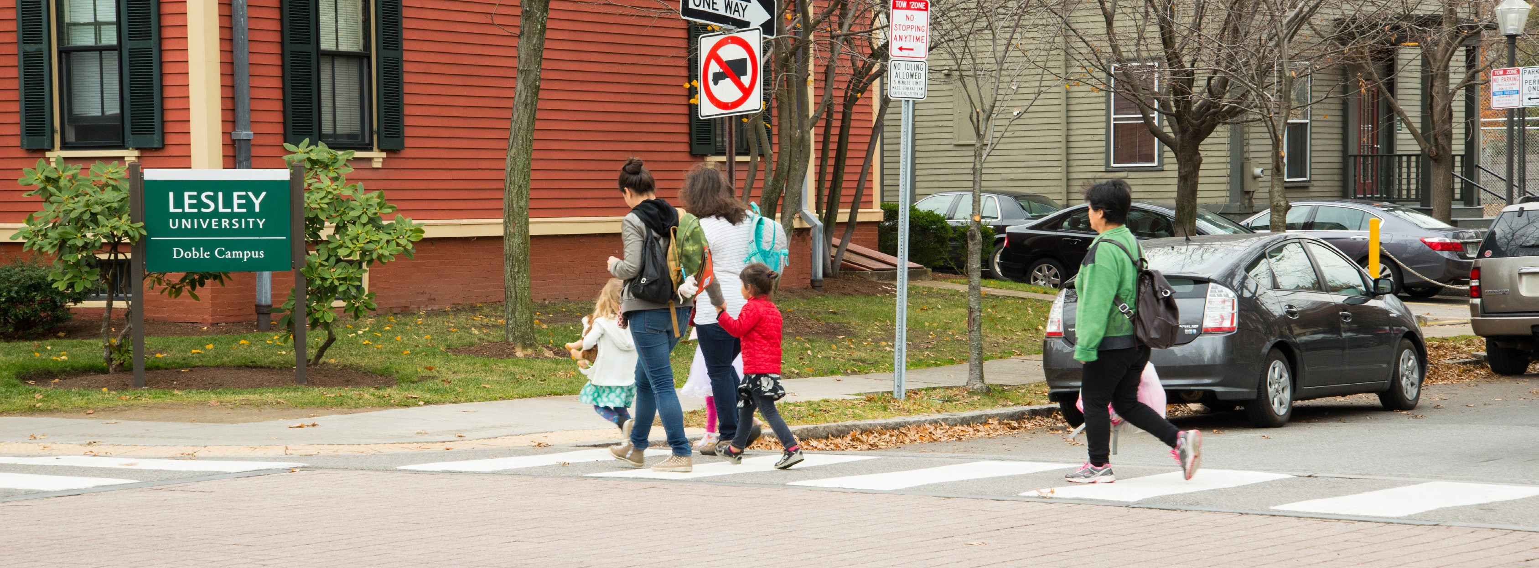
INTRODUCTION COMPLETE STREETS
Complete Streets are streets for everyone. They are designed and operated to enable safe access for all users. Pedestrians, bicyclists, motorists, and public transportation (transit) users of all ages and abilities are able to safely move along and across a Complete Street. Complete Streets make it easy to cross the street, walk to shops, and bicycle to work. They help buses to run on time and make it safe for people to walk to and from train stations.
More sidewalks and bicycle facilities are included, which provides increased accessibility for pedestrians and cyclists.
During design and construction of Complete Streets, our goal is to communicate projects with neighborhoods, facilitate an integrated design process, minimize disruption to community life and provide reasonable access for all users during reconstruction.
Notes:
City Council adopted a complete streets policy in 2016. Goal of designing and operating streets to enable safe access for all users of all ages and abilities.

Slide 5

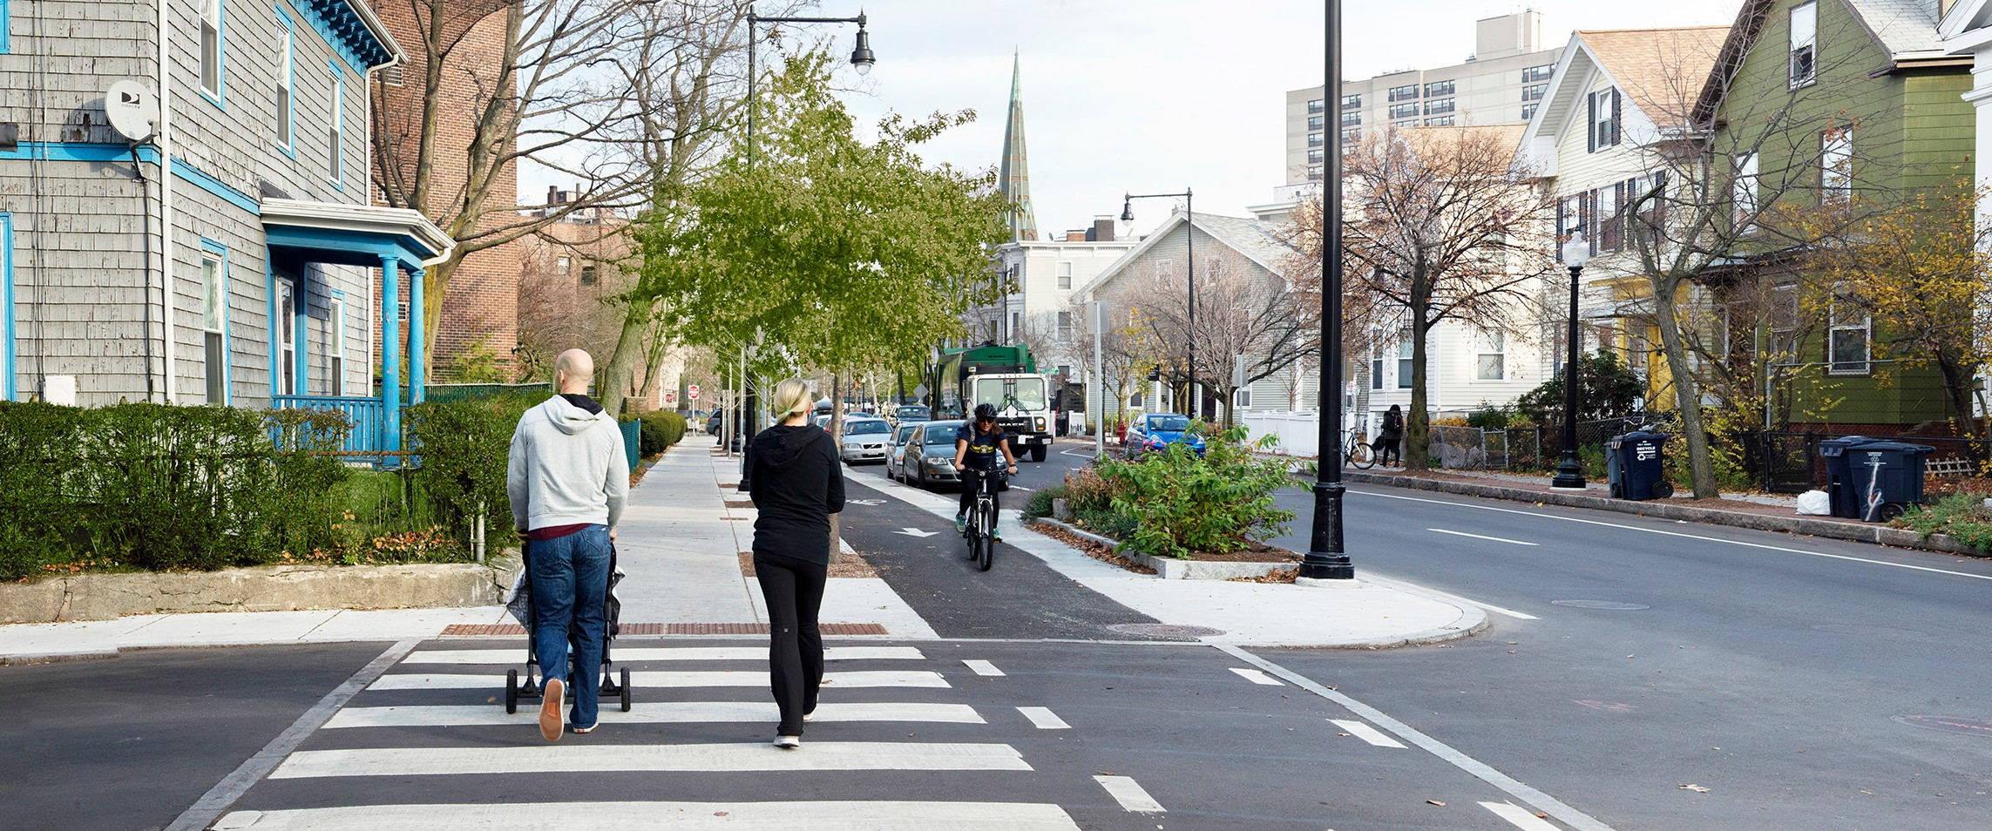
INTRODUCTION VISION ZERO
On March 21, 2016, the Cambridge City Council unanimously passed resolutions put forth by the City Manager to formally adopt Complete Streets and Vision Zero policies, showing that the City of Cambridge is committed to achieving these goals, assuring safe access for all users.
Vision Zero calls for the elimination of fatalities and serious injuries resulting from traffic crashes, and emphasizes that they can and should be prevented. The City of Cambridge is the 17th city in the U.S. to commit to a Vision Zero Policy.
Notes:
City Council adopted a Vision Zero policy in 2016. Vision Zero calls for the elimination of fatalities and serious injuries resulting from traffic crashes.

Slide 6
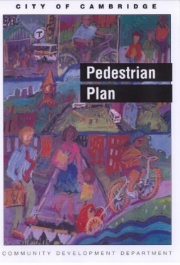

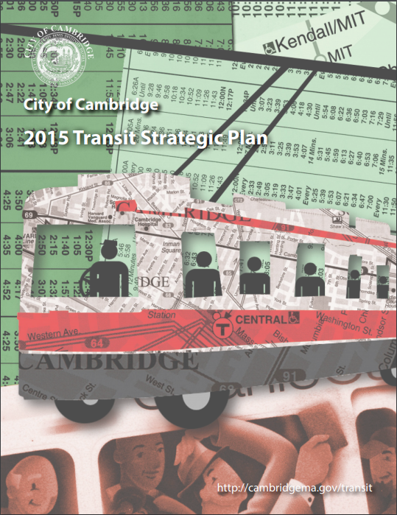


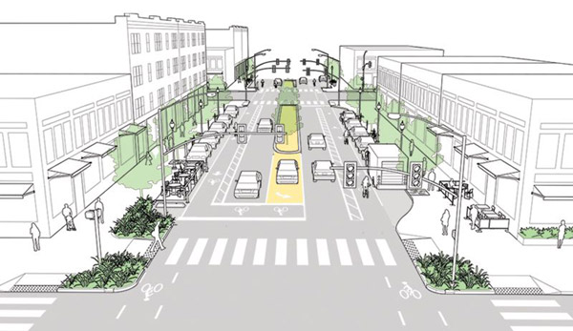
INTRODUCTION GUIDING PLANS AND POLICIES
In addition to Complete Streets and Vision Zero
Vehicle Trip Reduction Ordinance established programs to encourage alternatives to single-occupancy vehicle travel (1992).
Cambridge Growth Policy emphasizes sustainable modes of transportation such as walking, biking and using transit and low-emission vehicles, which promote livability and help to improve air quality and reduce greenhouse gas emissions (1993/2007).
Notes:
In addition to Complete Streets and Vision Zero, the city has several other policies and plans that form the basis of our approach to street reconstruction.
Policies – Cambridge Growth Policy and Vehicle Trip Reduction Ordinance – emphasis on sustainable modes of transportation to promote livability, improve air quality and reduce gas emissions.
Pedestrian Plan, Bicycle Plan and Transit Plan – emphasis on how to improve comfort, safety and operation for sustainable modes of transportation.
Goal is to provide a transportation system that is sustainable and efficient; moving people safely.
Climate Plan and commitment to urban forest (street trees) – important commitments for a changing environment,
slow down climate change by lowering greenhouse gas emissions
and reduce impacts of climate change (provide increased tree canopy to reduce impacts of increasing heat waves.
Use these policies and plans to provide basis for design process. Then work with residents on detailed design options.

Slide 7






5 YEAR PLAN SCOPE OF WORK
Our approach emphasizes streets designed and operated for everyone. Pedestrians, bicyclists, motorists, and transit users of all ages and abilities will be able to safely move along and across Complete Streets.
Emphasis on accessibility – pedestrian ramps, sidewalks and universal design.
Vision Zero calls for the elimination of fatalities and serious injuries resulting from traffic crashes.
Transit improvements – accessibility of bus stops and transit priority, as feasible.
Network of bike facilities – support people of all ages and abilities to bike safely throughout the city.
Additional street trees and green infrastructure.
Maintain and improve city infrastructure, and coordinate with private utilities to facilitate upgrades.
Notes:
Highlight the overall scope of work for streets in the 5 Year Plan. We’ll focus a bit more on some of these, but want to emphasize the all of the things we consider as we begin a design process.
Accessibility – core mission of 5 Year Plan is to improve the accessibility of our streets and sidewalks. Vision Zero – safety.
Transit improvements – accessibility of bus stops and transit priority, as feasible.
Bike = vision of a network of connected bike facilities
Street trees and green infrastructure – improve stormwater quality and reduce urban heat island impacts of our streets.
Utilities – A significant portion of the work we do is coordinated with city and private infrastructure needs. We are committed to maintaining and enhancing our infrastructure (sewer, drainage, water systems).

Slide 8
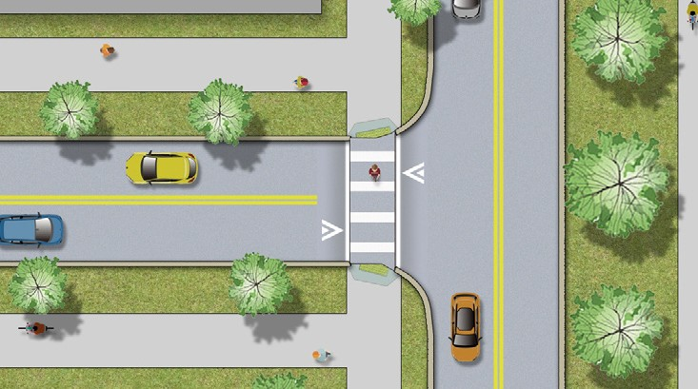


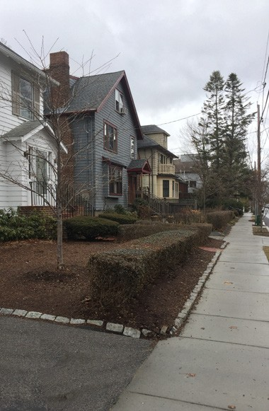

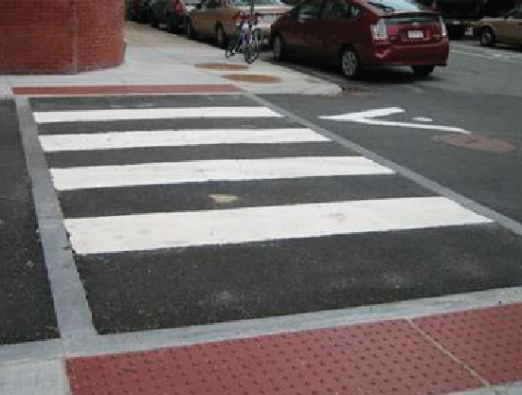
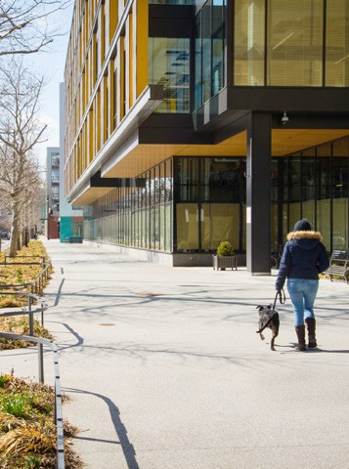




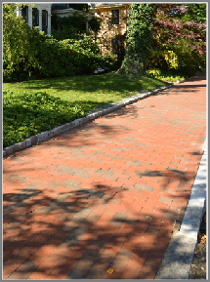
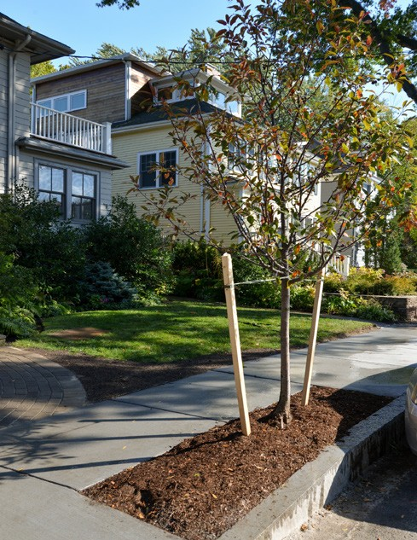

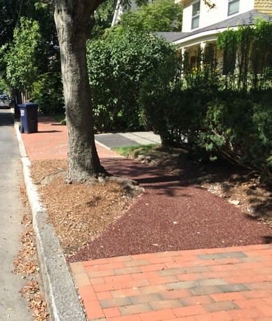

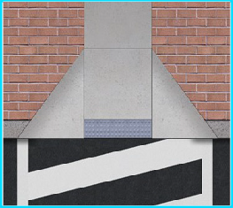
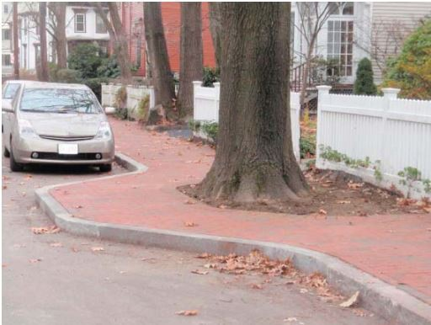
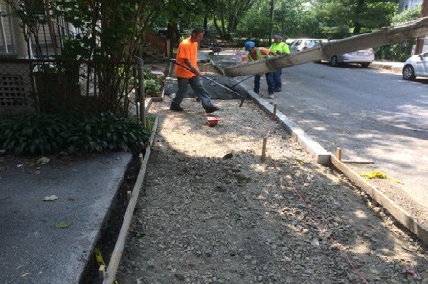

PROGRAMS STREET & SIDEWALK
Street and sidewalk contracts are funded locally and by the state. These contracts are managed by the Department of Public Works. Construction generally includes surface enhancements such as:
Paving
Sidewalk and pedestrian ramps
Traffic calming
Street trees
Stormwater management and green infrastructure
Bike and transit improvements
Toolbox Design Elements
Raised Crosswalks
New Sidewalks
New Tree
TOOLBOX DESIGN ELEMENTS
STREET & SIDEWALK RECONSTRUCTION
New Tree Plantings
Plantings
Flexi Pave
[at trees]
Curb Extensions & Ramps
Sidewalk
Construction
Notes:
Provides some examples / visuals of the scope of work and what that means. Will highlight a few of these in more detail.

Slide 9
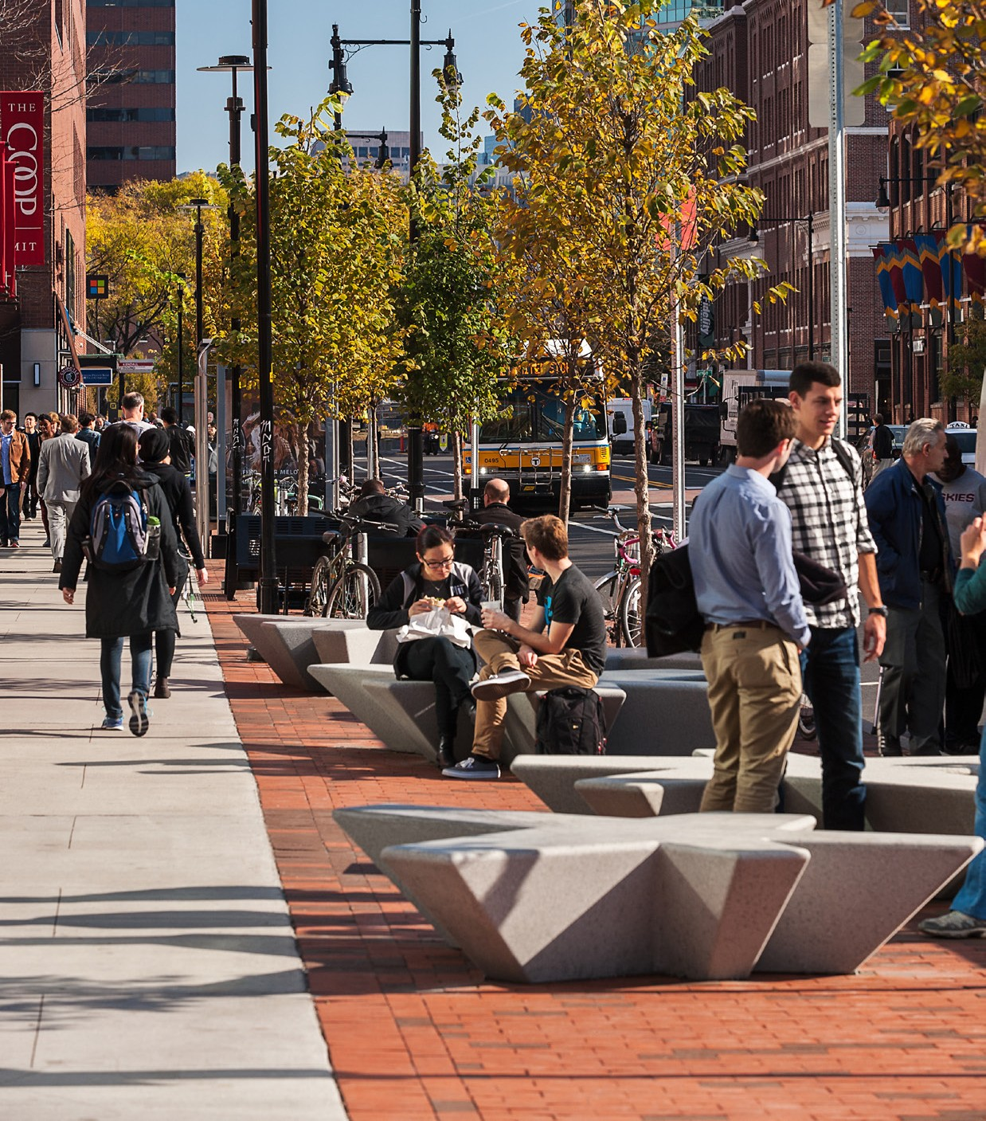
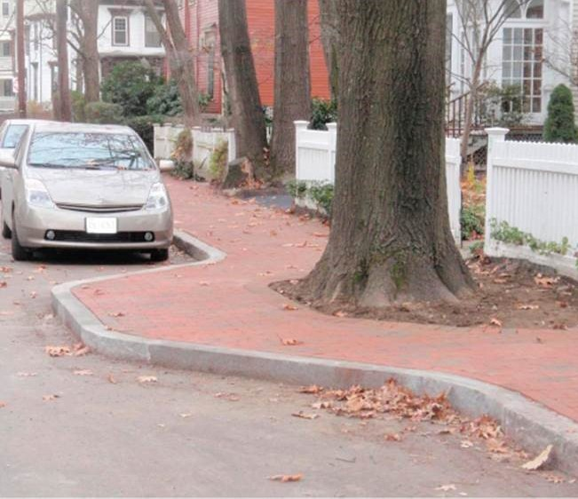
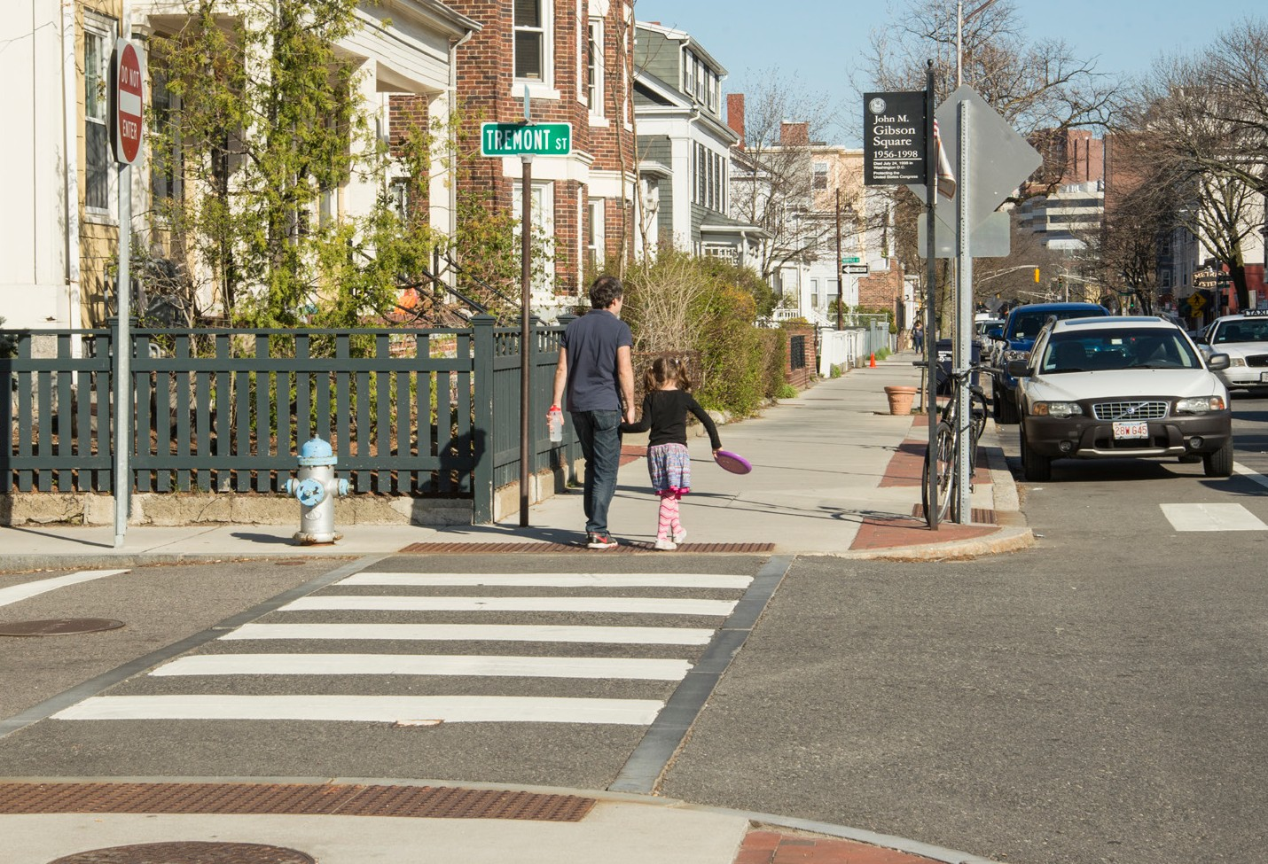
DESIGN
SIDEWALKS AND ACCESSIBILITY
The City is committed to accessibility in all of our construction projects.
All new sidewalks and pedestrian ramps will meet ADA / AAB requirements.
Sidewalk widths vary by the type of street. Typically 5’ sidewalk is required, but wider sidewalks are required on busier commercial streets and arterials.
4’ min is required at new driveways and street trees. 3’ min is allowable at existing street trees.
Sidewalks will include a minimum 3’ of sidewalk or accessible routes around existing trees.
The best design for pedestrian crossings, particularly on narrow side streets, may be a modified raised crosswalk.
Photo Credit:
Christian Phillips Photography and Klopfer Martin Design Group
Notes:
Accessibility, why is this important?
1 – it’s the law. Both Federal and State regulations cover the construction of sidewalks and require newly constructed sidewalks to be accessible.
2 (and more importantly) – it’s the right thing to do. We want our sidewalks to be as inviting and usable by people of all ages and abilities. People using wheelchairs, walkers or pushing strollers.
Interesting context:
As the population ages, the percentage of people with disabilities increases.
In 2016 12.8% of US population identified as having a disability. For people over 65 year of age, 35.2%.
Accessible sidewalks are part of the efforts to allow people to age in place.
What is required to make a sidewalk accessible?
Typically think about condition of the sidewalk. Is it smooth?
Also, think about the cross-slope of the sidewalk. How steep is it? How steep is the sidewalk as it goes across driveways?
What is the width of the sidewalk? What about at existing street trees and driveways?
As we are reconstructing sidewalks, need to address these deficiencies.

Slide 10
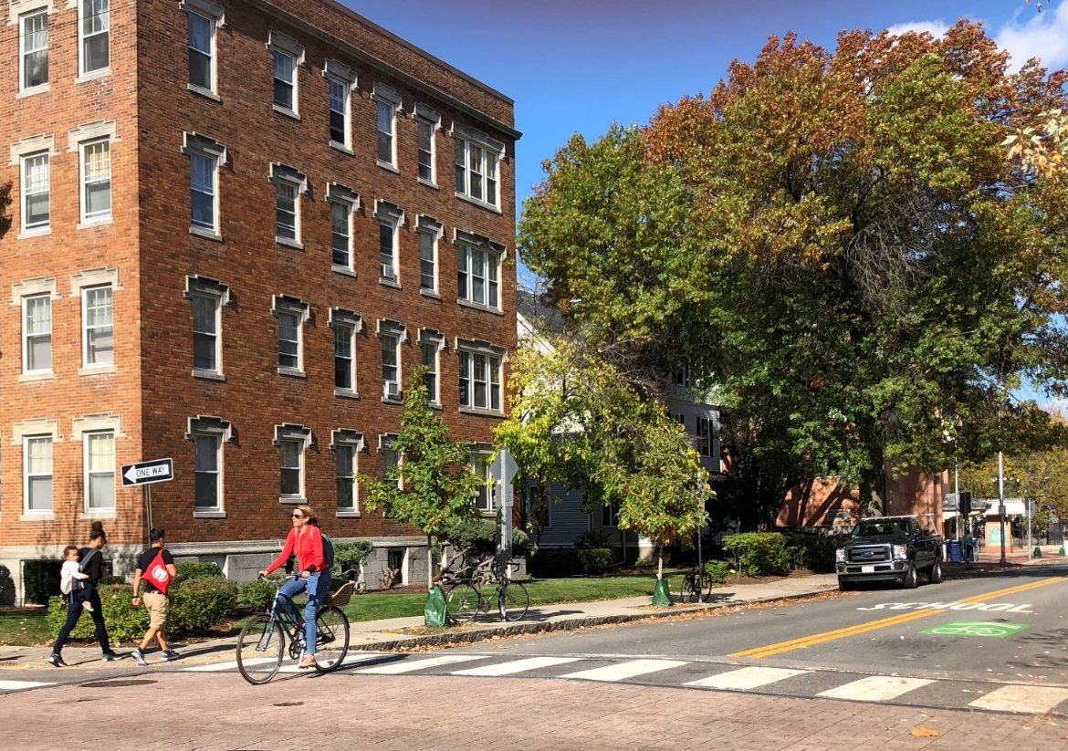

DESIGN BICYCLE FACILITIES
Bicycle Facilities
Improvements for bicycling will be considered in all projects undertaken in the City and will be guided by the Bicycle Plan.
The Bicycle Plan lays out a vision for where we as a City want to be. The fundamental guiding principle for this plan is to enable people of all ages and abilities to bicycle safely and comfortably throughout the City. The Bicycle Plan provides the framework for developing a network of Complete Streets and supporting programs and policies that will help meet this goal.
Notes:
Bike Plan lays out a vision for where we as a City want to be.
Goal is to enable people of all ages and abilities to bicycle safely and comfortably throughout the City.
Plan provides framework for developing a network of Complete Streets.
Plan is a guide, but doesn’t provide specific designs for individual streets. Through the design process, we develop the design for individual streets.

Slide 11
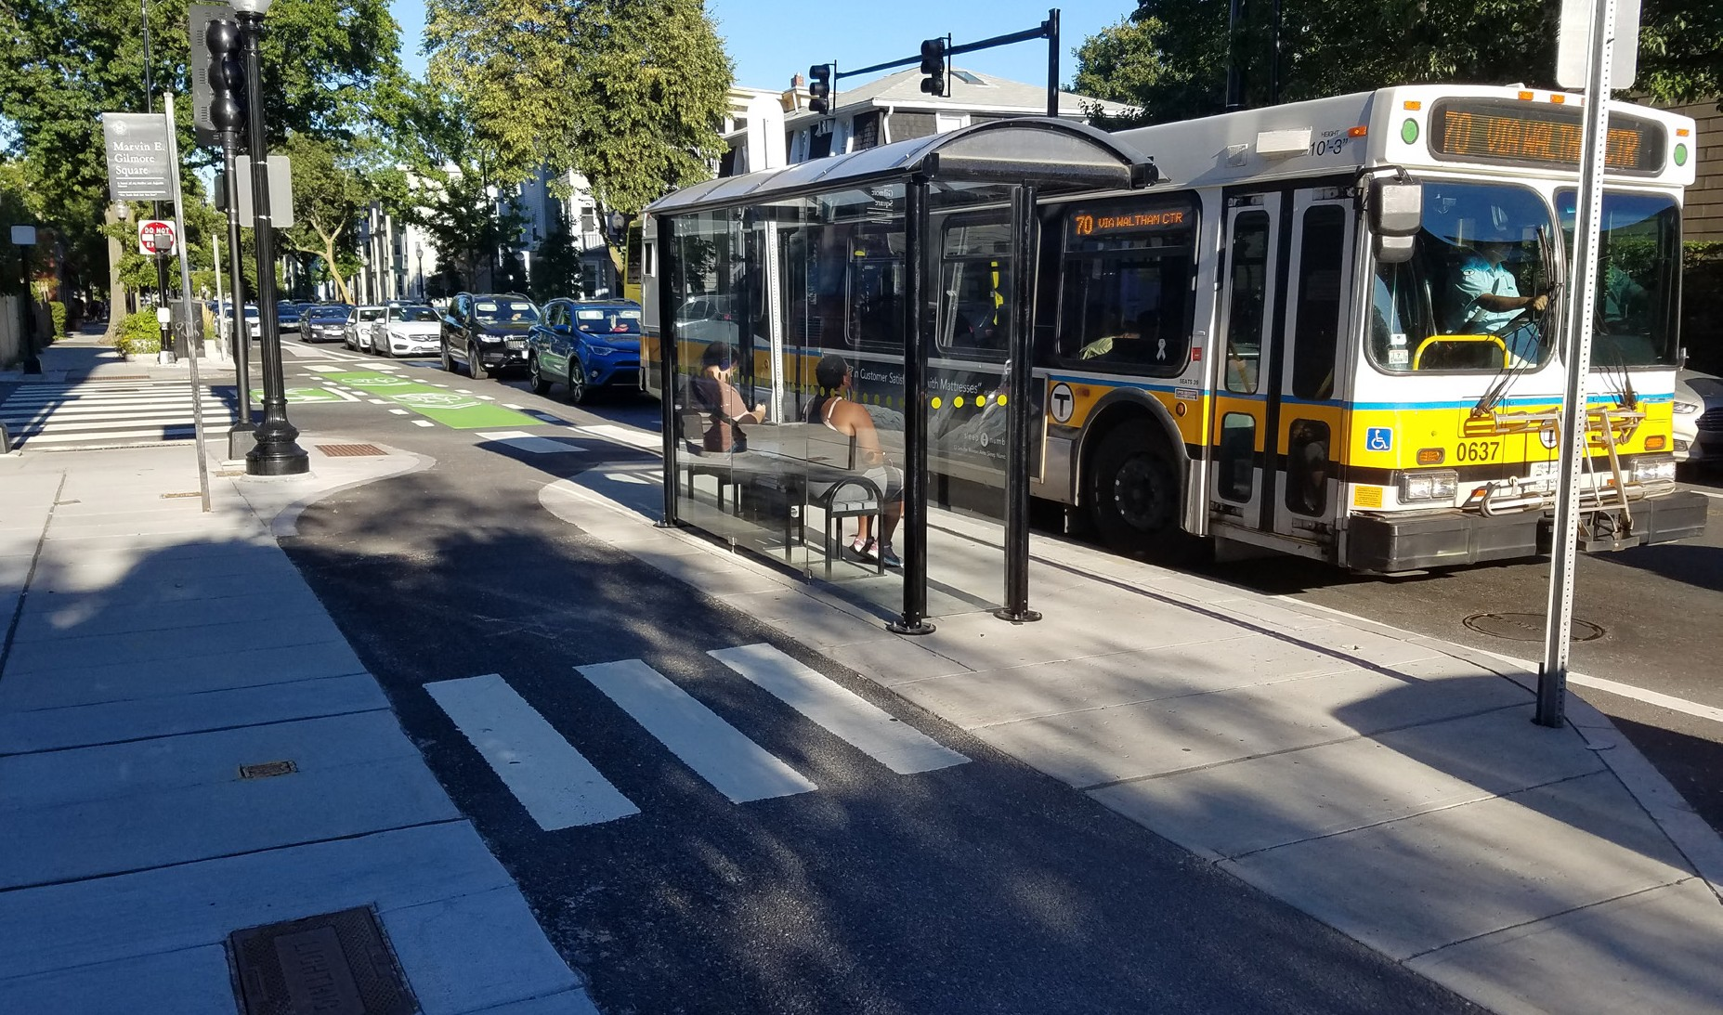
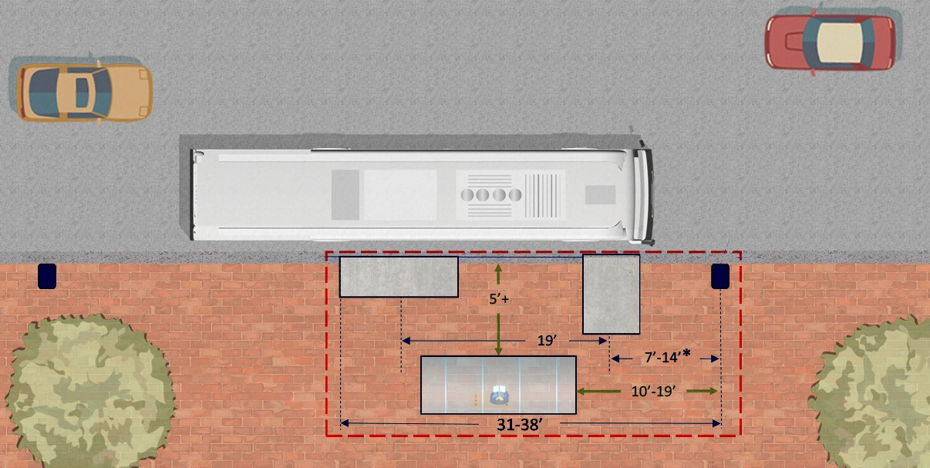

DESIGN TRANSIT
A sustainable and efficient mode of transportation that moves people safely compared to driving in private automobiles.
Transit considerations include:
Accessibility
Ensure that bus stops are accessible and provide amenities when appropriate.
Priority
City performed a bus delay and reliability assessment so that we can explore options for transit priority (e.g. dedicated lanes) in roadway projects where there are expected benefits.
40’ MBTA Bus (10.5’ wide with mirrors)
5’ x 8’ ADA
landing pad
Front bus stop sign
Rear bus stop sign 90’ from front sign
4’ x 10’ rear
door clear zone 5’x13’ Shelter
or smaller bench
Notes:
The City doesn’t control the MBTA system, but we can make improvements in our projects to improve accessibly of bus stops and improve access to the bus system.
On some streets, there may not be transit facilities or considerations, but want to emphasize that we are committed to improving transit access and accessibility of transit.

Slide 12
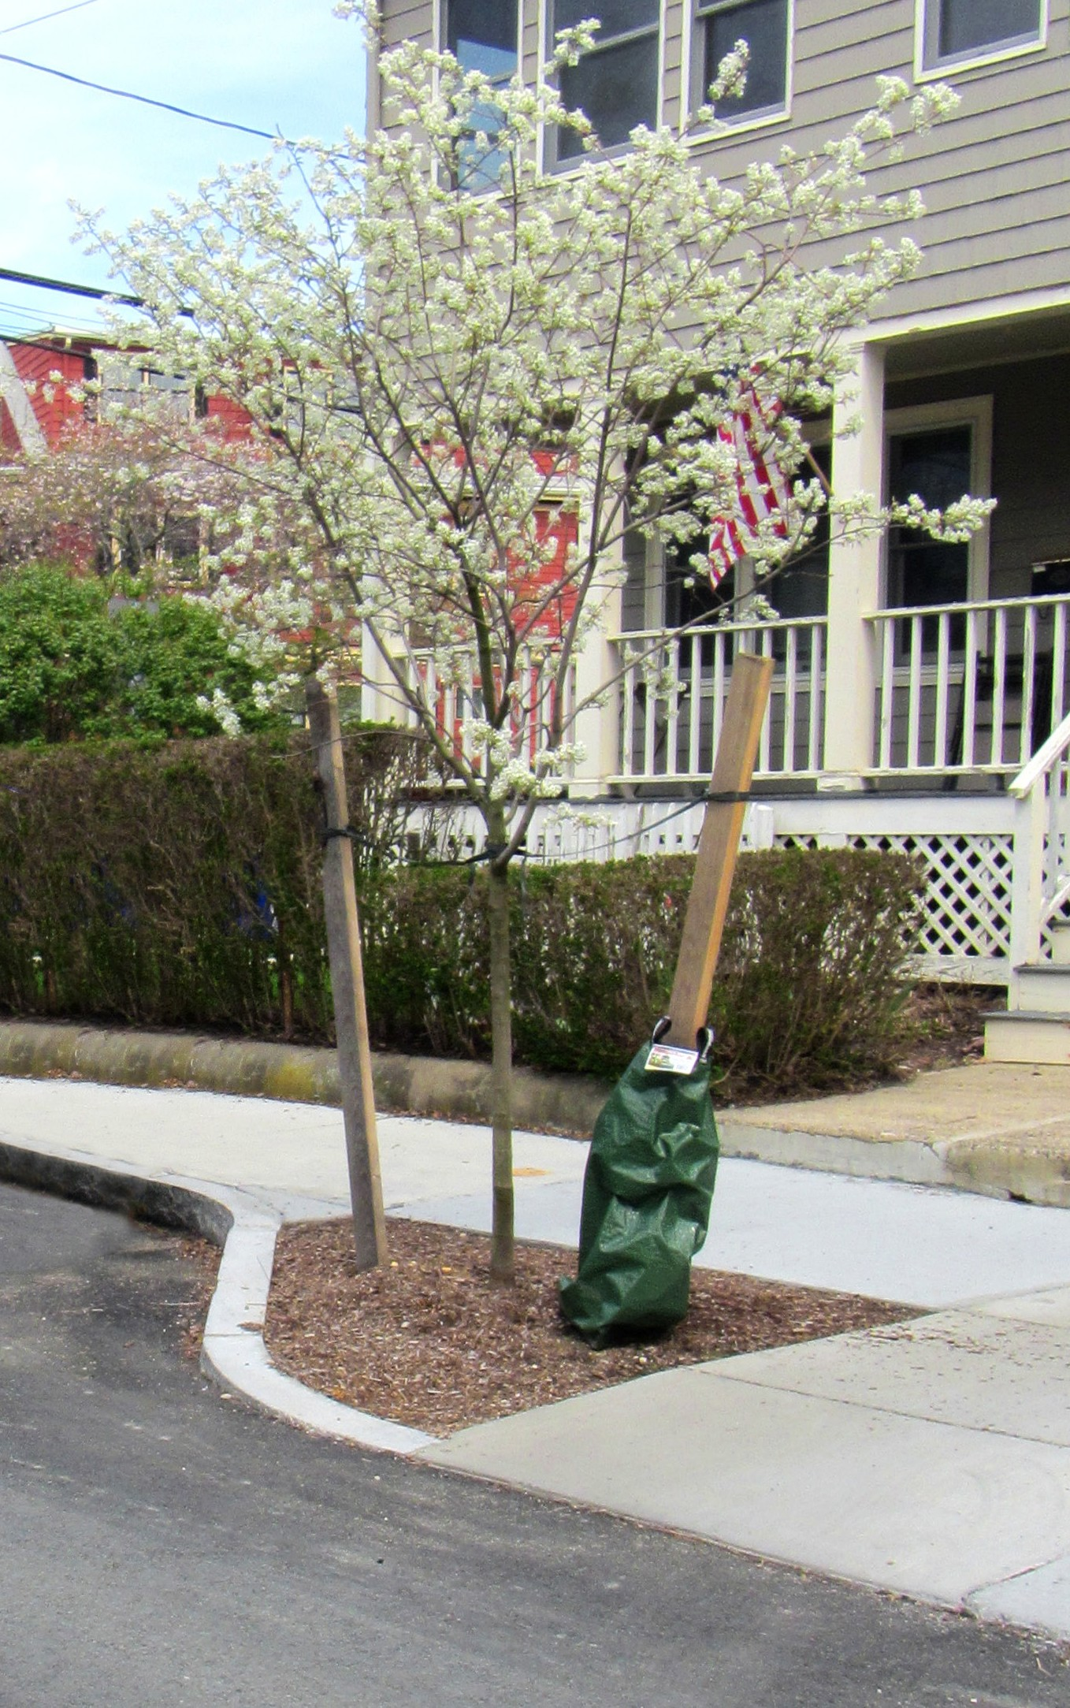
SCOPE STREET TREES
Existing Street Trees
Existing street trees will be protected during construction and the sidewalks will be carefully evaluated to ensure adequate accessible routes through the neighborhood.
New Tree Plantings
The City Arborist will review each street and sidewalk project to determine tree planting opportunities; evaluating the location of overhead and underground utilities, proximity to intersections, site lines, building setbacks, locations of entrances, etc.
On narrow sidewalks (less than 8’ wide), a minimum of 4’ of sidewalk width will be retained adjacent to new trees.
On wider sidewalks (8’ wide or greater), a minimum of ½ of the overall sidewalk width will be retained for pedestrians.
GOALS
Protect existing street trees during construction.
Increase the number of street trees and maintain accessible sidewalks.
Back of Sidewalk Trees
The Arborist will work with residents interested in back of sidewalk tree plantings.
Notes:
Street trees – important element of our projects.
Protect existing trees during construction.
Provide new trees as part of construction projects.
Need to ensure that new trees do not compromise accessibility of sidewalks.
Carefully evaluate location and planting details for trees to improve their success.
Provide expanded zone of sand based structural soil at new trees and
contract provides watering for 2 years.
Review widths required and back of sidewalk program.

Slide 13
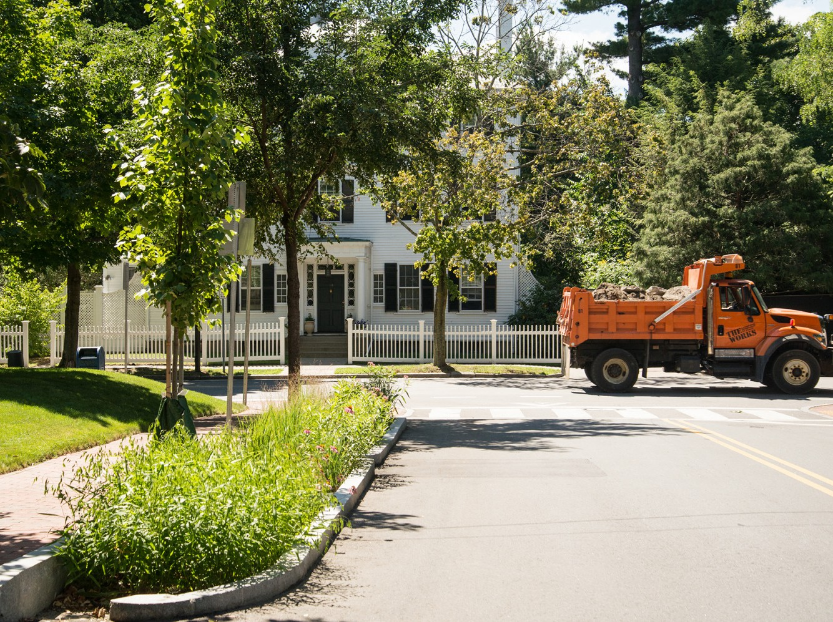
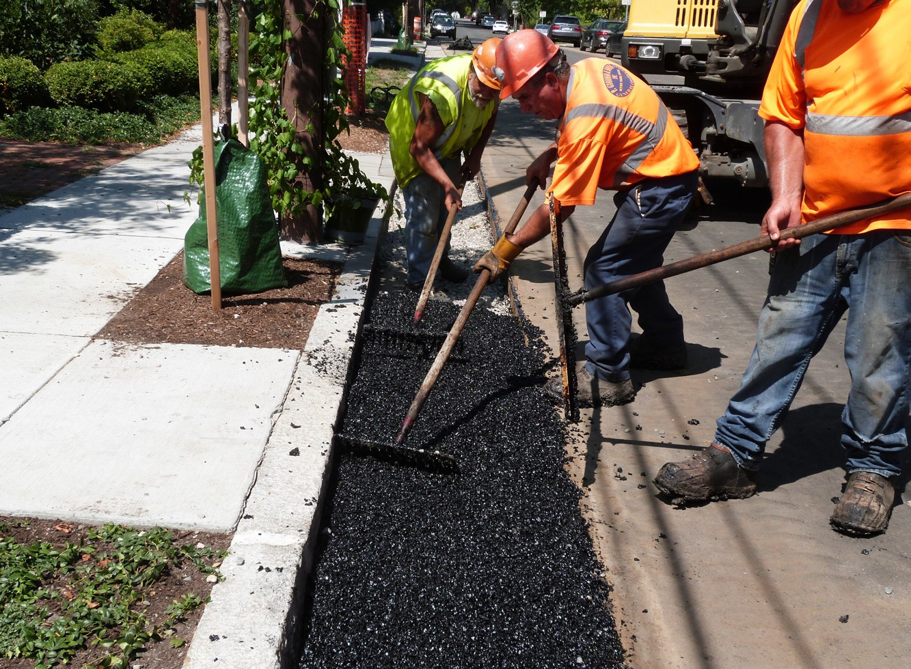
SCOPE GREEN INFRASTRUCTURE
The City is incorporating green infrastructure on projects, as conditions and space allow.
Goals
Stormwater discharges are contributing to at least 55% of impairments to Massachusetts’ assessed waters.
Goal: improve the water quality of stormwater before discharging to outfalls at the Alewife Brook and Charles River.
Types of Improvements
Porous asphalt
Infiltrating catch basins
Rain gardens/bio basins
Siting Evaluation
Soil conditions
Groundwater
Space constraints
Maintenance
Notes:
Green infrastructure is a part of our efforts to improve the water quality of stormwater before it is discharged to the Alewife Brook or Charles River.
Have successfully implemented green infrastructure on Western Avenue and the West Cambridge sewer separation project.
Committed to incorporating it into smaller projects, as conditions and space allow.

Slide 14
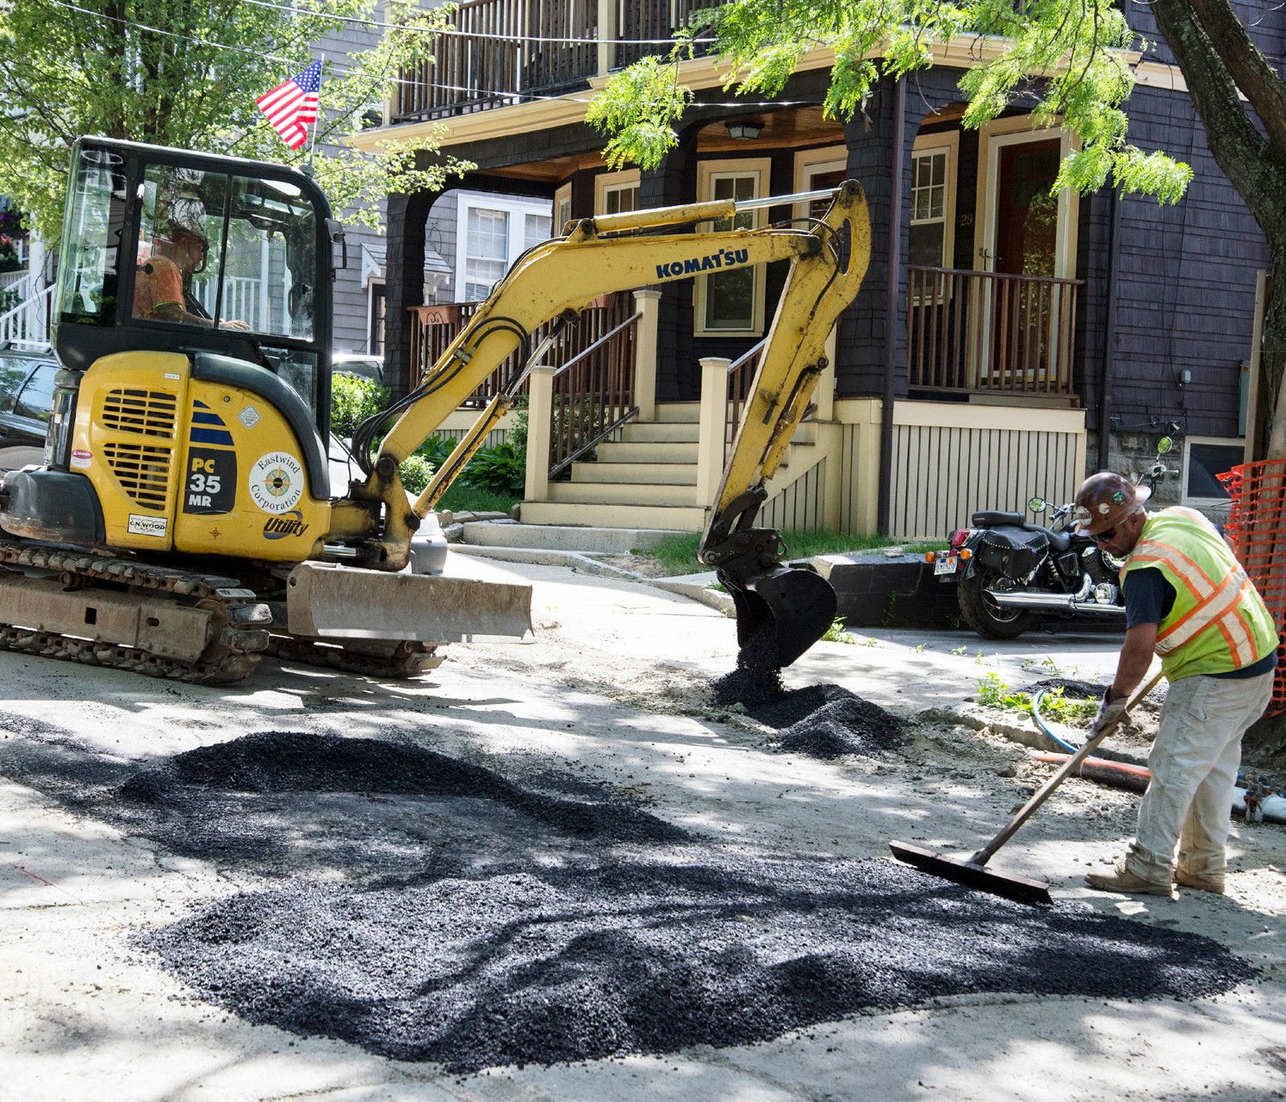
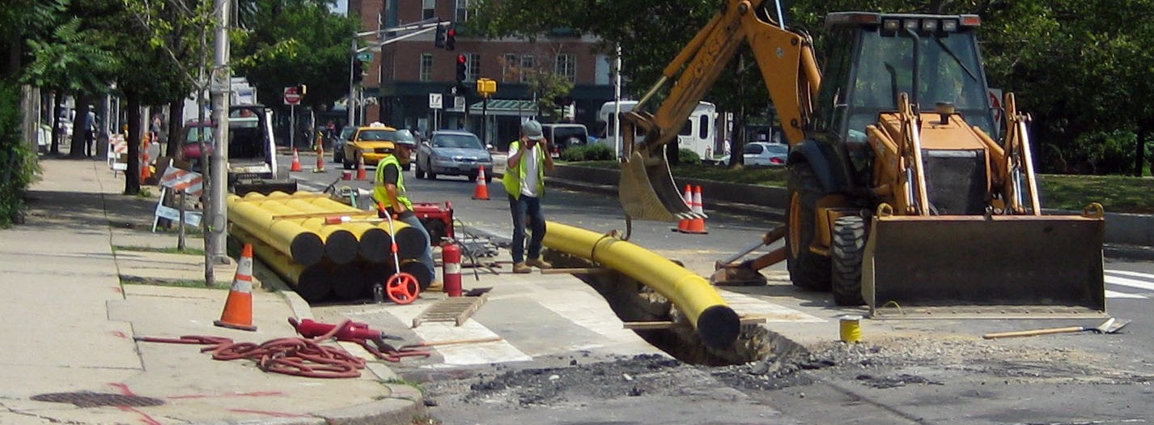
SCOPE Construction
The City is committed to working with residents and businesses throughout the construction process.
Construction Coordination
Project Manager and Community Relations Manager assigned to every project.
Manage contractor and coordinate construction activities and community notifications.
Standard Work Hours: Mon – Fri 7 am – 4 pm
Maintain safe and effective traffic management plans to assist pedestrians, cyclists, drivers and buses travelling through project area.
Notes:
Construction is disruptive – loud and frustrating. We can’t make it magically go away, but we are committed to working with residents and businesses throughout the construction project.
Each project is assigned a project manager and community relations manager. Manage contractor and coordinate with residents.
Work Hours – 7 to 4 mon to fri – typical.

Slide 15
Construction Project Scope
Reconstruct/repave street
Reconstruct sidewalks and curb ramps
New crosswalks, pavement markings
Evaluation and updating utilities
Project Objectives
Meet access codes
Improve safety for all users
Enhance appearance of the neighborhood
Enhance green areas/new trees

Slide 16
Elm Street Hampshire St to Cambridge City Line

Slide 17
Discussion
Comments?
Questions?
Concerns?
Tell us what you think!

Slide 18
