Slide 1
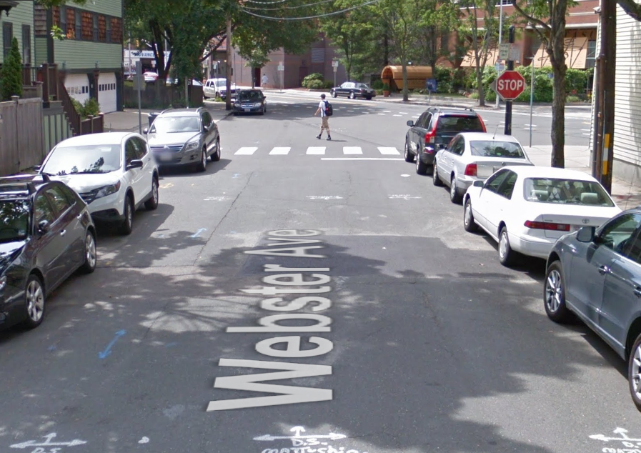
Webster Avenue
Hampshire Street to Lincoln Street
Reconstruction Project

Slide 2
Construction Project Scope
Reconstruct/repave street
Reconstruct sidewalks and curb ramps
New crosswalks, pavement markings
Evaluation and updating utilities
Project Objectives
Meet access codes
Improve safety for all users
Enhance appearance of the neighborhood
Enhance green areas/new trees

Slide 3
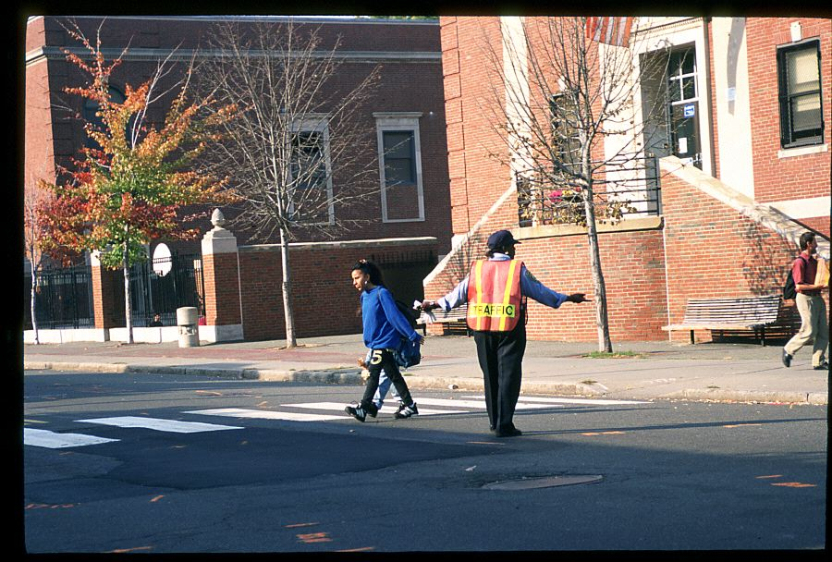
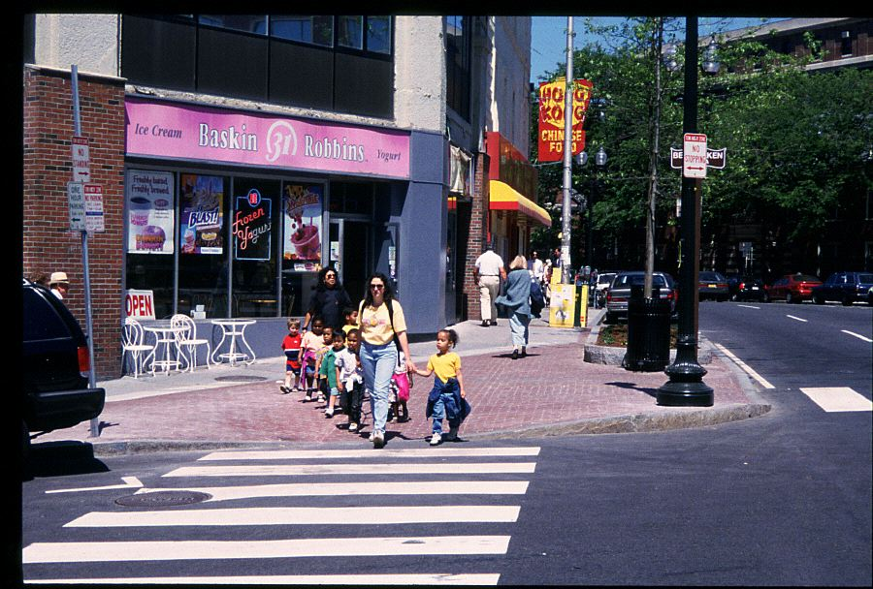
Safety first !!

Slide 4
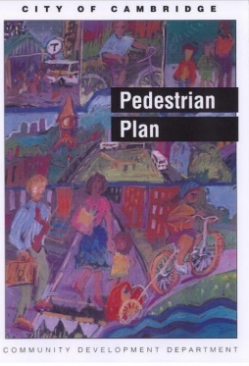

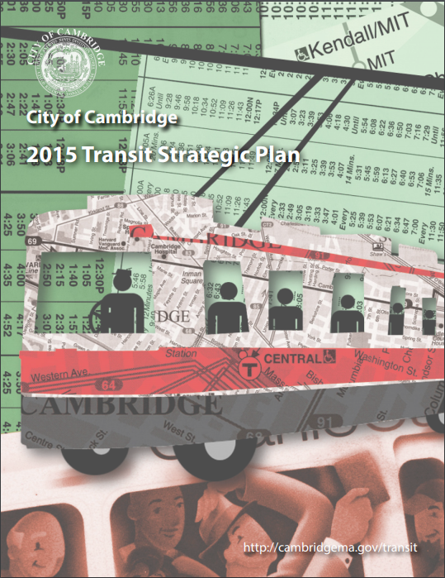

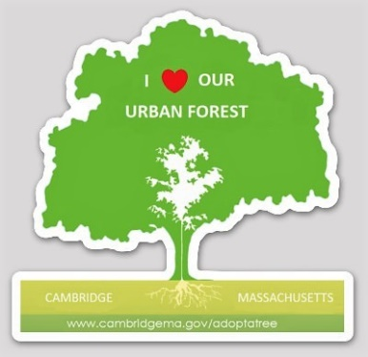
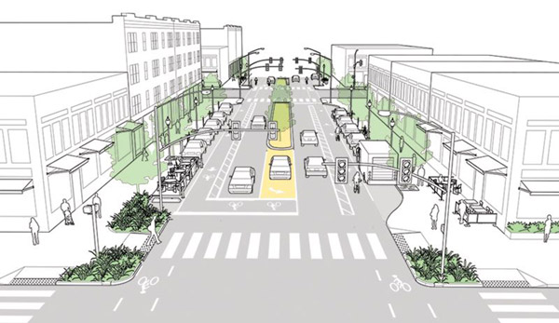
GUIDING PLANS AND POLICIES
In addition to Complete Streets and Vision Zero
Vehicle Trip Reduction Ordinance established programs to encourage alternatives to single-occupancy vehicle travel (1992).
Cambridge Growth Policy emphasizes sustainable modes of transportation such as walking, biking and using transit and low-emission vehicles, which promote livability and help to improve air quality and reduce greenhouse gas emissions (1993/2007).
Notes:
In addition to Complete Streets and Vision Zero, the city has several other policies and plans that form the basis of our approach to street reconstruction.
Policies – Cambridge Growth Policy and Vehicle Trip Reduction Ordinance – emphasis on sustainable modes of transportation to promote livability, improve air quality and reduce gas emissions.
Pedestrian Plan, Bicycle Plan and Transit Plan – emphasis on how to improve comfort, safety and operation for sustainable modes of transportation.
Goal is to provide a transportation system that is sustainable and efficient; moving people safely.
Climate Plan and commitment to urban forest (street trees) – important commitments for a changing environment,
slow down climate change by lowering greenhouse gas emissions
and reduce impacts of climate change (provide increased tree canopy to reduce impacts of increasing heat waves.
Use these policies and plans to provide basis for design process. Then work with residents on detailed design options.

Slide 5
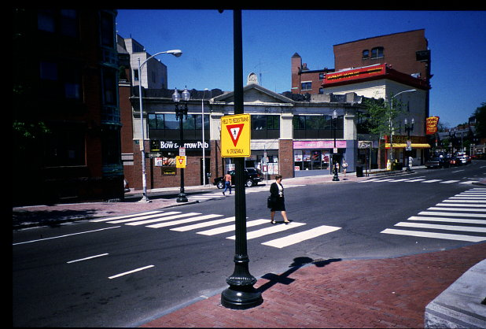

Making crossings work
International or “zebra” striping
Mark all legs of an intersection
Thermoplastic or inlay tape
Curb extensions reduce crossing distances
and improve visibility

Slide 6
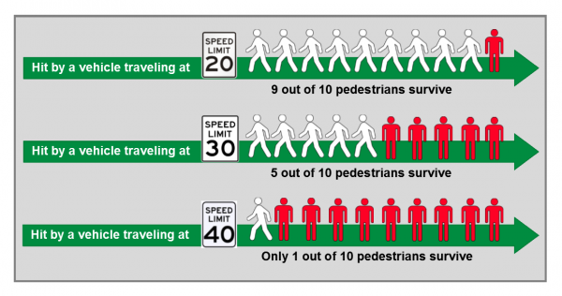
Pedestrian injuries/Fatalities in Crashes by Vehicle Speed

Slide 7
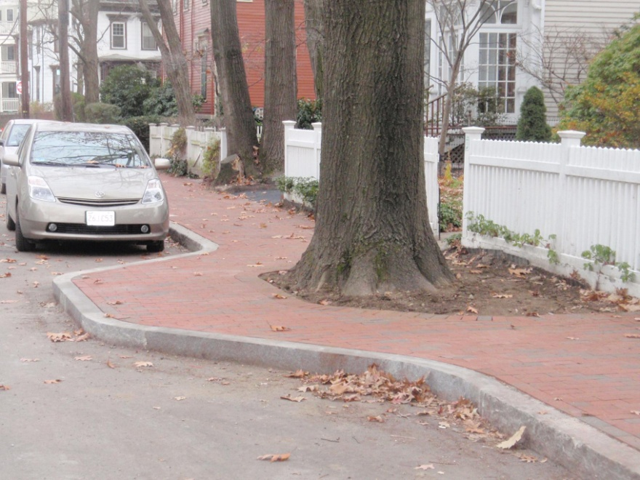
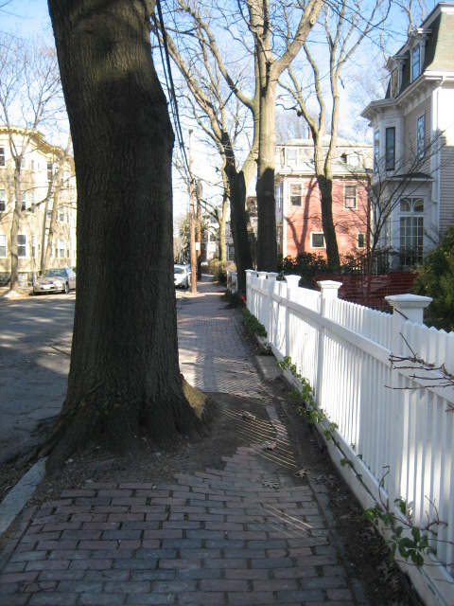
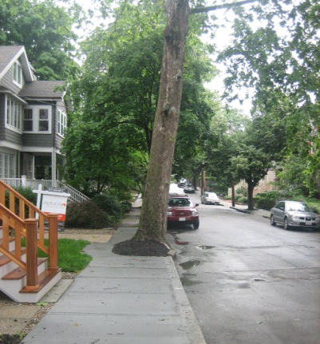
Access

Slide 8
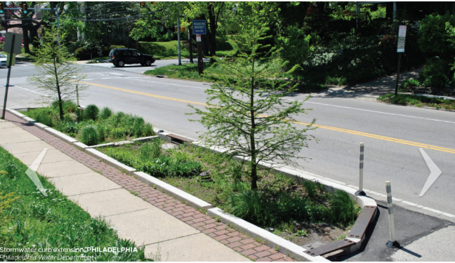
Green Curb Extension

Slide 9
Traffic Calming Tools
• Narrow the road
Add Parking
Pavement Markings (edge line for bikes)
Visual Narrowing by Adding Trees
• Horizontal Devices: make the road less straight
Chicanes
Crossing Islands
• Vertical devices: make vehicles go over something
Raised intersections & crosswalks

Slide 10
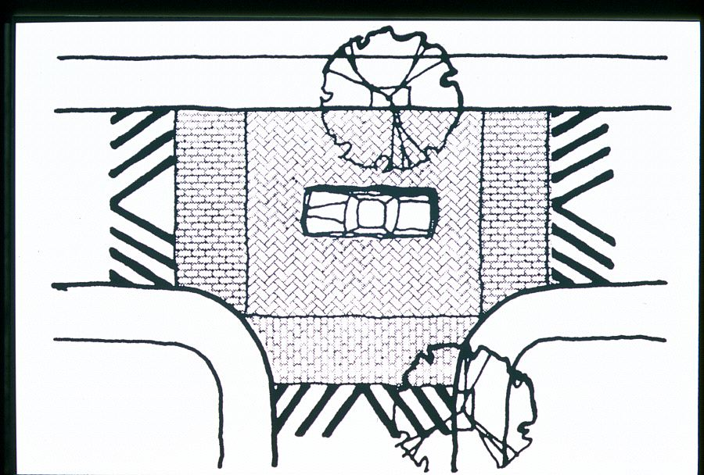
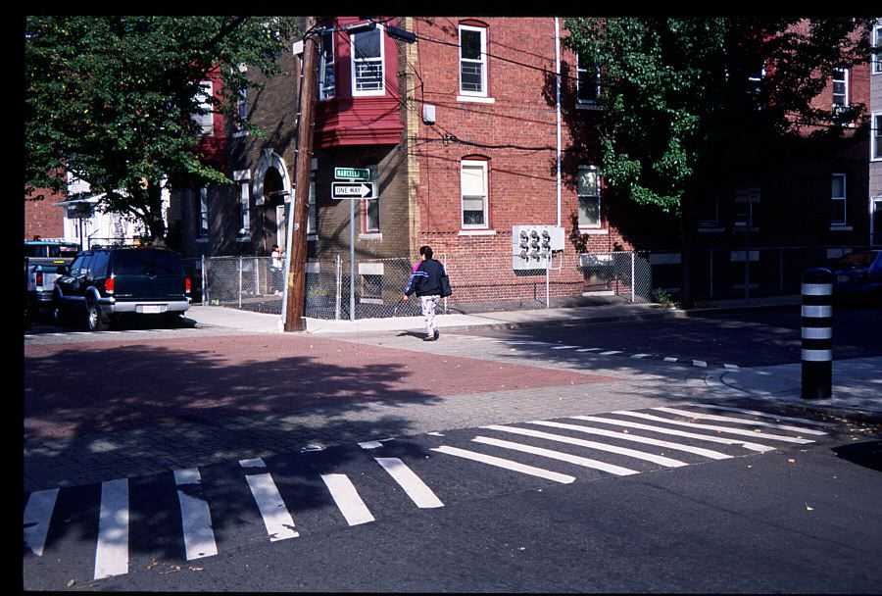
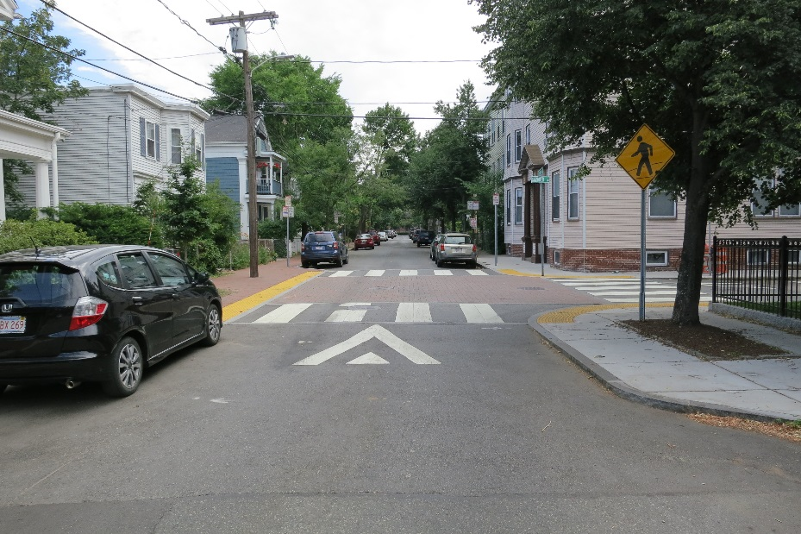
Raised intersection

Slide 11
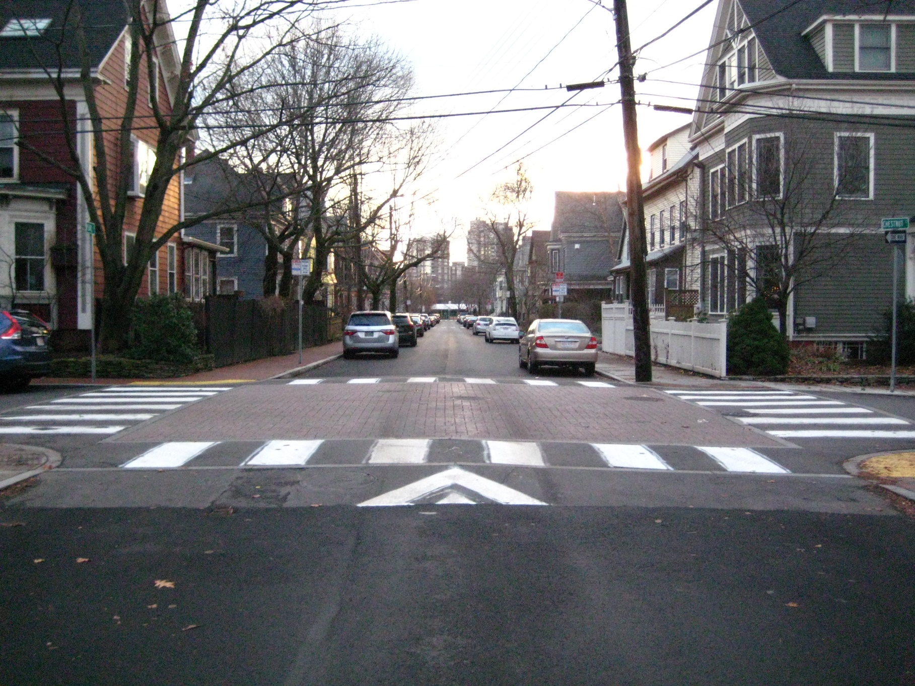
Raised Intersection
Raised intersections reduce vehicle speed, improves accessibility
and improves visibility

Slide 12
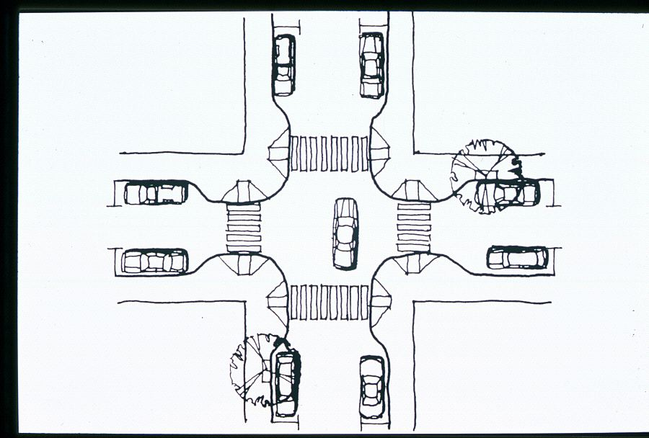
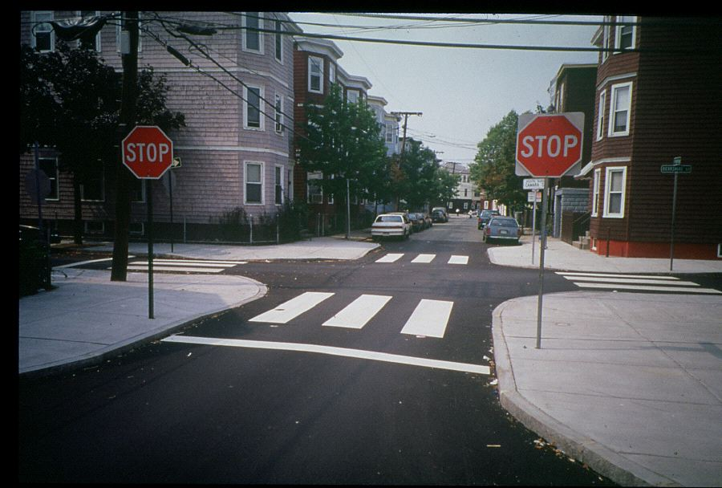
Curb extension

Slide 13
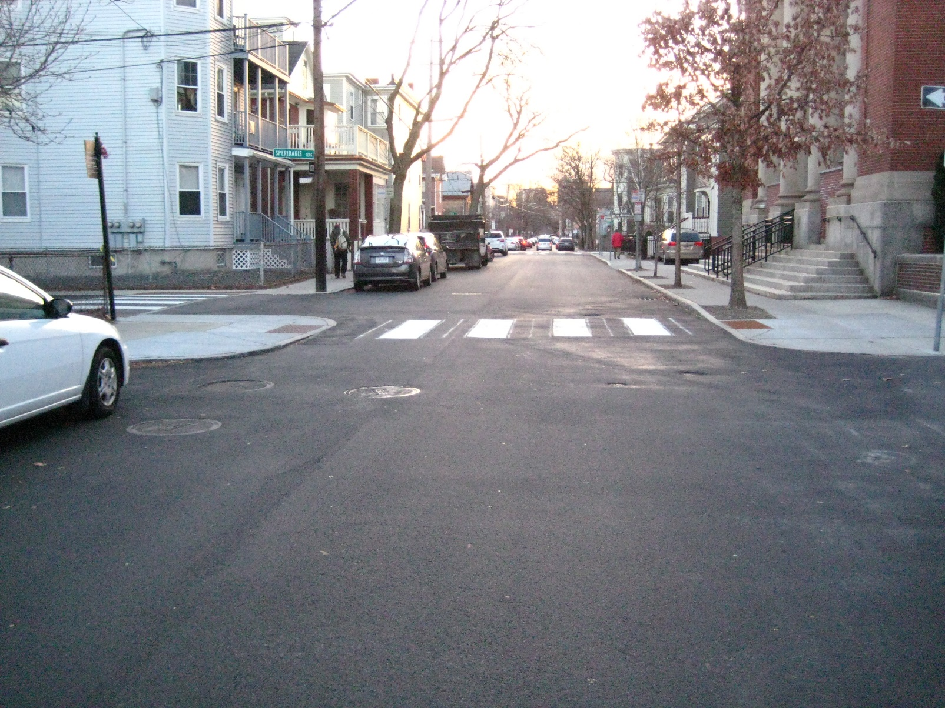
Curb extension
Curb extensions reduce crossing distance, improves accessibility, prevents vehicles from parking too close to the intersection
and improves visibility

Slide 14
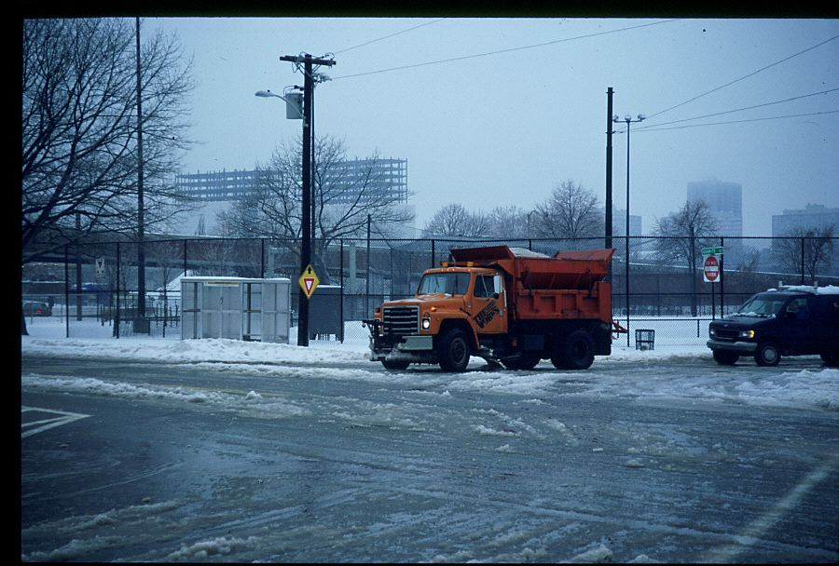
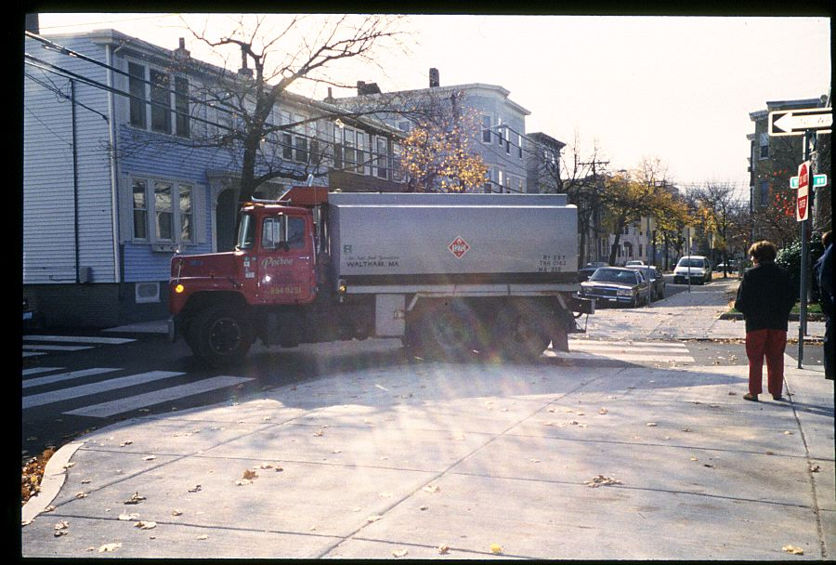
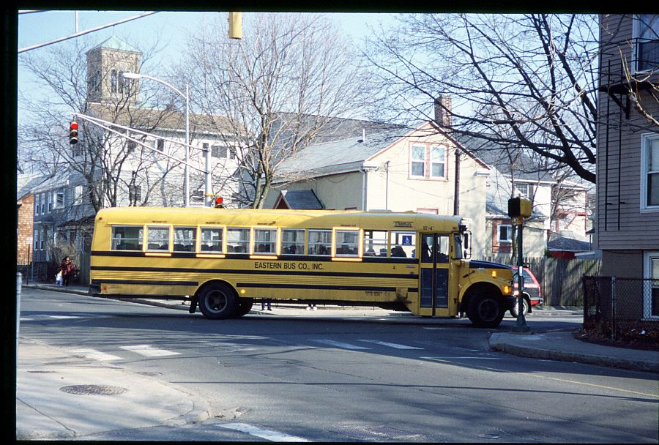
Service and Emergency vehicles

Slide 15
WEBSTER AVENUE Reconstruction – First Meeting held 4/23/2019
Community Feedback:
Webster at Hampshire - Safety concerns crossing Webster and/or Hampshire, intersection is too wide, speeds, drainage issues
Sidewalk in poor condition near Hampshire Street*
Broken sidewalk at Clark due to large vehicles turning
Visibility at Bristol Street
Access for pedestrians at Bristol Street
Vehicles crossing Webster Avenue too fast from Plymouth Street
Access for pedestrians at Plymouth
Access for pedestrians at Seckel Street
Visibility concerns at Willow/York/Webster intersection
Significant number of pedestrians crossing at Willow/York/Webster intersection
School buses
* Repeated Concern

Slide 16
How did we develop the plans we are presenting today?
DESIGN PROCESS:
Community Input
City/State/Federal policies
Walk with City Arborist to:
  Evaluate condition of existing trees
  Identify possible location for new street trees
Data collection:
  Speed
  Traffic volume
  Crash
Meet with Fire Department to discuss:
  Potential raised intersection (Fire Chief)
  Potential Curb extension

Slide 17
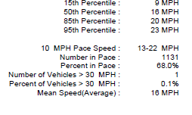
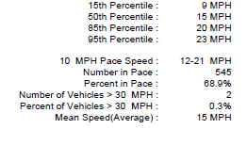
Speed data – 85th Percentile
Webster Avenue
^{20 MPH}
Portsmouth Street/Plymouth Street
Southbound
Northbound
^{20 MPH}

Slide 18
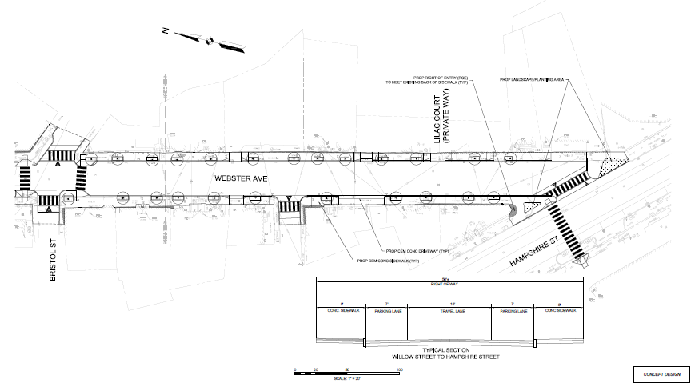
Conceptual Design (NOT FOR CONSTRUCTION)

Slide 19
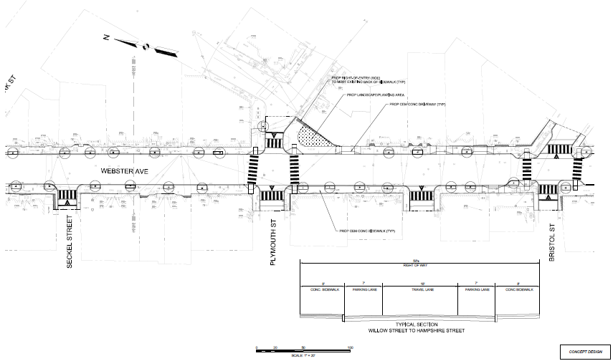
Conceptual Design (NOT FOR CONSTRUCTION)

Slide 20
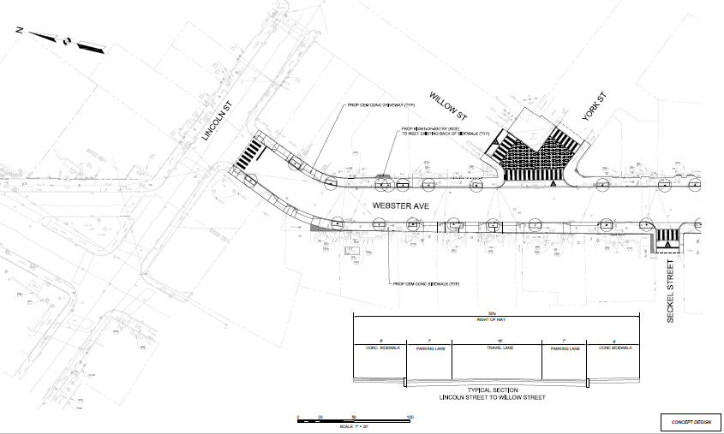
Conceptual Design (NOT FOR CONSTRUCTION)

Slide 21
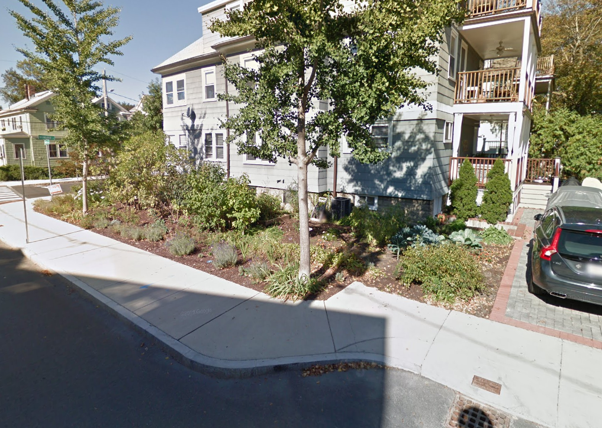
Curb extension
(Green area behind sidewalk)

Slide 22
Raised intersection

Slide 23
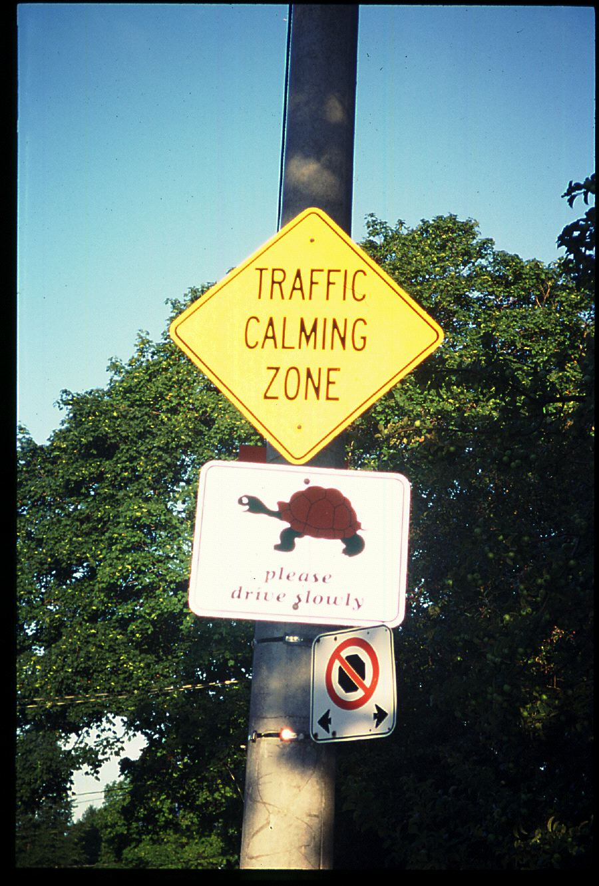
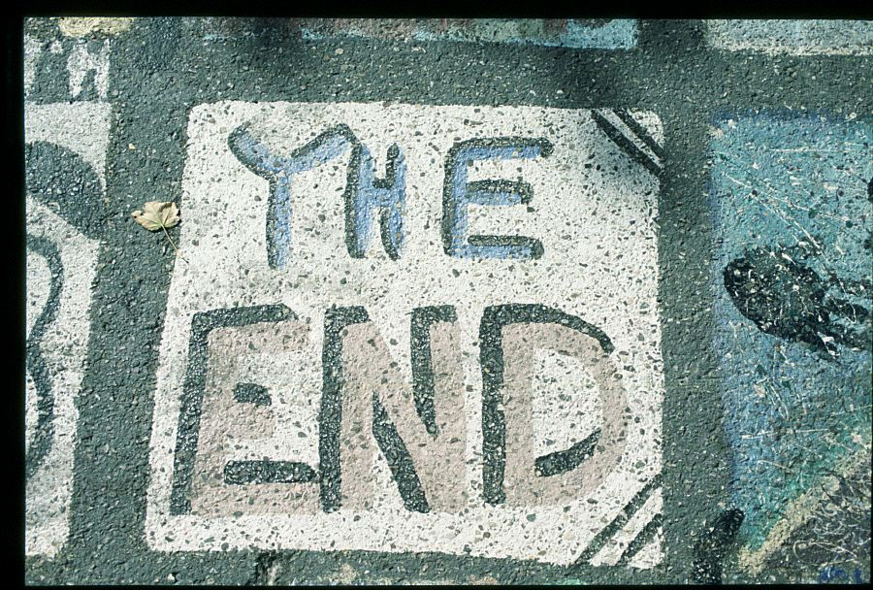
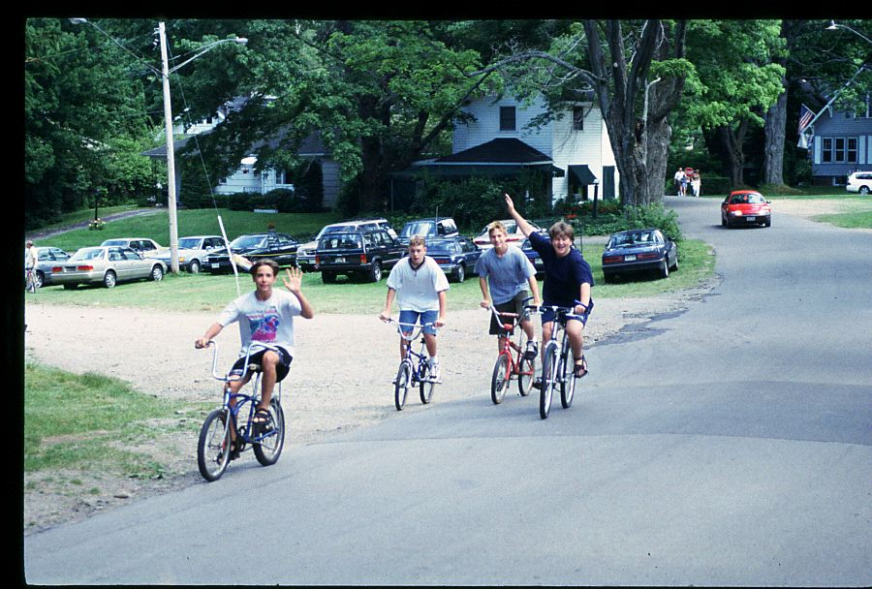
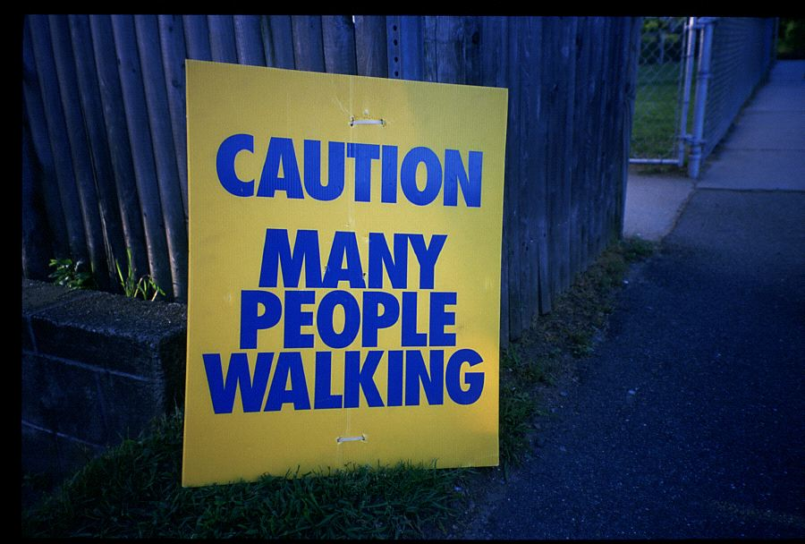

Slide 24
Questions and Comments

Slide 25
Next steps
Advance design
Project Schedule:
  Bid late: summer 2020
  Construction: late summer/early fall 2020
    Part of a larger construction package
      5 streets
    Project page will provide updates and construction schedule
      Please sign up for email alerts:
https://www.cambridgema.gov/Departments/publicworks/cityprojects/2019/websteravenue

Slide 26
Source: Devon County Council Engineering and Planning traffic Calming Guidelines, U.K., 1991, p27

Slide 27
Curb extensions

