Slide 1


Zero Waste Master Plan – an Overview
December 18, 2018

Slide 2
What is Zero Waste?
“Zero Waste is a goal that envisions…all discarded materials are designed to become resources for others to use.”
But we must reduce & reuse first
Zero Waste International Alliance
http://zwia.org/standards/zw-definition/

Slide 3

Purpose of the Plan
Meet City’s waste reduction goals
Continue to maintain high quality public services
Maximize operational efficiency
Protect employee health & safety
Reduce GHG emissions
Reduce costs

Slide 4
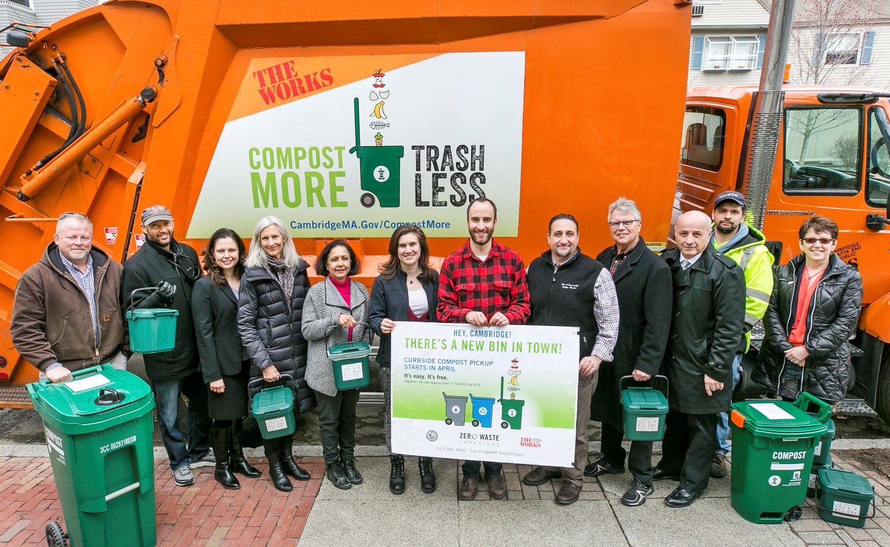
Current Waste Management System
Trash
Recycling
Yard Waste
Curbside Organics
Household Hazardous Waste
Electronics
Bulky Waste
Recycling Center

Slide 5
How are we doing compared to others?
Recycling Rates among select big cities (2016 data)
San Francisco, CA 80%
Seattle, WA 58.8%
Alexandria, VA 49.3%
Cambridge, MA 42%
Boulder, CO 39%
Portland, ME 38%
Worcester,MA 38%

Slide 6
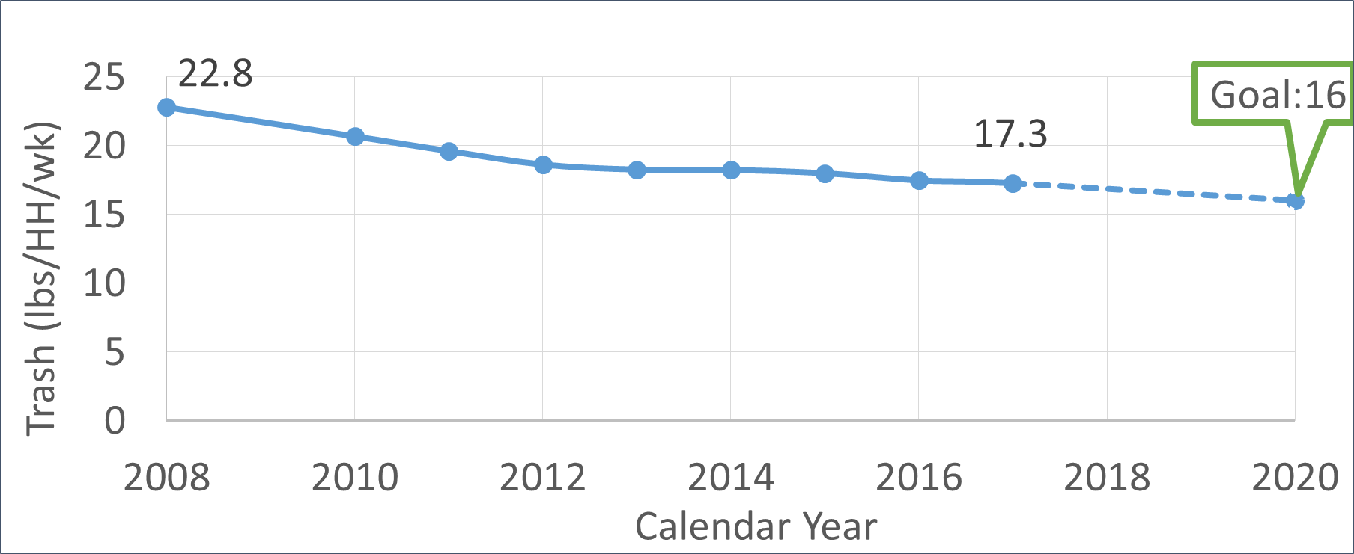
Trash Generation Rate
  2050 Goal: 80% reduction in municipal waste, 4 lbs/HH/wk

Slide 7
What’s still in our trash barrels?
**Other: Textiles, Electronics, Scrap metal
DATA: 2016 waste audit

Slide 8
Goal – Maintain High Quality Service
City has consistently high Customer satisfaction
  90%+ of residents rate recycling and trash collection as “excellent or good”
City collects trash from +/- 32,000 HH/week
Source: Biannual Citizen Satisfaction Telephone Survey

Slide 9
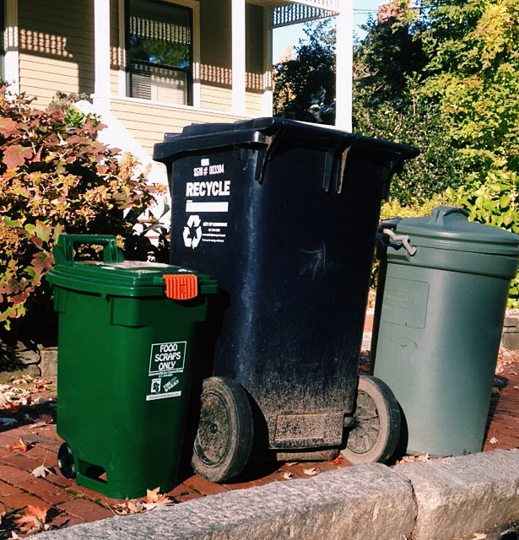
Goal – Maximize Operational Efficiency
Example: Expansion of curbside organics program increased DPW fleet by 1 truck, not 2 trucks.
Route Optimization

Slide 10
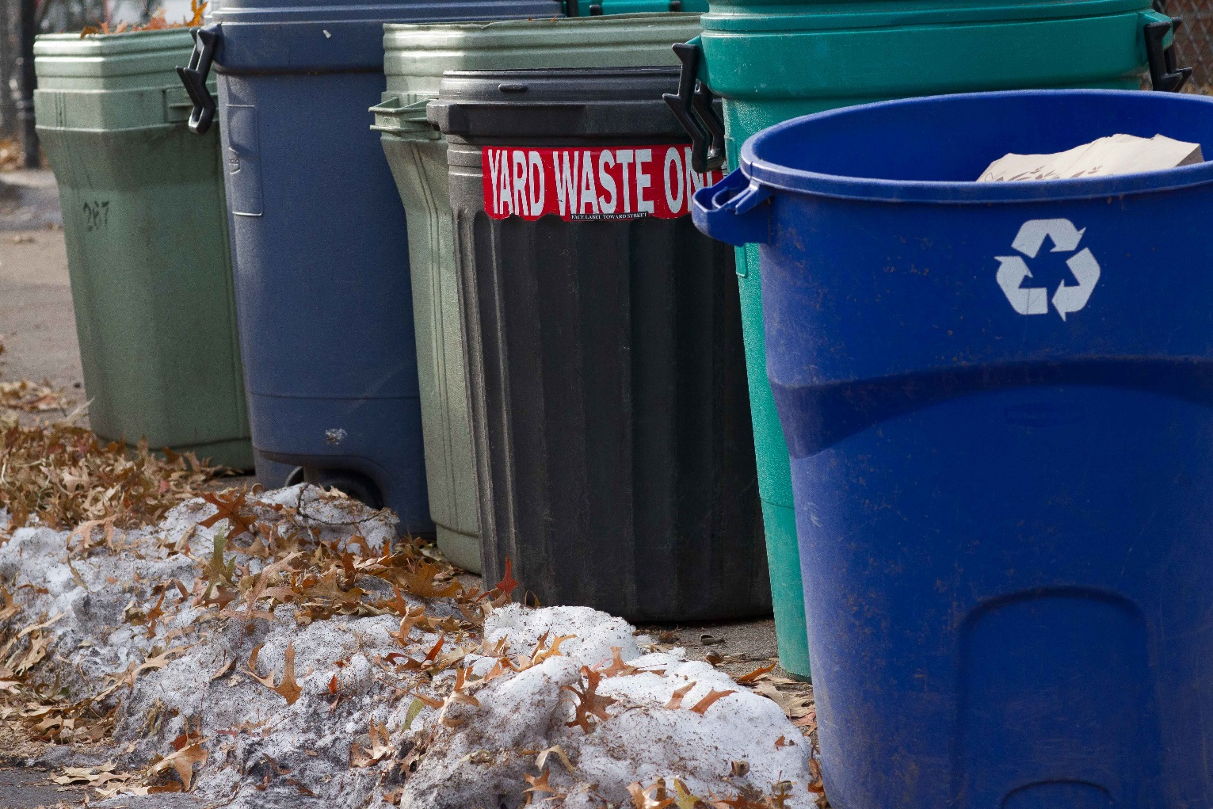
Goal – Protect Employee Health & Safety
Example: reduce lifting impacts with semi-automated curbside trash collection

Slide 11
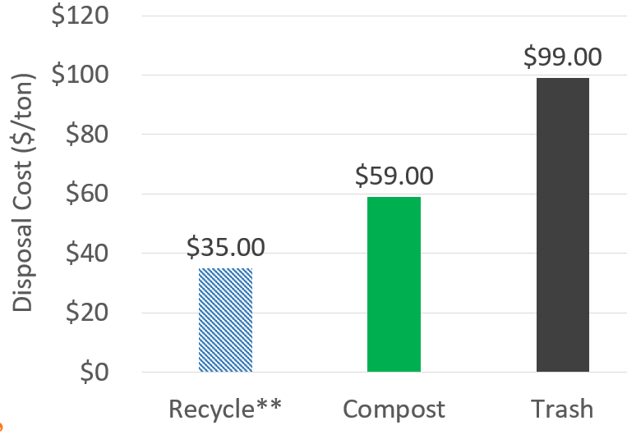
Goal – Evaluate Costs
FY19 Disposal Costs (Tip fee only)
Reduce costs by diverting materials from trash
Reduce contamination in recycling
**Currently pay $70/ton to recycle due to excessive contamination.

Slide 12
Goal – Evaluate Impact of GHG Emissions
Most of the emissions come from disposal, not transportation
Waste reduction and diversion have potential to significantly decrease CO₂ emissions from waste operations
Estimated Changes in GHG Emissions

Slide 13
Master Plan Recommendations
Expand
Curbside Organics
Evaluate
Trash disposal and collection processes
Expand
Waste reduction and diversion programs
Evaluate
Existing City policies

Slide 14
Expand Curbside Organics
Early Implementation
Moving Forward - Recommendations
April 2014:
Oct 2015:
April 2018:
600 HH
6 tons/month
5,200 HH
30 tons/month
25,000 HH
140 tons/month
Expand to 13+ units: fall 2019 to fall 2020
Continue evaluating options for disposal sites of food waste
Evaluate ordinances to increase diversion
Potential to reduce trash disposal by 4 to 5 lbs/HH/week

Slide 15

Expand Curbside Organics
An audit this Fall found that the set out rate for organics was less than 60%.
What do you think would increase participation in the program?
Providing more compost bags periodically?
More guidance on how to use the program?
More peer-to-peer education about reducing trash?
Mandatory composting ordinance?
All of the above?
Other actions?
Curbside Organics August 2018 Survey: 1300 respondents, over 90% approval rating

Slide 16
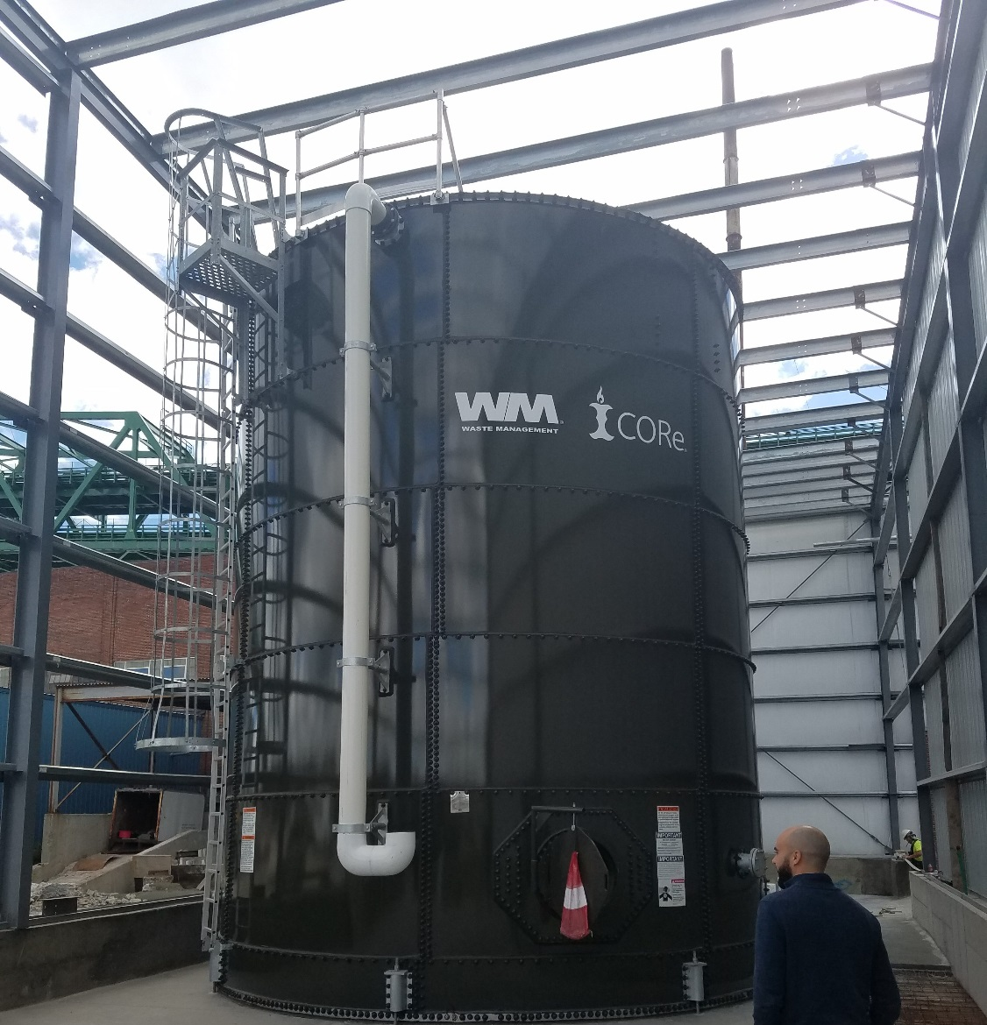
Expand Curbside Organics
Processing Organics
Contract to implement program (expires April 1, 2021)
Current program focus is to increase quantity of organics diverted
Increase in state-wide permitted processing capacity offers new options
CORe in Charlestown pre-processes food scraps into a slurry sent to Greater Lawrence Sanitary District in North Andover

Slide 17
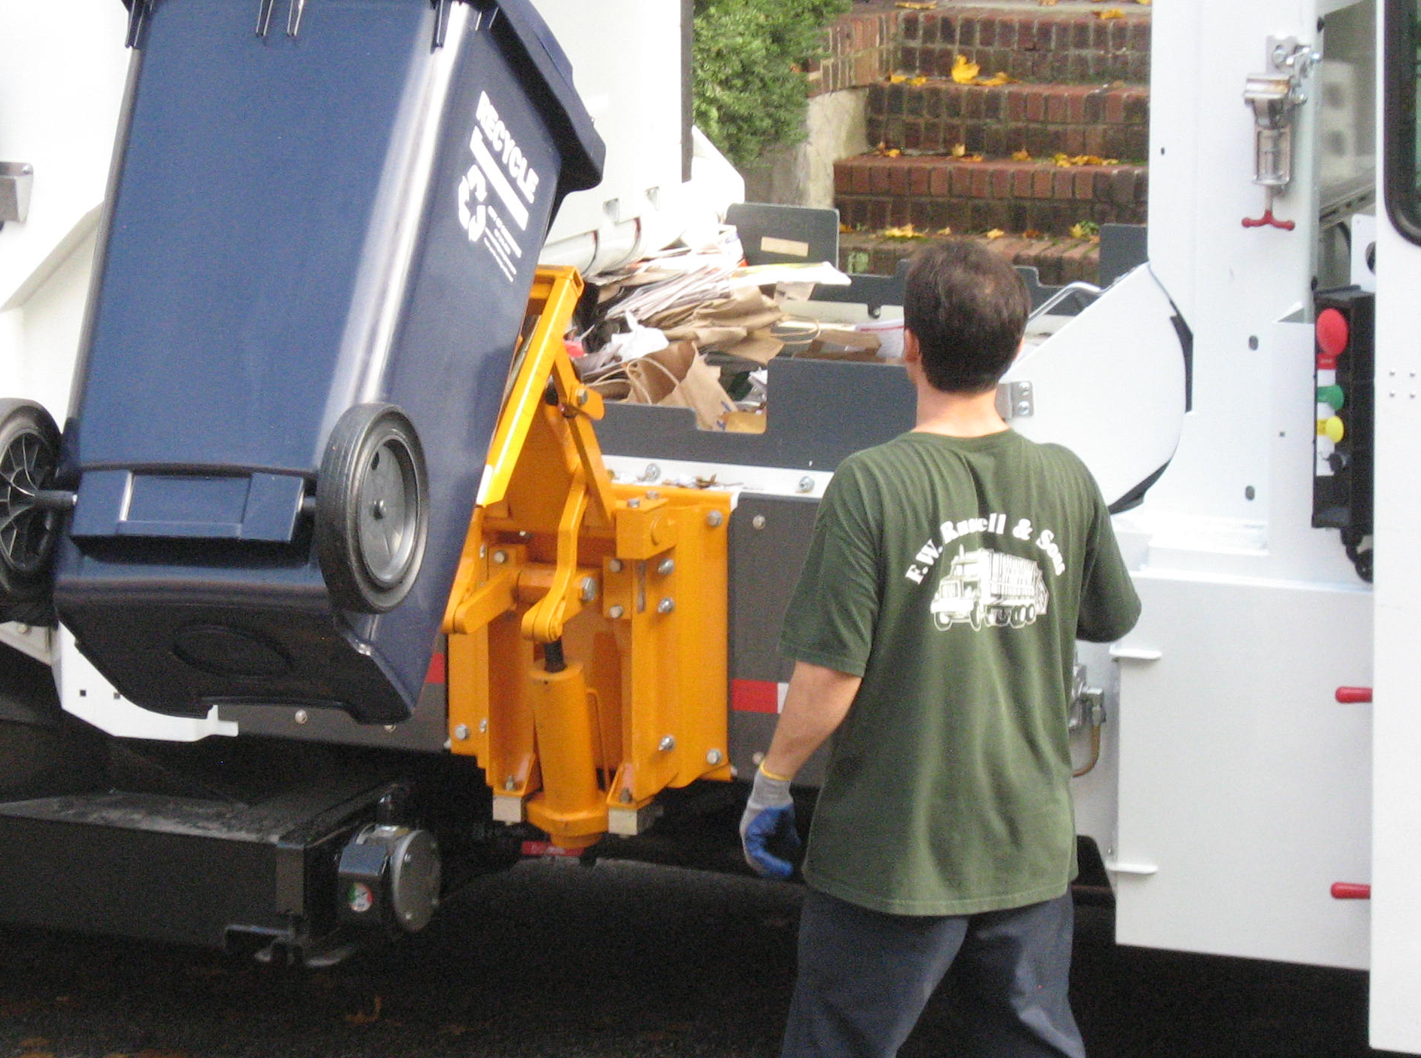
Evaluate Trash Disposal and Collection
Early Implementation
Moving Forward - Recommendations
Decreased trash truck fleet from 7 to 6 in April 2018
Route optimization
Standard Trash Container
Semi-automated collection, reduces lifting impacts
Reinforced plastic helps rodent control
Improved sidewalk accessibility
Less trash spills
Increased diversion

Slide 18
Curbside Audit Results
Over 75% of households set out less than 32 gallons of trash that week
Monday route example of mature organics program

Slide 19
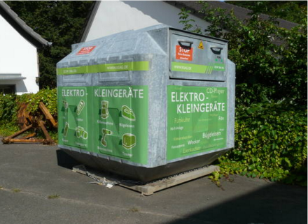
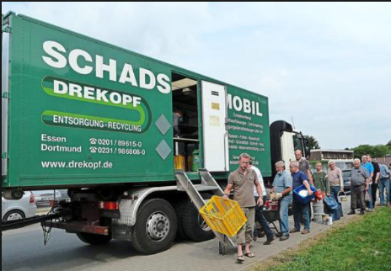
Waste Reduction & Diversion
Early Implementation
Moving Forward- Recommendations
Mattress Recycling
Examine existing recycling center, 2020
Textile recycling strategy, 2020/2021
Continue support for food waste reduction, sharing libraries, reuse events
Potential to reduce trash by 2 to 3 lbs/HH/week
Recycle Right Campaign
Small Business Recycling Pilot (Nov 2018 launch)

Slide 20
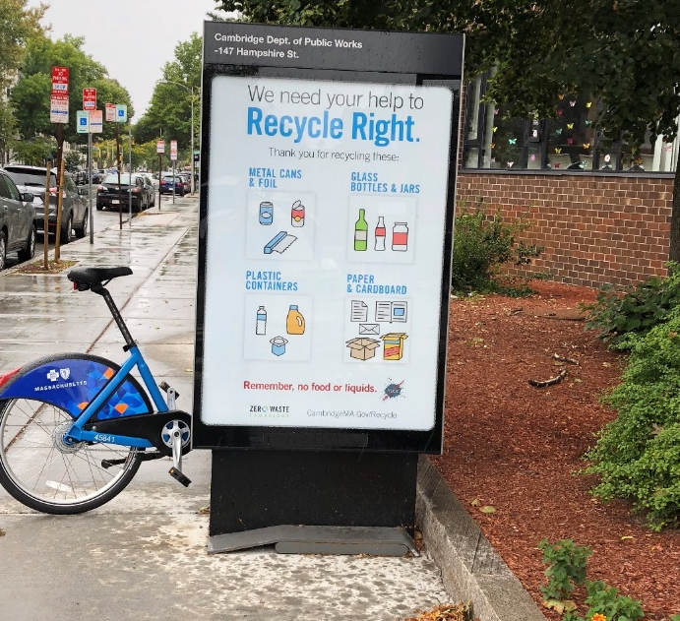
Improving Recycling
40% of recycle carts had moderate to major contamination. What do you think would help people reduce contamination?
More guidance on how to use the program?
Notices on the carts when contamination is present?
Not emptying cart with contaminated material?
All of the above?
Other actions?

Slide 21
Evaluate Existing City Policies
Early Implementation
Moving Forward- Recommendations
BYOB and Polystyrene Ordinances, 2016 (50 to 80% reduction in single-use bag consumption)
Mandatory Recycling Ordinance
Reduction in Trash Setout (from 150 gallons/HH to one standard trash container)

Slide 22
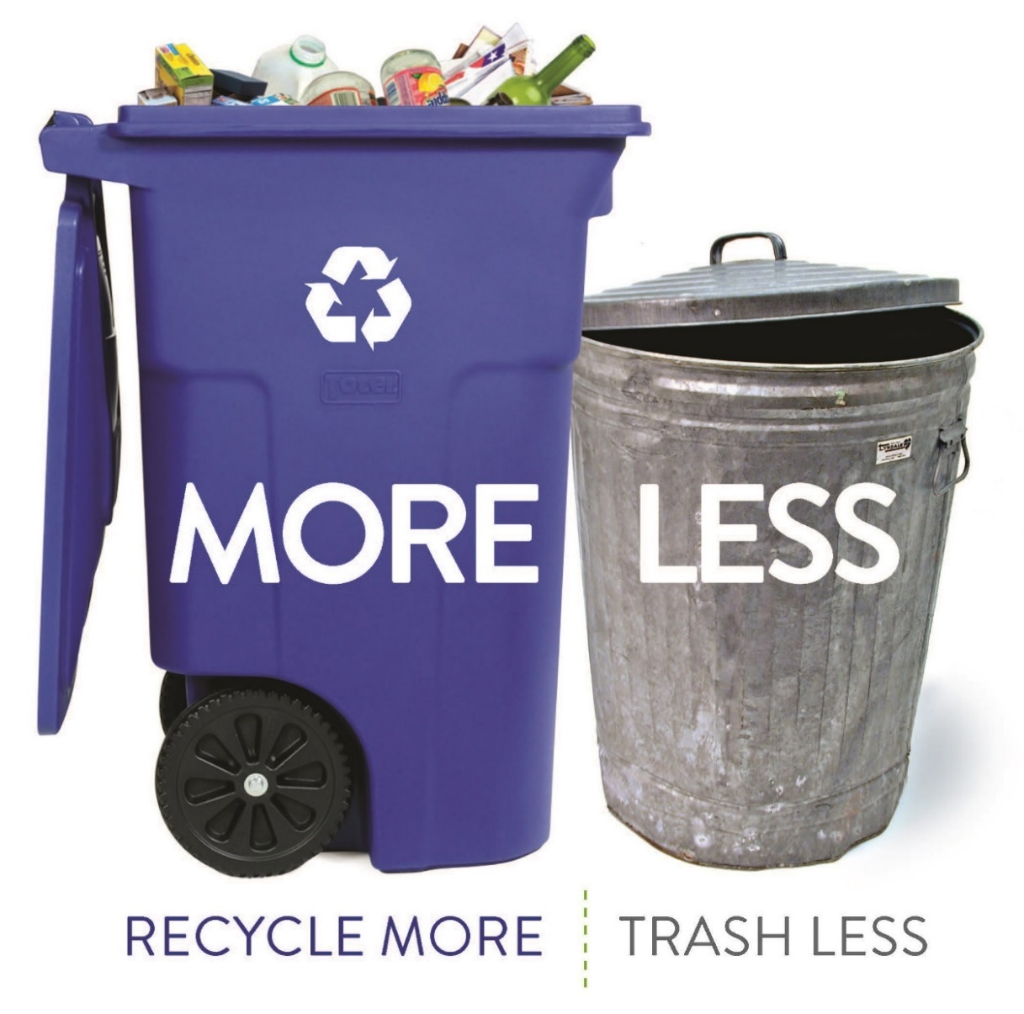
What are your thoughts on goals and objectives for the Zero Waste Master Plan Recommendations?
Visit CambridgeMA.Gov/ZWMP
Email Recycle@cambridgema.gov to comment

